Slide 1
Activities that enhance the conceptual understanding of statistics
Michael Sullivan
Joliet Junior College
sullystats@gmail.com or msulliva@jjc.edu

Slide 2
Designing a study
Traditional underwriting to determine the risks associated with lending include credit scores, income, and employment history. The online lender ZestFinance wanted to determine whether people who fill out loan applications using all capital letters versus those who use all lower case letters versus those who fill out the application using upper and lowercase letters accurately default at different rates. Explain how to obtain and analyze data in order to determine whether the method used to fill out loan applications results in different default rates.
Notes:
Homogeneity of Proportions. Obtain a random sample of 500 applications for each characteristic.

Slide 3
The Challenge in Polling
One of the challenges in polling for elections is deciding who to include in your frame.
(a) Suppose you were asked to conduct a poll for a senatorial election. Explain how you might design your poll. In your explanation include a discussion of the difference between "registered voters" and "likely" registered voters. What role would stratification play in your poll?
(b) Voter turnout is different for presidential election cycles (2012, 2016, 2020, and so on) versus non-presidential election cycles (2014, 2018, 2022, and so on). Explain the role election cycle plays in voter turnout and explain how this may affect your polling model.
(c) During the 2014 election, Nate Silver of FiveThirtyEight said "the pre-election polling averages (not the FiveThirtyEight forecasts, which also account for other factors) in the 10 most competitive Senate races had a 6-percentage point Democratic bias as compared to the votes counted in each state so far." Explain what this means and explain how this would have impacted polling results compared with actual results.

Slide 4
The law of large numbers
Suppose you live in a town with two hospitals - one large and the other small. On a given day in one of the hospitals, 60% of the babies who were born were girls. Which one do you think it is? Or, is it impossible to tell. Support your decision.
Notes:
Answer: The smaller hospital due to the Law of Large Numbers. The larger hospital likely has more births so it is less likely that the births would deviate from the expected proportion of girls.

Slide 5
The Role of randomness
One measure of successful investing is being able to "beat the market". To beat the market in any given year, an investor must earn a rate of return greater than the rate of return of some market basket of stocks, such as the Dow Jones Industrial Average (DJIA) or Standard and Poor's 500 (S&P500). Suppose in any given year, there is a probability of 0.5 that a particular investment advisor beats the market for his/her clients.
(a) If there are 5000 investment advisors across the country, how many would be expected to beat the market in any given year? 2500
(b) Assuming beating the market in one year is independent of beating the market in any other year, what is the probability that a randomly selected investment advisor beats the market in two consecutive years? Based on this result, how many of 5000 investment advisors would be expected to beat the market for two consecutive years? 0.25; 1250
(c) Assuming beating the market in one year is independent of beating the market in any other year, what is the probability that a randomly selected investment advisor beats the market in five consecutive years? Based on this result, how many of 5000 investment advisors would be expected to beat the market for five consecutive years? 0.03125; 156.25
(d) Assuming beating the market in one year is independent of beating the market in any other year, what is the probability that a randomly selected investment advisor beats the market in ten consecutive years? Based on this result, how many of 5000 investment advisors would be expected to beat the market for ten consecutive years? 0.00098; 4.9

Slide 6
The Role of randomness
(e) Assume a randomly selected investment advisor can beat the market with probability 0.5 and investment results from year to year are independent. Suppose we randomly select 5000 investment advisors and determine the number x who have beaten the market the past ten years. Explain why this is a binomial experiment (assuming there are tens of thousands of investment advisors in the population) and clearly state what a success represents.
(f) Use the results of part (e) to determine the probability of identifying at least six investment advisors who will beat the market for ten consecutive years. Interpret this result. Is it unusual to identify at least six investment advisor who consistently beats the market even though his/her underlying ability to beat the market is 0.5? Explain. 0.3635

Slide 7
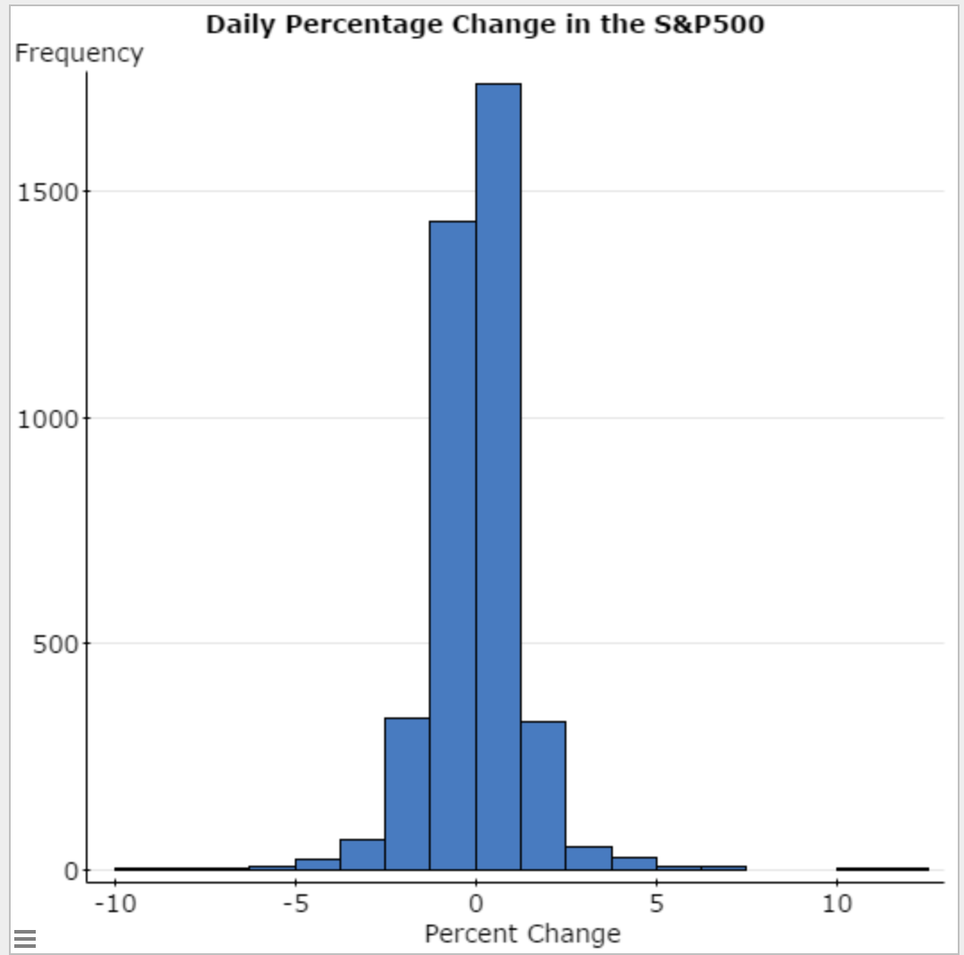
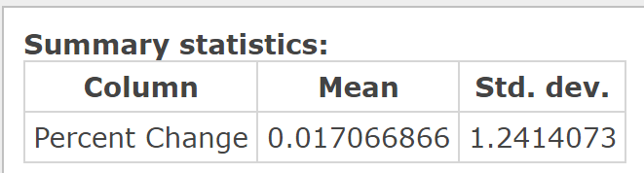
The black swan
Open the data file “Daily Percentage Change in S&P500” in StatCrunch.
Draw a histogram of the variable “Percentage Change.” Describe the shape of the distribution.
Compute the mean and standard deviation percentage change.

Slide 8
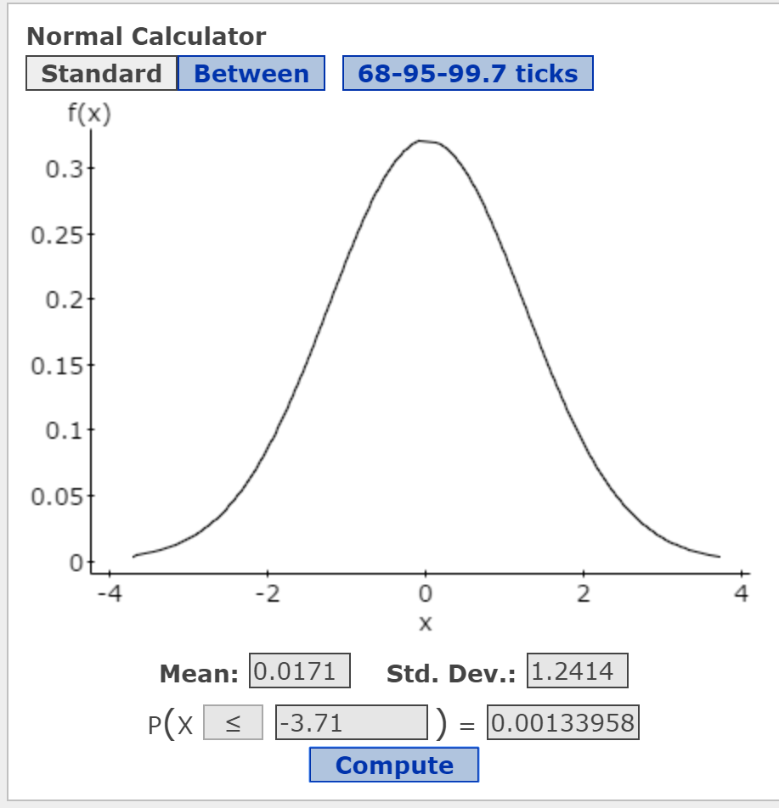
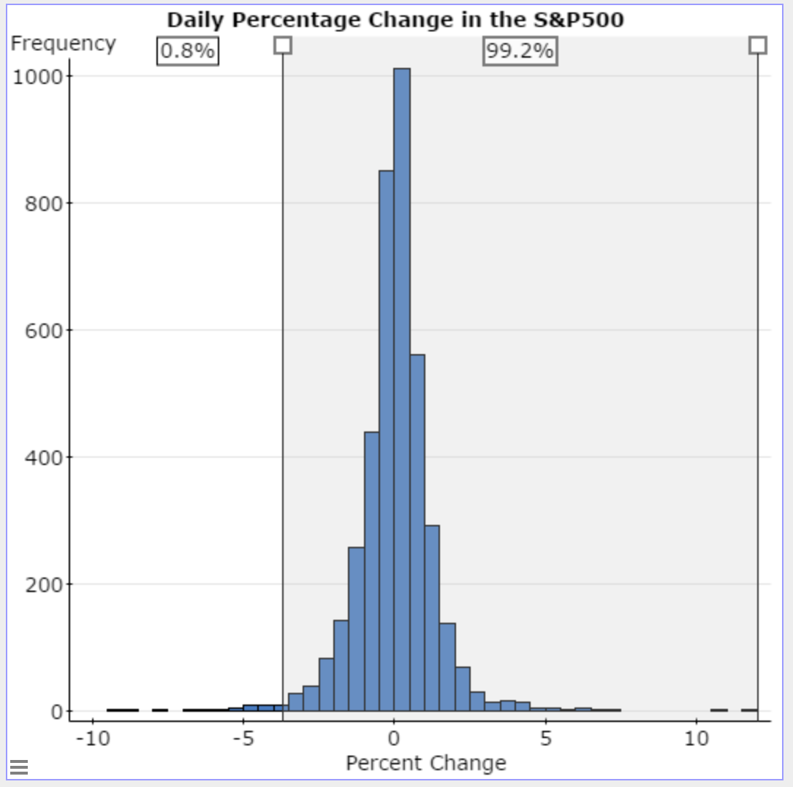
The Black Swan
(c) Determine the percentage change value for
Use the normal model to determine the proportion of observations that should be less than three standard deviations below the mean.
Redraw the histogram with a lower class limit of the first class of -10 and a class width of 0.5. In StatCrunch, there is an option called “Dividers” in the histogram dialogue box. Select the Percent radio button. Click Compute! Double-click on the left-most divider and enter the value found in part (c). What proportion of observations are less than this value? Is this close to the value given by the normal model?
Ans: -3.71

Slide 9
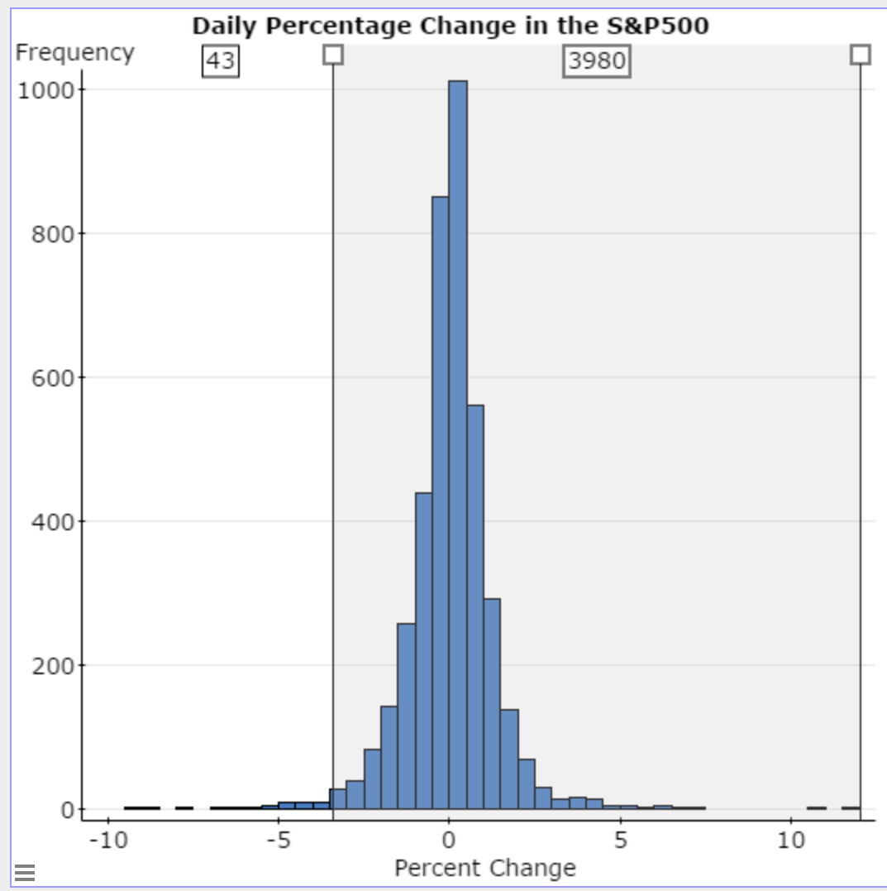
The black swan
(f) In his book The Black Swan, author Nassim Nicholas Taleb warns of using the normal model for financial markets. According to the normal model, what proportion of the days should the percentage change of the S&P 500 be less than -7.0%? Ans: 0.0000000073
(g) The number of days one should expect to wait before observing an event equals 1/p where p is the probability of observing the event. Use the result of part (f) to determine the number of days one should expect to wait before observing a percentage change in the S&P500 of -7.0 or less. Ans: 136,986,301
(h) There were 4023 trading days from 11/7/00 to 11/3/2016. How many of these days had a percentage change in the S&P500 of -7.0 or less? What does this result suggest?

Slide 10
Confidence intervals
According to Harris Interactive, 41% of adult Americans (aged 18 years or older) believe in ghosts.
Step 1: Use StatCrunch to generate 1000 simple random samples of size n = 120 from a population whose proportion is 0.41. StatCrunch: Data > Simulate > Bernoulli Enter 120 rows; 1000 columns, p = 0.41; Stacked with Column ID
Step 2: Construct a 95% confidence interval for each sample. Be sure to store the results in the StatCrunch spreadsheet. Stat > Proportion Stats > One Sample > With Data; Be sure to store results
Step 3: Compute the theoretical mean and standard deviation for the sampling distribution of the sample proportion. Determine the cut-off points for the middle 95% of all sample proportions.

Slide 11
CONFIDENCE INTERVALS
Step 4: In StatCrunch, select Applets > Confidence Intervals > Plotter. Plot the confidence intervals from Step 2. What proportion of the intervals capture the parameter?
Step 5: Select any interval that does not capture the parameter. Find the interval in the StatCrunch spreadsheet. What do you notice about the sample proportion? Hint: See Step 3.

Slide 12
Intro to hypothesis testing
The proportion of the human population that is left-handed is 0.12. Mensa is an organization of high-IQ individuals (to qualify to be a member of Mensa one’s IQ must be at the 98th percentile). In a random sample of 20 members of Mensa, it was found that 4 were left-handed. Does this result suggest that a higher proportion of Mensa members are left-handed that the general population?
What is the variable of interest in this study? Is it qualitative or quantitative?
What are the null and alternative hypotheses?
Why can’t a fair coin be used to simulate the outcomes of this study?
Use the Urn applet in StatCrunch to build a null model that could be used to simulate the outcomes of the study. Hint: There are approximately 120,000 members of Mensa worldwide. Under the assumption the null hypothesis from part (b) is true, how many of the 120,000 Mensa members would be left-handed? How many would not be left-handed?
Use the Urn applet built in part (d) to simulate 1 repetition of this study. Explain what the result represents.
Use the Urn applet built in part (d) to simulate 2000 more repetitions of this study. What does the result suggest?
Use the binomial probability distribution function to find P(X > 4) where n = 20 and p = 0.12.
Notes:
Sample proportion = 4/20 = 0.2.
We want to test H0: p = 0.12 versus H1: p > 0.12
120,000(0.12) = 14,400 left-handed; 120,000(0.88) = 105,600

Slide 13
Intro to hypothesis testing
The proportion of the human population that is left-handed is 0.12. Mensa is an organization of high-IQ individuals (to qualify to be a member of Mensa one’s IQ must be at the 98th percentile). In a random sample of 120 members of Mensa, it was found that 24 were left-handed. Does this result suggest that a higher proportion of Mensa members are left-handed that the general population?
Build the Urn applet again and run 2000 simulations. Be sure to select proportions.
Click Analyze. Find the mean and standard deviation of the 2000 sample proportions.
Determine the theoretical mean and standard deviation of the sample proportion assuming p = 0.12. Compare to part (b).
Use the normal model to find the probability of observing 24 or more left-handers from a population whose proportion is 0.12.

Slide 14
Testing a Hypothesis about a Population Mean: Simulation
Coors Field is home to the Colorado Rockies baseball team and is located in Denver, Colorado. Denver is approximately one mile above sea level where the air is thinner. Therefore, baseballs are thought to travel farther in this stadium. Does the evidence support this belief? In a random sample of 15 homeruns hit in Coors Field, the mean distance the ball traveled was 411.9 feet. Does this represent evidence to suggest that the ball travels farther in Coors Field than it does in the other Major League ballparks?

Slide 15
Testing a Hypothesis about a Population Mean: Simulation

Slide 16
Testing a Hypothesis about a Population Mean: Simulation
To do this, we will obtain 1000 simple random samples of size n = 15 from the population.

Slide 17
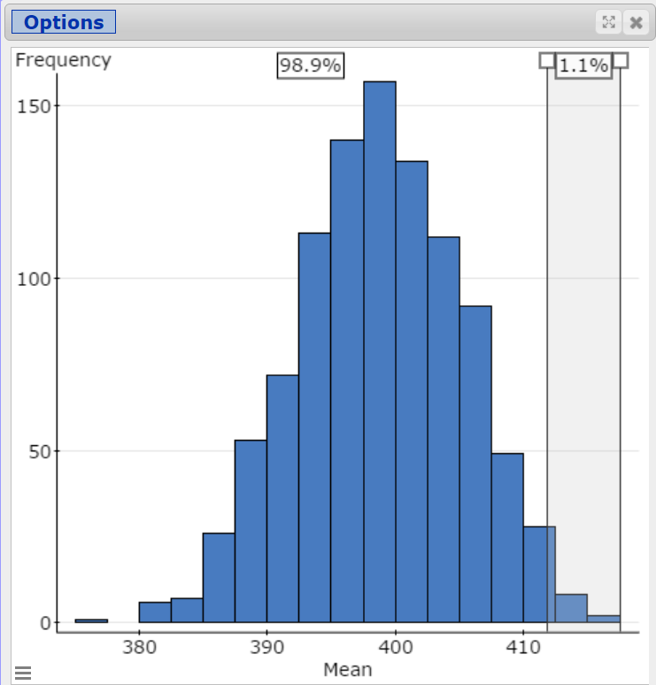
Testing a Hypothesis about a Population Mean: Simulation
Notes:
Use StatCrunch “Divider” option. Double-click on vertical bar to enter 411.9 as lower bound.

Slide 18
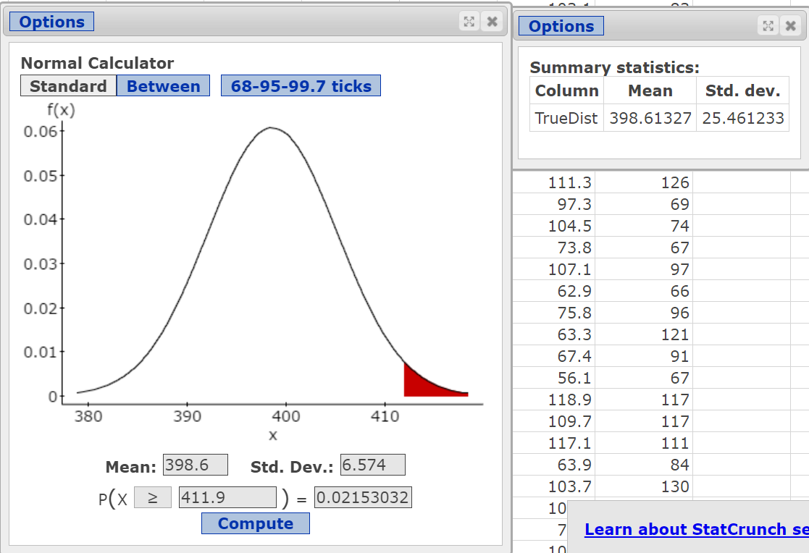
Testing a Hypothesis about a Population Mean: Simulation

Slide 19
Testing a hypothesis about two independent population proportions: Math Redesign Program at JJC
Last semester, Joliet Junior College implemented a redesign of its Intermediate Algebra course. The Math Redesign Program (MRP) is a mastery-based learning model in which students must work at a minimally prescribed pace and each module must be mastered prior to moving to the next module. The goal of the research was to determine if the MRP course results in a higher pass rate than the traditional lecture course. During the Fall, 2015 semester, Professor Egner recruited 48 volunteer students who were going to enroll in Intermediate Algebra in the Spring, 2016 semester. She randomly assigned the students to either the MRP course or traditional course. Professor Egner taught both sections. At the end of the semester, she determined whether a student passed, or failed, the course. The table summarizes the results of the study in a contingency table. Does this evidence suggest the MRP course is superior to the traditional course as measured by pass rates?
 | MRP Course | Traditional Course | Total
Pass | 19 | 14 | 33
Fail | 5 | 10 | 15
Total | 24 | 24 | 48

Slide 20
Math Redesign Program at JJC
What is the response variable in the study?
What is the explanatory variable in the study?
What type of experimental design is this? What role does randomization play in this study?
What or who are the experimental units in the study?
Are any variables controlled?
Is there the potential for confounding in this study? Explain.

Slide 21

Math Redesign Program at JJC
What proportion of students in the MRP program passed? What proportion of students in the traditional course passed?
${\hat{p}}_{MRP}=0.792$ and ${\hat{p}}_{Trad}=0.$583
What is the difference in sample proportions, ${\hat{p}}_{MRP}−{\hat{p}}_{Trad}?$
${\hat{p}}_{MRP}−{\hat{p}}_{Trad}$ = 0.792 – 0.583 = 0.209

Slide 22
Math Redesign Program at JJC
The difference of 0.209 seems significant. That is, it sure seems like the MRP course has a higher pass rate. That said, is it possible that the MRP course had a higher pass rate due to random chance? Put another way, is it possible the 33 students who passed would have passed regardless of which course they were enrolled in and they just happened to end up in the MRP course? So, there are two possibilities here:
(1) The MRP course is not effective and the higher pass rate in the MRP course was due to random chance. That is, the proportion of students who pass the MRP course equals the proportion who pass the traditional course.
(2) The MRP course is effective and this explains the difference in pass rates. That is, the proportion of students who pass the MRP course is greater than the proportion of students who pass the traditional course.

Slide 23

Math Redesign Program at JJC
The statement of “no change”, “no effect”, or “no difference” is
$$H_{o}:p_{MRP}=p_{Trad}$$
We wonder if the evidence suggests that MRP is more effective. What is the alternative hypothesis?
$$H_{o}:p_{MRP}>p_{Trad}$$

Slide 24
Math Redesign Program at JJC
To develop a conceptual understanding for building the null model, we use an urn. Let 33 green balls represent the 33 students who passed the course and let 15 red balls represent the 15 students who did not pass. Mix the 48 balls in the urn and randomly choose 24 balls. These 24 balls will represent the 24 students who were assigned to the MRP course. Notice that this random assignment is done under the assumption the statement in the null hypothesis is true because each ball has an equally likely chance of going to the MRP course or the traditional course. Note: We are not saying that passing versus not passing is equally likely, just that the likelihood of a “passing” student going to the MRP course is the same as that student going to the traditional course.

Slide 25
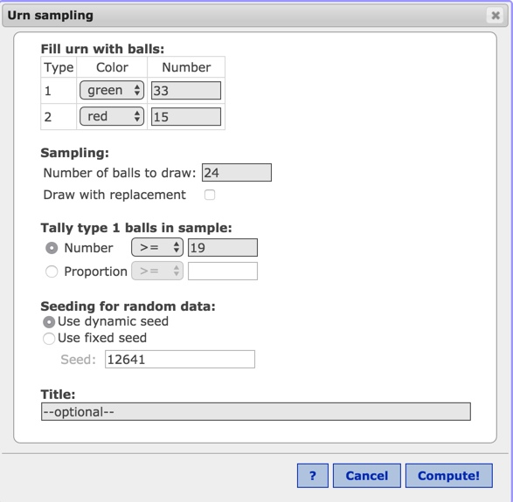
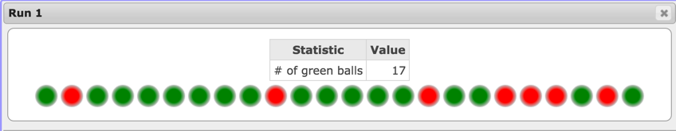
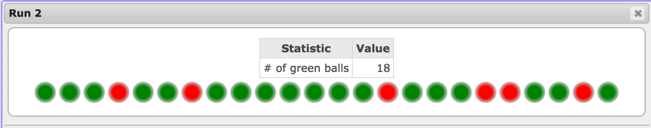
Math Redesign Program at JJC
Test Statistic

Slide 26
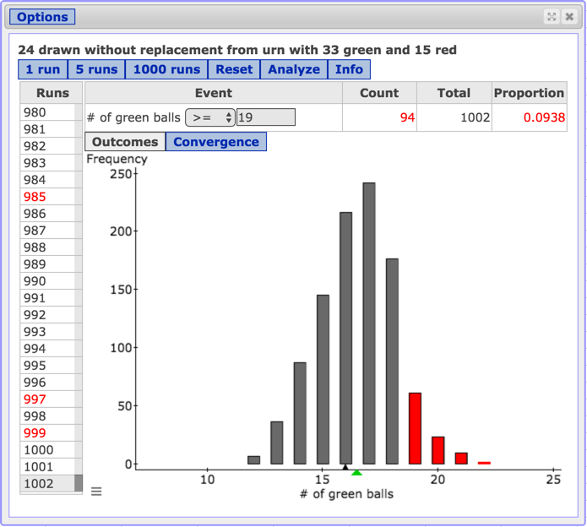
Math Redesign Program at JJC

Slide 27
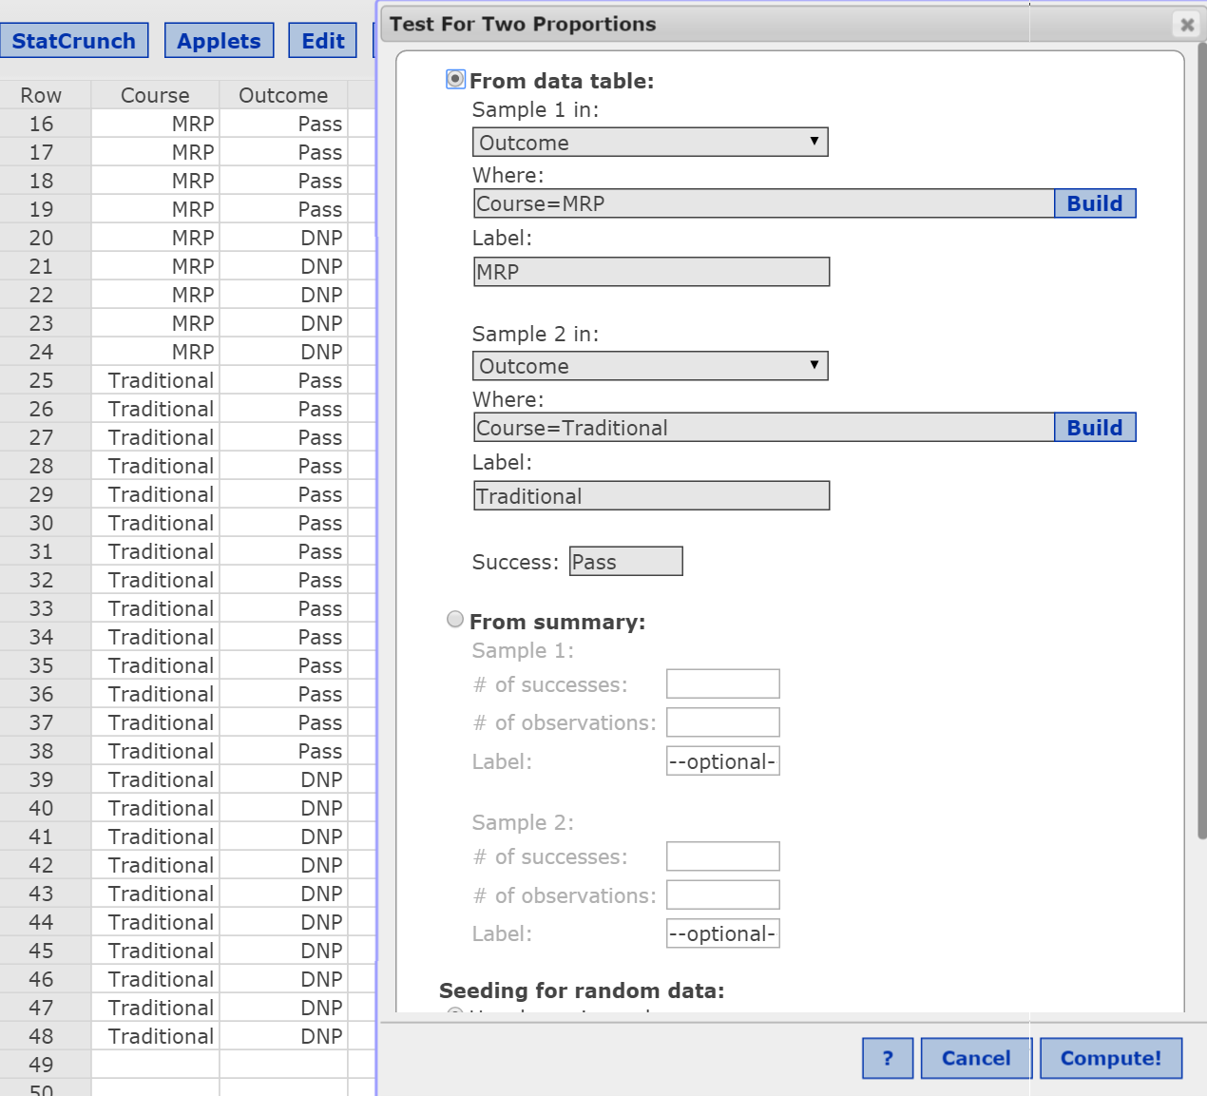
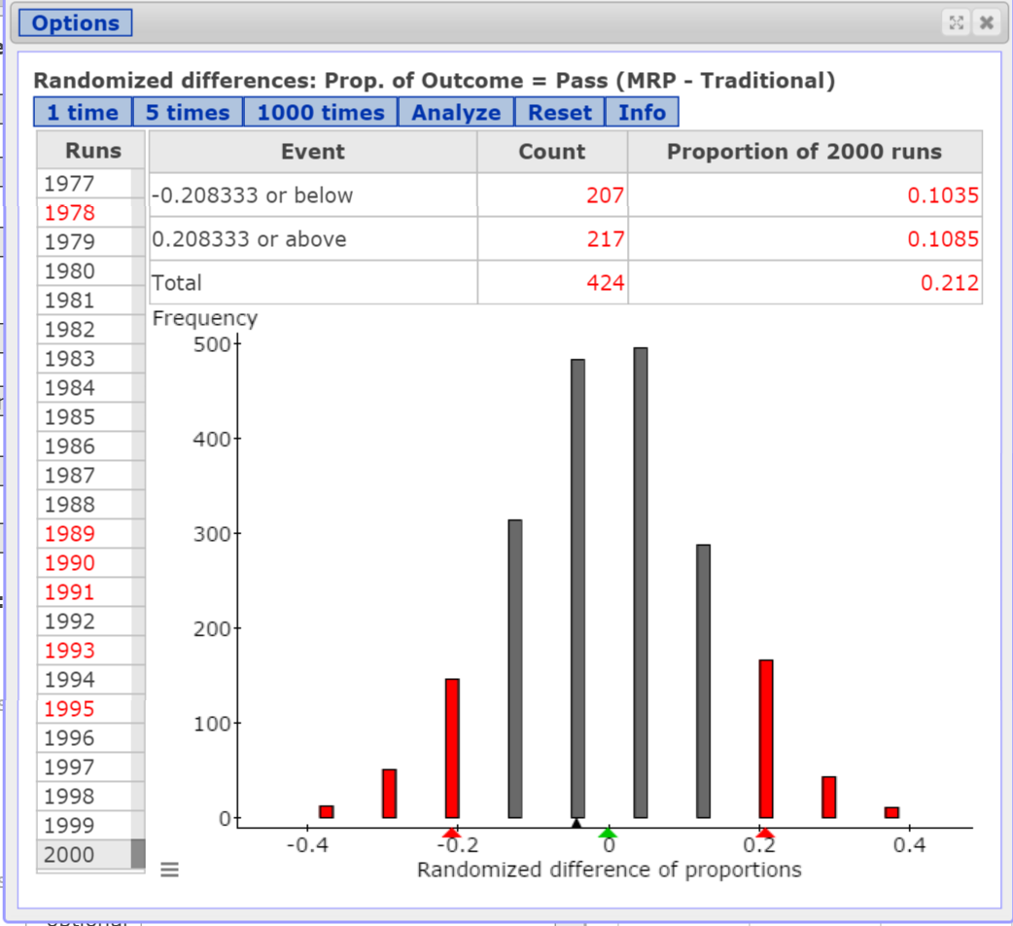
Math Redesign Program at JJC
Notes:
Be sure to point out that the distribution of outcomes is centered at 0. Why? We conducted this test under the assumption there is no difference in the effectiveness of the courses. In other words, when the null hypothesis is true, we would expect the MRP program to have a higher proportion of passers half the time and the traditional course to have a higher proportion of passers about half the time.
What would happen if we increased the sample size ten-fold, but had the same proportion of success in each treatment group?

Slide 28
Math Redesign Program at JJC
In the 2000 repetitions of the experiment (through the applet), 217 resulted in a sample difference of 0.209 or higher. We estimate the P-value to be 217/2000 = 0.1085.
The probability of observing a sample difference in proportions of 0.209 or higher under the assumption the difference in proportions is zero is 0.1085.

Slide 29
Math Redesign Program at JJC
What would happen if we increased the sample size five-fold?
So, we now have 95 out of 120 MRP students passing and 70 out of 120 Traditional Students passing.

Slide 30
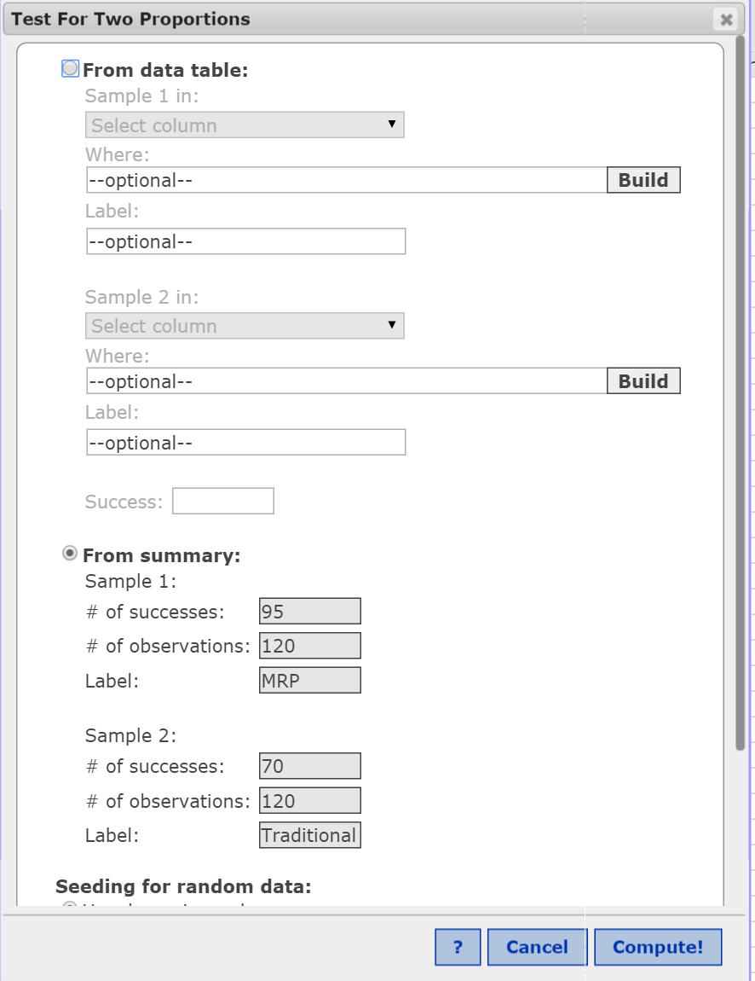
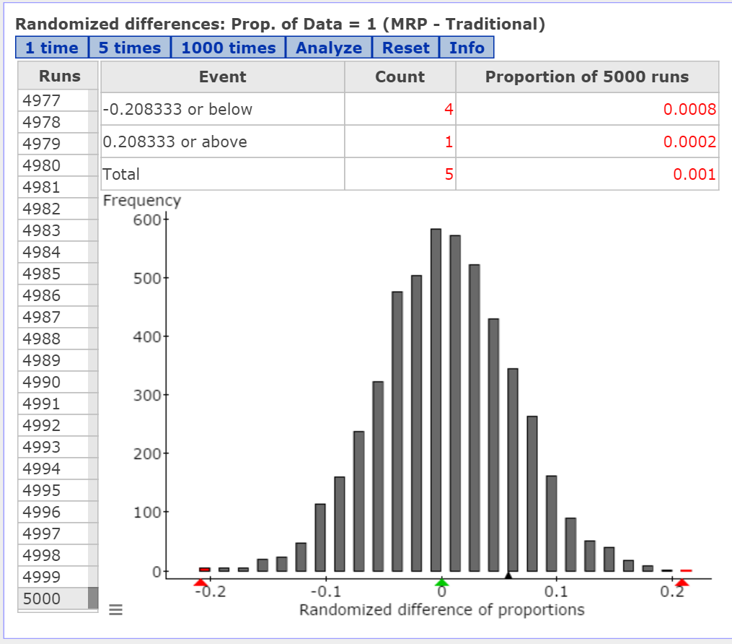
Math Redesign Progam at JJC

Slide 31
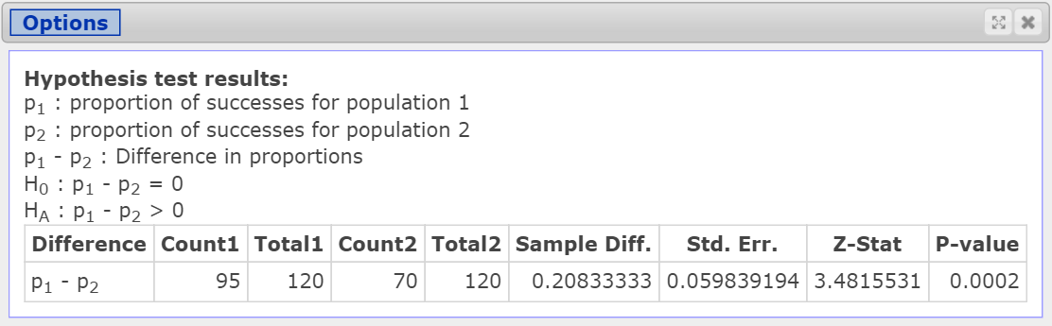
Math Redesign Program at JJC

Slide 32
Hand washing
The American Society for Microbiology (ASM) and the Soap and Detergent Association (SDA) jointly commissioned two separate studies, both of which were conducted by Harris Interactive. In one of the studies, 1001 adults were interviewed by telephone and asked about their hand-washing habits. In the telephone interviews, 921 of the adults said they always wash their hands in public rest rooms. In the other study, the hand-washing behavior of 6076 adults was inconspicuously observed within public rest rooms in four U.S. cities and 4679 of the 6076 adults were observed washing their hands.
(a) In the telephone survey, what is the variable of interest? Is it qualitative or quantitative?
(b) What is the sample in the telephone survey? What is the population to which this study applies?
(c) Verify that the requirements for constructing a confidence interval for the population proportion of adults who say they always wash their hands in public rest rooms are satisfied.
(d) Using the results from the telephone interviews, construct a 95% confidence interval for the proportion of adults who say they always wash their hands in public rest rooms.
(e) In the study where hand-washing behavior was observed, what is the variable of interest? Is it qualitative or quantitative?

Slide 33
Hand washing
(f) We are told that 6076 adults were inconspicuously observed, but were not told how these adults were selected. We know randomness is a key ingredient in statistical studies that allows us to generalize results from a sample to a population. Suggest some ways randomness might have been used to select the individuals in this study.
(g) Verify that the requirements for constructing a confidence interval for the population proportion of adults who actually washed their hands while in a public rest room.
(h) Using the results from the observational study, construct a 95% confidence interval for the proportion of adults who wash their hands in public rest rooms.
(i) Based on your findings in parts (a) through (h), what might you conclude about the proportion of adults who say they always wash their hands versus the proportion of adults who actually wash their hands in public rest rooms?
(j) Cite some sources of variability in both studies.
Notes:
(f) Randomness could be achieved using systematic sampling. Also, want to be sure about ½ the individuals are male and ½ are female.
(j) In the telephone survey there is person-to-person variability. This variability also exists in the observational study, bu there is also individual variability. For example, people may not always wash their hands when they visit. The type of public restroom may add variability as well. Do people wash their hands in different proportions for airport bathrooms versus those at a sports stadium?

Slide 34
Deciding on an inferential method
It is well-documented that watching TV, working on a computer, or any other activity involving artificial light can be harmful to sleep patterns. Researchers wanted to determine if the artificial light from e-Readers also disrupted sleep. In the study, 12 young adults were given either an iPad or printed book for four hours before bedtime. The following evening, they switched reading devices. Whether the individual received the iPad or book first was determined randomly. Bedtime was 10 PM and the time to fall asleep was measured each evening. It was found that participants took an average of 10 minutes longer to fall asleep after reading on an iPad. The P-value for the test was 0.009. Source: Anne-Marie Chang, et.al. “Evening Use of Light-Emittting eReaders Negatively Affects Sleep, Circarian Timing, and Next-Morning Alertness” PNAS 2015 112(4) 1232-1277, doi:10.1073/pnas.1418490112.
(a) What was the research objective?
(b) What is the response variable? Is it quantitative or qualitative?
(c) What is the treatment?
(d) Is this a designed experiment or observational study? What type?
(e) Interpret the P-value.

Slide 35
Deciding on an inferential method
In clinical trials of the allergy medicine Clarinex (5 mg), 3307 allergy sufferers were randomly assigned to either a Clarinex group or a placebo group. It was reported that 50 out of 1655 individuals in the Clarinex group and 31 out of 1652 individuals in the placebo group experienced dry mouth as a side effect of their respective treatments. Source: www.clarinex.com
What type of experimental design is this?
What is the response variable? Is it qualitative or quantitative?
What is the explanatory variable? How many levels does the treatment have?
The clinical trial was double-blind. What does this mean?
Why is it important to have a placebo group?
Does the sample evidence suggest that a side effect of Clarinex may be dry mouth?
Do you think the results are practically significant?
Why is a large sample size needed for this study?
Notes:
Why is a large sample size needed here

Slide 36
Deciding on an inferential method
For each study, explain which statistical procedure (estimating a single proportion; estimating a single mean; hypothesis test for a single proportion; hypothesis test for a single mean; hypothesis test or estimation of two proportions, dependent or independent; hypothesis test or estimation of two means, dependent or independent) would most likely be used for the research objective given. Assume all model requirements for conducting the appropriate procedure have been satisfied.
Researchers measured regular testosterone levels in a random sample of athletes and then measured testosterone levels prior to an athletic event. They wanted to know whether testosterone levels increase prior to athletic events.

Slide 37
Deciding on an inferential method
For each study, explain which statistical procedure (estimating a single proportion; estimating a single mean; hypothesis test for a single proportion; hypothesis test for a single mean; hypothesis test or estimation of two proportions, dependent or independent; hypothesis test or estimation of two means, dependent or independent) would most likely be used for the research objective given. Assume all model requirements for conducting the appropriate procedure have been satisfied.
Do adult males who take a single aspirin daily experience a lower rate of heart attacks than adult males who do not take aspirin daily?

Slide 38
Deciding on an inferential method
For each study, explain which statistical procedure (estimating a single proportion; estimating a single mean; hypothesis test for a single proportion; hypothesis test for a single mean; hypothesis test or estimation of two proportions, dependent or independent; hypothesis test or estimation of two means, dependent or independent) would most likely be used for the research objective given. Assume all model requirements for conducting the appropriate procedure have been satisfied.
Does turmeric (a antioxidant that can be added to foods) help with depression? Researchers randomly assigned 200 adult women who were clinically depressed to two groups. Group 1 had turmeric added to their regular diet for one week; Group 2 had no additives in their diet. At the end of one week, the change in their scores on the Beck Depression Inventory was compared.

Slide 39
Deciding on an inferential method
For each study, explain which statistical procedure (estimating a single proportion; estimating a single mean; hypothesis test for a single proportion; hypothesis test for a single mean; hypothesis test or estimation of two proportions, dependent or independent; hypothesis test or estimation of two means, dependent or independent) would most likely be used for the research objective given. Assume all model requirements for conducting the appropriate procedure have been satisfied.
While exercising by climbing stairs, is it better to take one stair, or two stairs, at a time? Researchers identified 30 volunteers who were asked to climb stairs for two different 15-minute intervals taking both one stair and two stairs at a time. Whether the volunteer did one stair or two stairs first was determined randomly. The goal of the research was to determine if energy expenditure for each exercise routine was different.

Slide 40
Deciding on an inferential method
For each study, explain which statistical procedure (estimating a single proportion; estimating a single mean; hypothesis test for a single proportion; hypothesis test for a single mean; hypothesis test or estimation of two proportions, dependent or independent; hypothesis test or estimation of two means, dependent or independent) would most likely be used for the research objective given. Assume all model requirements for conducting the appropriate procedure have been satisfied.
What is the typical amount of time 20- to 24-year-old males spend brushing their teeth (each time they brush)?

Slide 41
Deciding on an inferential method
For each study, explain which statistical procedure (estimating a single proportion; estimating a single mean; hypothesis test for a single proportion; hypothesis test for a single mean; hypothesis test or estimation of two proportions, dependent or independent; hypothesis test or estimation of two means, dependent or independent) would most likely be used for the research objective given. Assume all model requirements for conducting the appropriate procedure have been satisfied.
Are a majority of registered voters in favor of a tax increase to reduce the federal debt?

