Slide 1
Randomization Techniques to Introduce Two-Sample Hypothesis Tests
Michael Sullivan
Joliet Junior College
sullystats@gmail.com
msulliva@jjc.edu

Slide 2
Math Redesign Program at JJC
Last semester, Joliet Junior College implemented a redesign of its Intermediate Algebra course. The Math Redesign Program (MRP) is a mastery-based learning model in which students work at a minimally prescribed pace in which each module must be mastered prior to moving to the next module. We wanted to determine if the MRP model results in a higher proportion of students passing the course over our traditional lecture model. During the Spring, 2015 semester, Professor Egner taught a section of each model. In her MRP class, 19 out of 24 students passed; in her traditional class, 14 out of 24 students passed. Does this evidence suggest the MRP course is superior to the traditional course in terms of pass rates?

Slide 3
Math Redesign Program at JJC
What is the response variable in the study?
What is the explanatory variable in the study?
What type of experimental design is this?
What or who are the experimental units in the study?
Are any variables controlled?
What role does randomization play in this study?

Slide 4
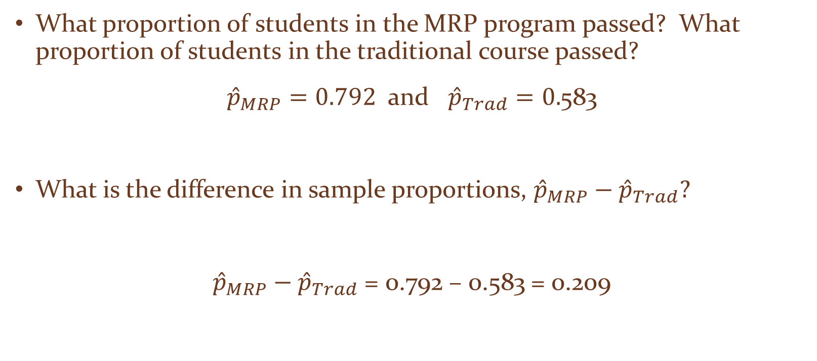
Math Redesign Program at JJC
What proportion of students in the MRP program passed? What proportion of students in the traditional course passed?
${\hat{p}}_{MRP}=0.792$ and ${\hat{p}}_{Trad}=0.$583
What is the difference in sample proportions, ${\hat{p}}_{MRP}−{\hat{p}}_{Trad}?$
${\hat{p}}_{MRP}−{\hat{p}}_{Trad}$ = 0.792 – 0.583 = 0.209

Slide 5
Math Redesign Program at JJC
The difference of 0.209 seems significant. That is, it sure seems like the MRP course has a higher pass rate. That said, is it possible that the MRP course had a higher pass rate due to random chance? Put another way, is it possible the 33 students who passed would have passed regardless of which course they were enrolled in and they just happened to end up in the MRP course? So, there are two possibilities here:
  (1) the MRP course is not effective and the higher pass rate in the MRP section was due to chance.
  (2) The MRP course is effective and this explains the difference in pass rates.

Slide 6
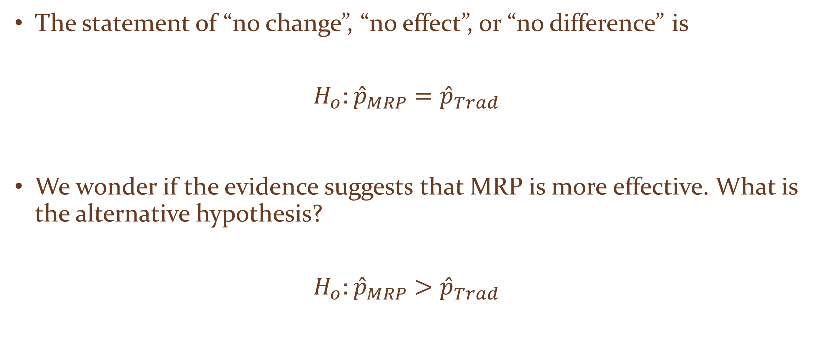
Math Redesign Program at JJC
The statement of “no change”, “no effect”, or “no difference” is
$$H_{o}:{\hat{p}}_{MRP}={\hat{p}}_{Trad}$$
We wonder if the evidence suggests that MRP is more effective. What is the alternative hypothesis?
$$H_{o}:{\hat{p}}_{MRP}>{\hat{p}}_{Trad}$$

Slide 7
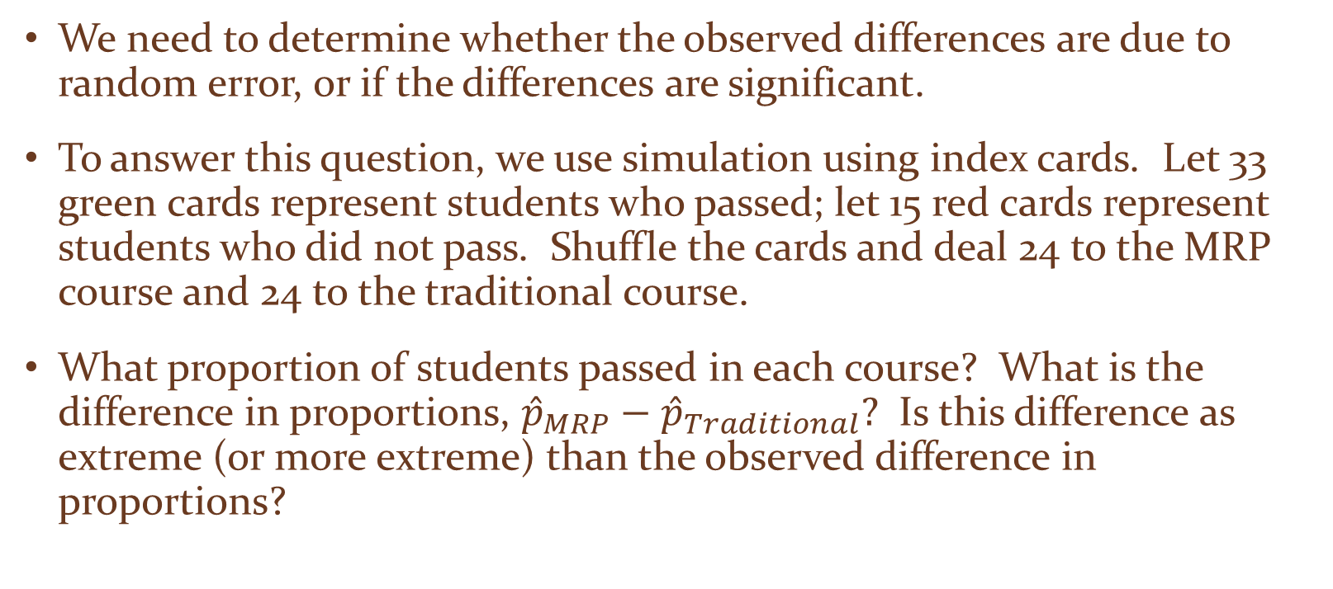
Math Redesign Program at JJC
We need to determine whether the observed differences are due to random error, or if the differences are significant.
To answer this question, we use simulation using index cards. Let 33 green cards represent students who passed; let 15 red cards represent students who did not pass. Shuffle the cards and deal 24 to the MRP course and 24 to the traditional course.
What proportion of students passed in each course? What is the difference in proportions, ${\hat{p}}_{MRP}−{\hat{p}}_{Traditional}?$ Is this difference as extreme (or more extreme) than the observed difference in proportions?

Slide 8
Math Redesign Program at JJC
In a classroom setting, combine the results of the class. Consider drawing a dotplot of the differences on the board. Or, use a survey tool (such as StatCrunch) to aggregate the classroom results.
Based on the classroom results, ask students if they are willing to conclude that the MRP program is superior to the traditional method with this number of observations.
In reality, we need to conduct this simulation many, many times. To do this, we use an applet.

Slide 9
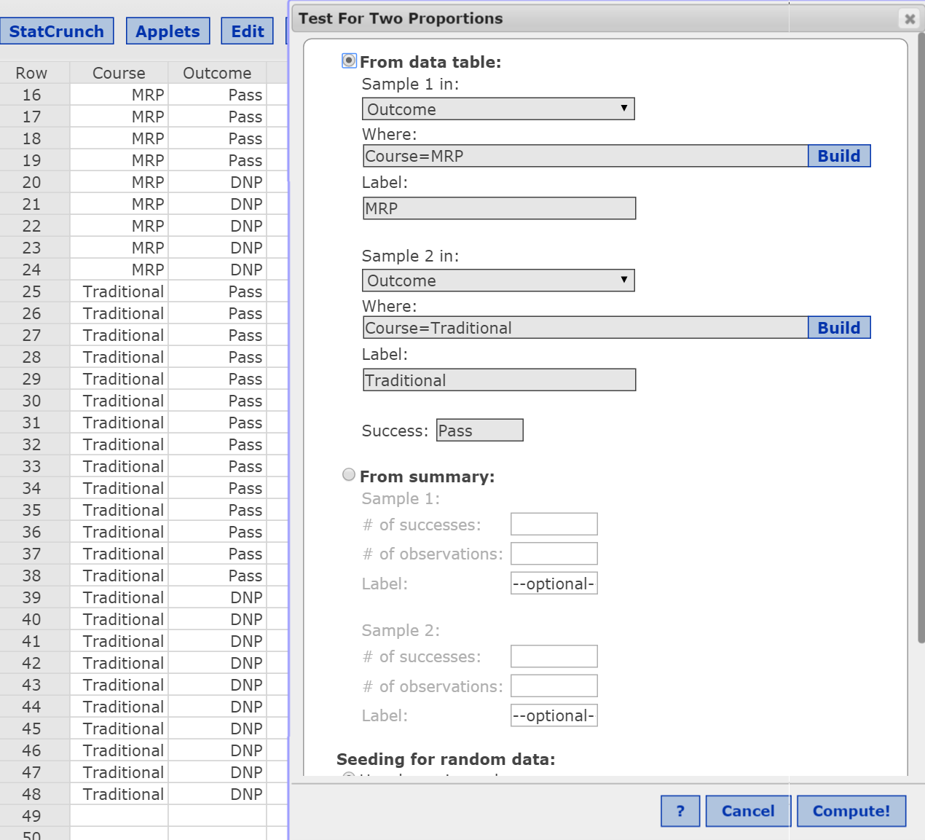
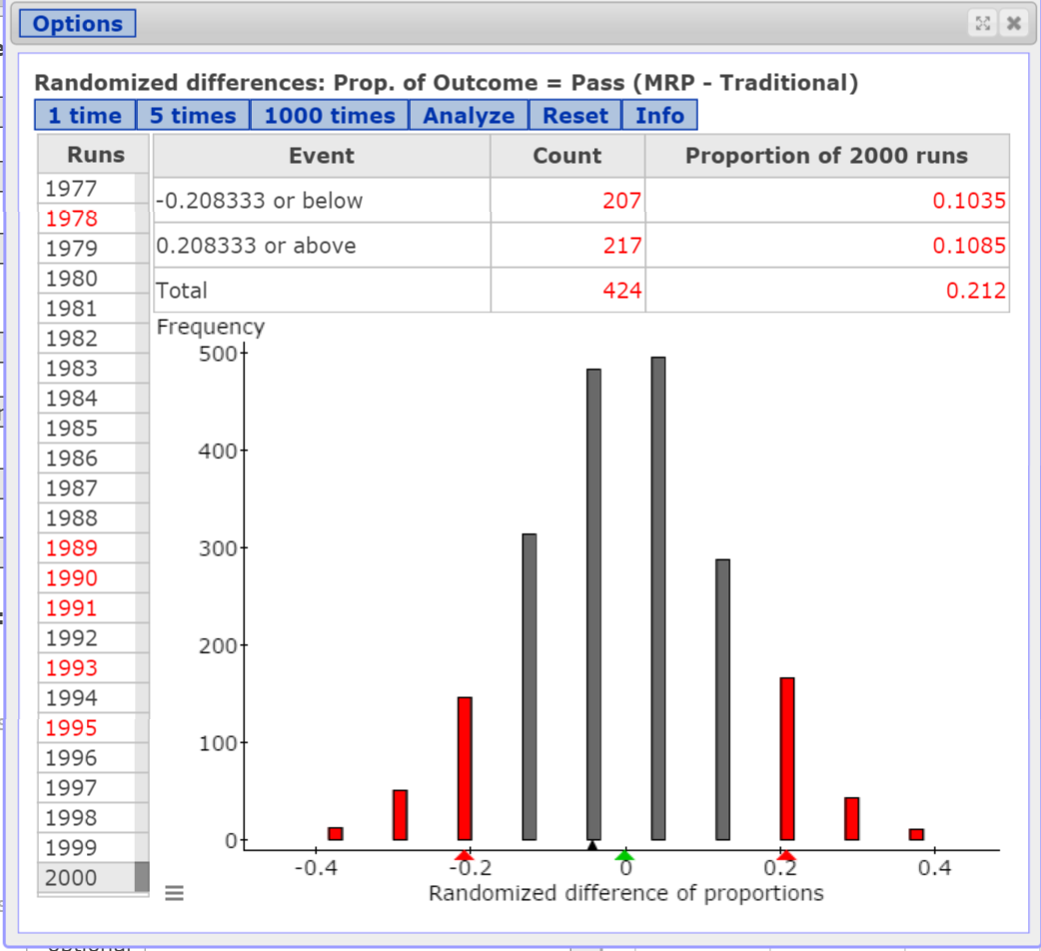
Math Redesign Program at JJC
Notes:
Be sure to point out that the distribution of outcomes is centered at 0. Why? We conducted this test under the assumption there is no difference in the effectiveness of the courses. In other words, when the null hypothesis is true, we would expect the MRP program to have a higher proportion of passers half the time and the traditional course to have a higher proportion of passers about half the time.
What would happen if we increased the sample size ten-fold, but had the same proportion of success in each treatment group?

Slide 10
Math Redesign Program at JJC
In the 2000 repetitions of the experiment (through the applet), 217 resulted in a sample difference of 0.209 or higher. We estimate the P-value to be 217/2000 = 0.1085.
The probability of observing a sample difference in proportions of 0.209 or higher under the assumption the difference in proportions is zero is 0.1085.
Notes:
Might ask the role confounding may play in this study. For example, suppose the traditional course was taught at 8 am and the MRP at 1 pm. Does this time difference matter?

Slide 11
Math Redesign Program at JJC
What would happen if we increased the sample size five-fold?
So, we now have 95 out of 120 MRP students passing and 70 out of 120 Traditional Students passing.

Slide 12
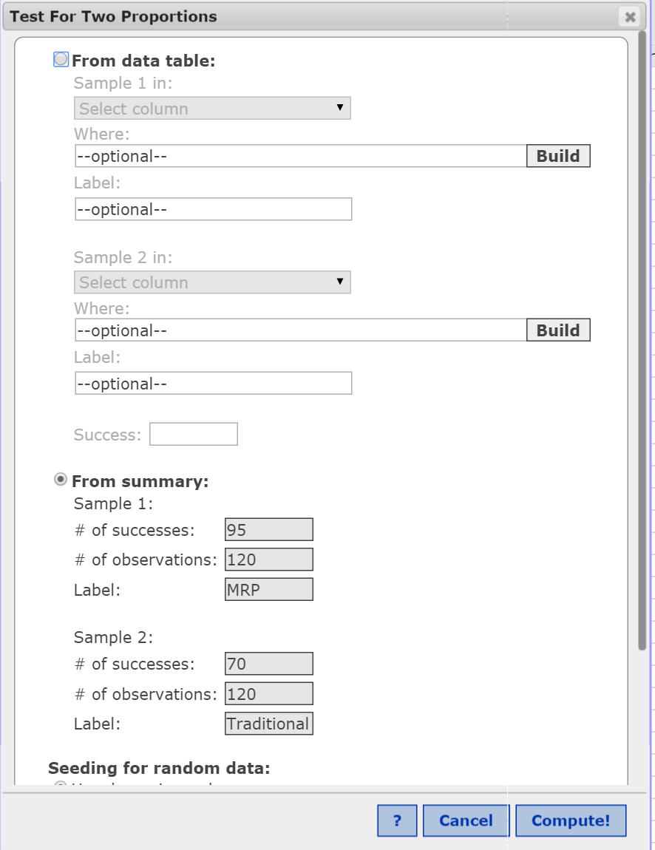
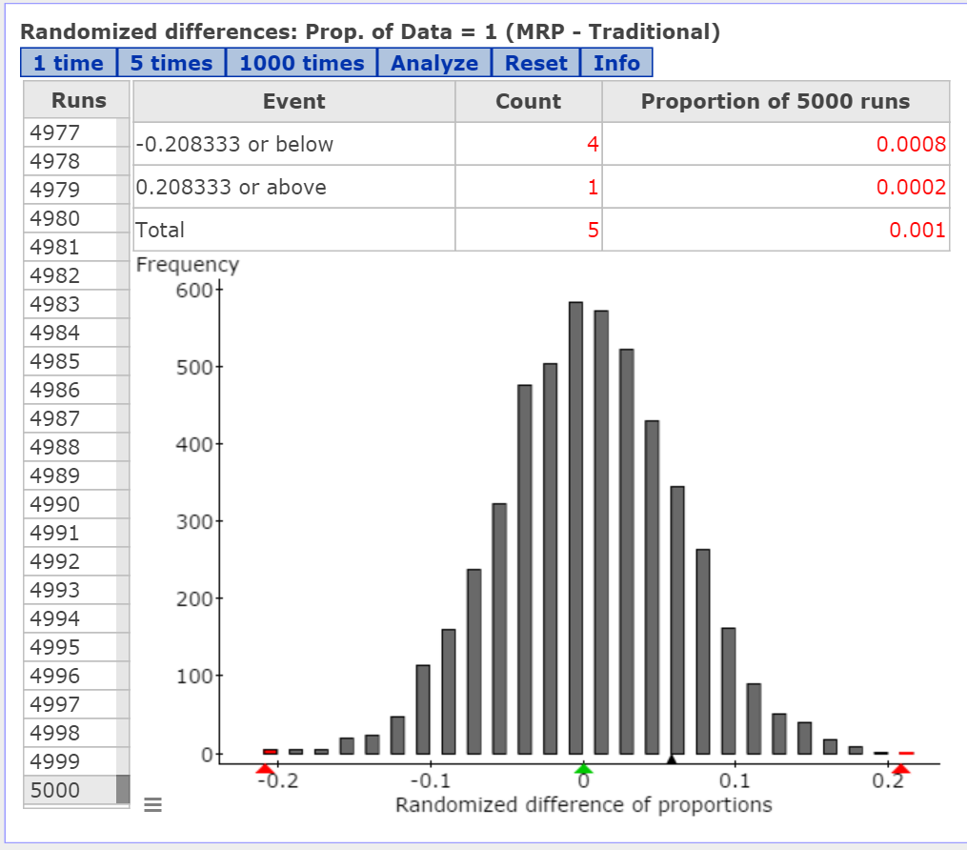
Math Redesign Progam at JJC

Slide 13
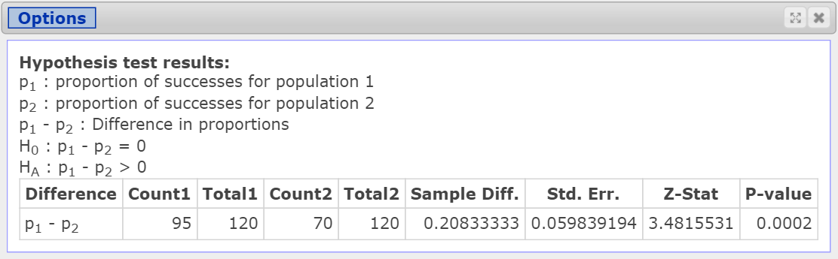
Math Redesign Program at JJC

Slide 14
Other Randomization Techniques
Randomization Test for Two Independent Means
Randomization Test for Correlation
  Drilling Data

