Slide 1
Hypothesis Tests on a population mean
Michael Sullivan
Joliet Junior College
sullystats@gmail.com or msulliva@jjc.edu
Visit sullystats.com

Slide 2
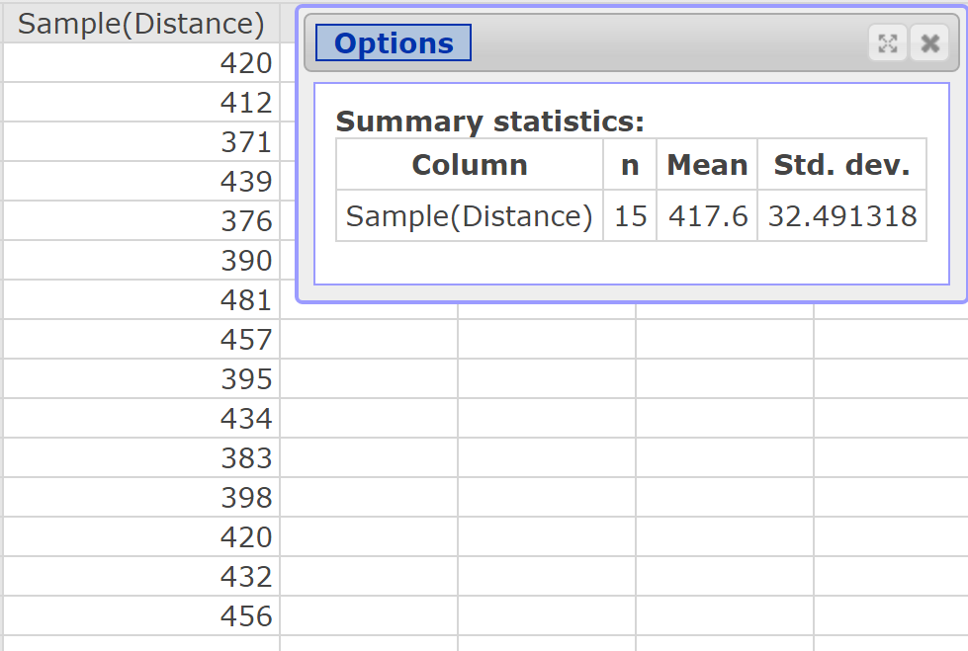
Testing a Hypothesis about a Population Mean: Simulation
Coors Field is home to the Colorado Rockies baseball team and is located in Denver, Colorado. Denver is approximately one mile above sea level where the air is thinner. Therefore, baseballs are thought to travel farther in this stadium. Does the evidence support this belief? In a random sample of 15 homeruns hit in Coors Field, the mean distance the ball traveled was 417.6 feet. Does this represent evidence to suggest that the ball travels farther in Coors Field than it does in the other Major League ballparks?

Slide 3
Testing a Hypothesis about a Population Mean: Simulation

Slide 4
Testing a Hypothesis about a Population Mean: Simulation
To do this, we will obtain 1000 simple random samples of size n = 15 from the population.
Data > Sample
Select the variable “Distance”. Enter 15 for the sample size. Check the radio button “Stacked with sample ID”. Open in new data table.
Compute the mean of each sample by selecting Stat > Summary Stats > Columns Select Distance(Sample) for the variable; group by Sample. Only compute the mean.

Slide 5
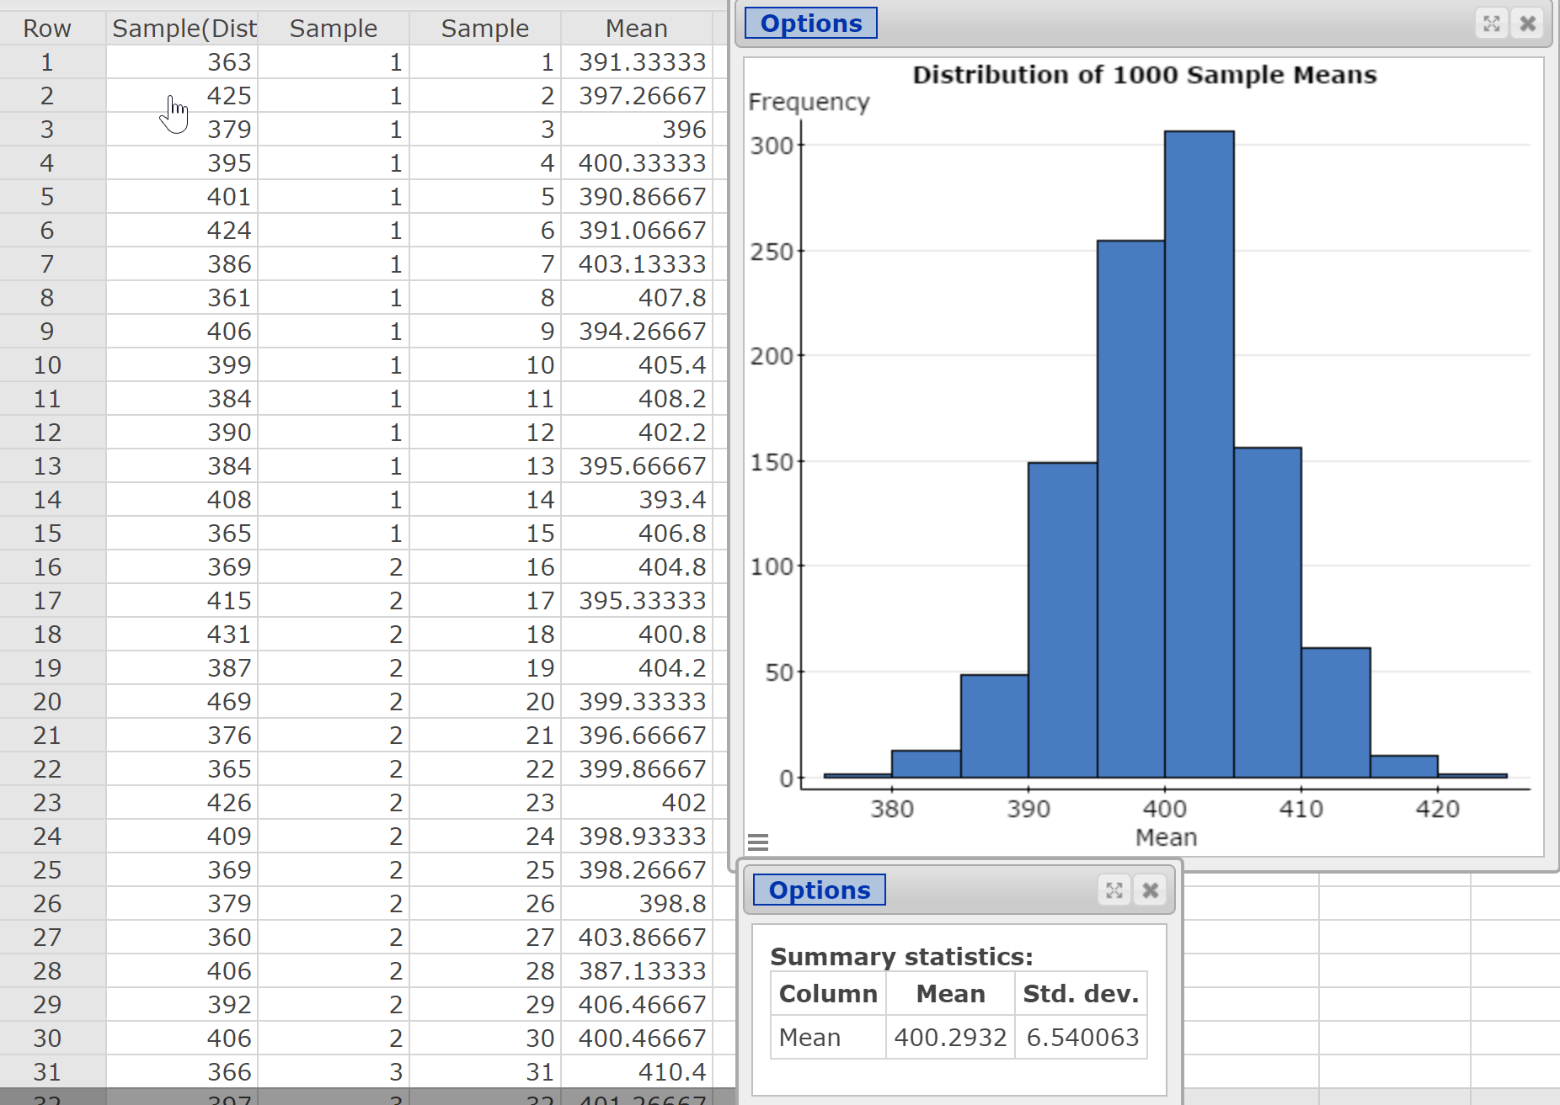

Slide 6
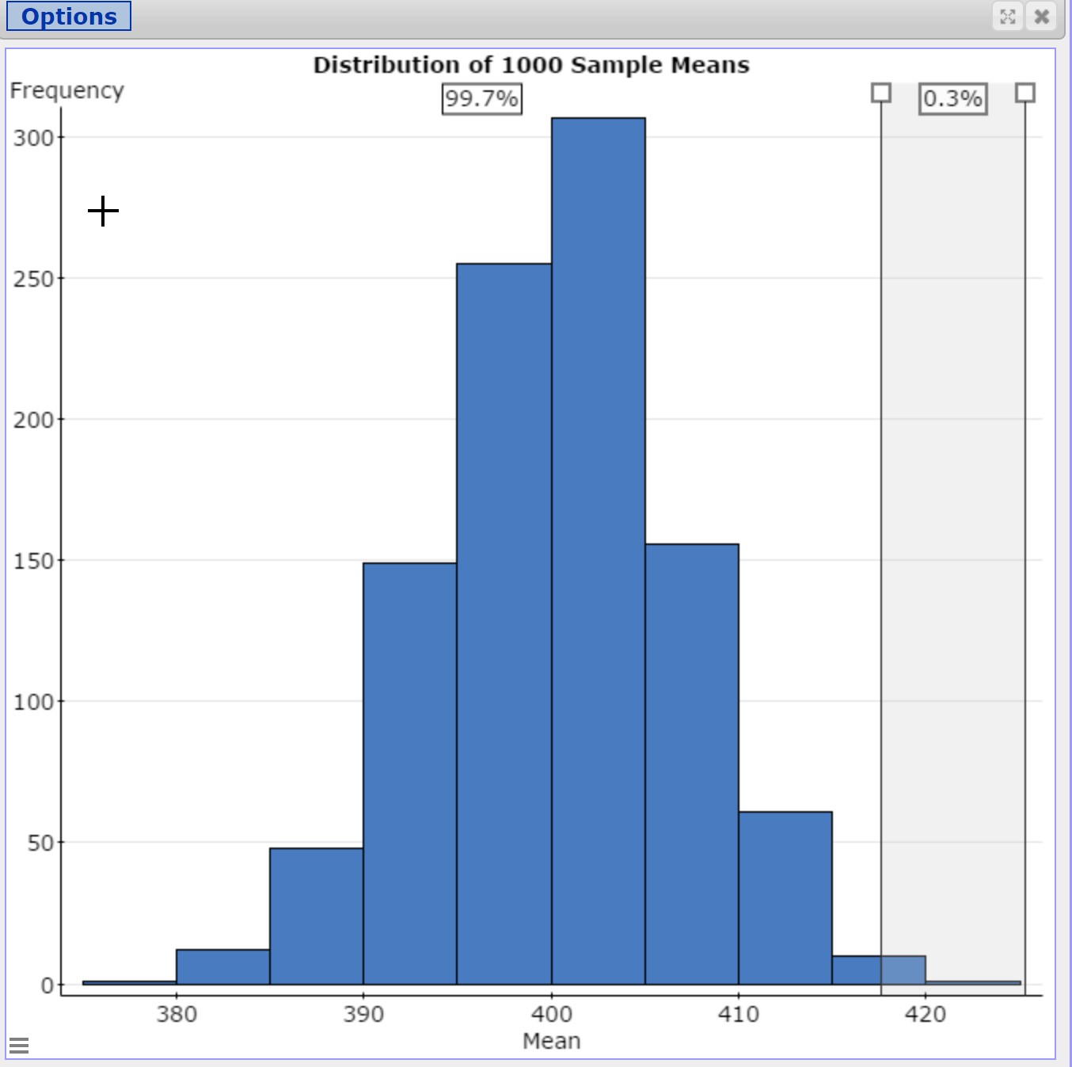
Notes:
Use the StatCrunch “Divider” option. Double-click on vertical bar to enter 417.6 as lower bound.

Slide 7
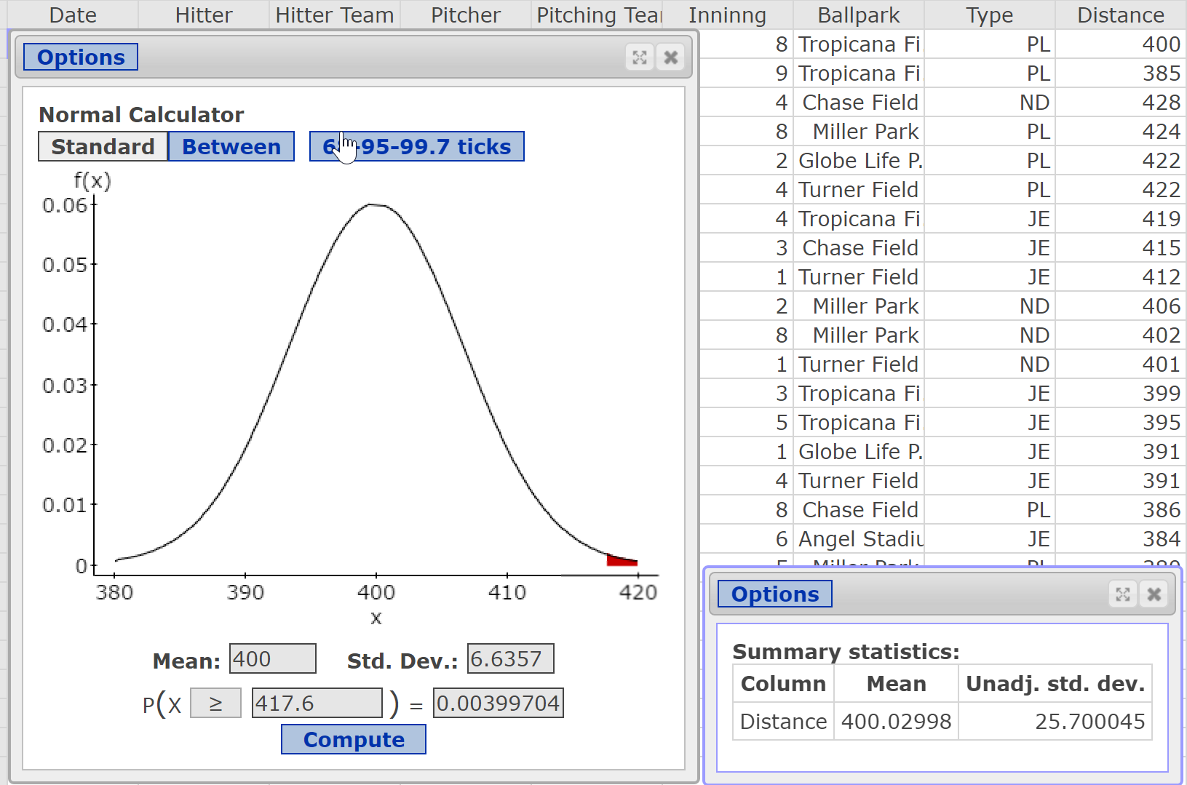
Notes:
Go back to the population data. Compute the population mean and standard deviation. Use the normal model to compute P(xbar > 417.6).

Slide 8
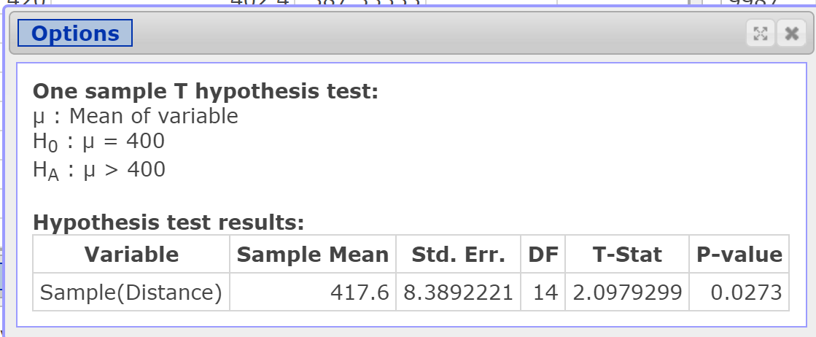
Why is the P-value so much larger using Student’s t-distribution?
Notes:
Notice the size of the standard error for this data. It is important for students to understand that a small sample size could lead to a standard error that is larger (even much larger) than what we would expect (using a model) if the sample data tends to be more dispersed than the overall population (as is the case in this data).

Slide 9
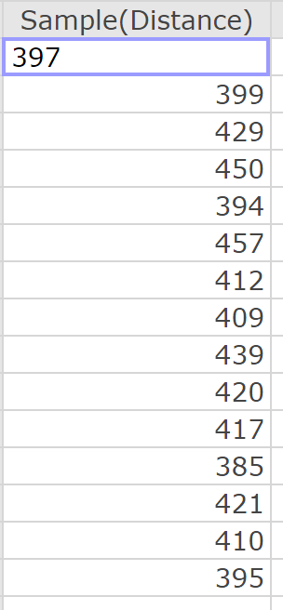
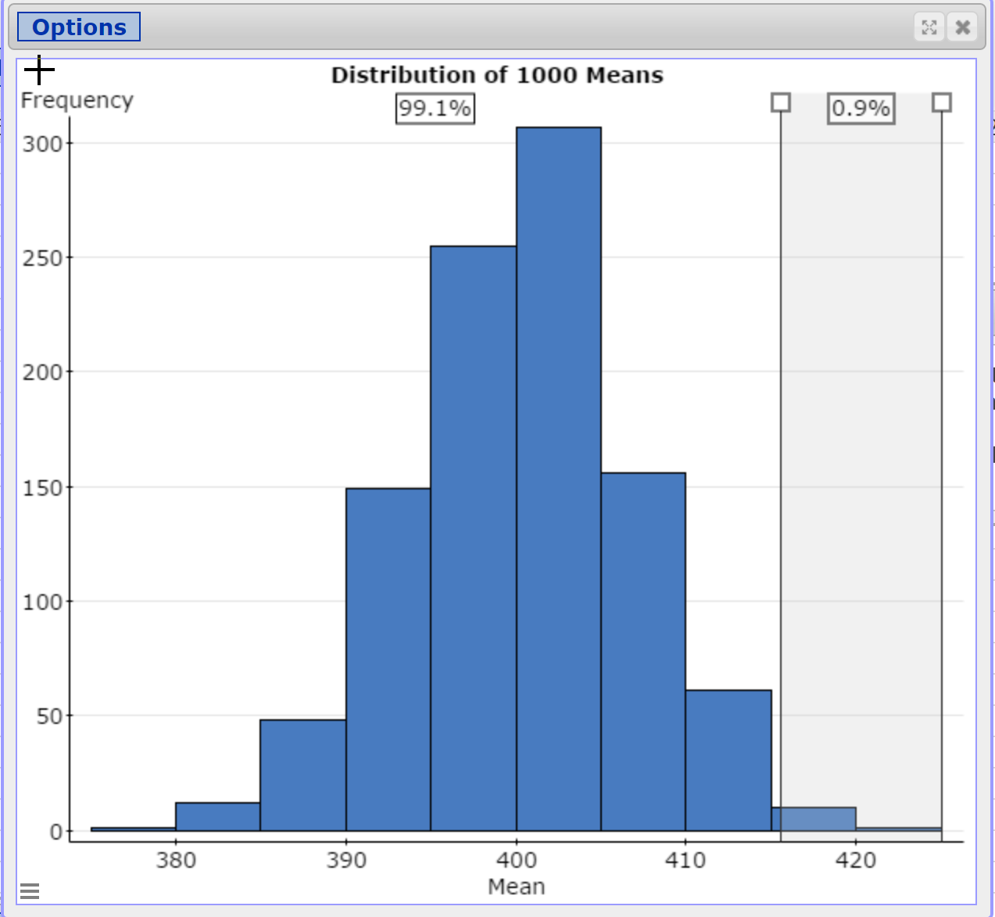
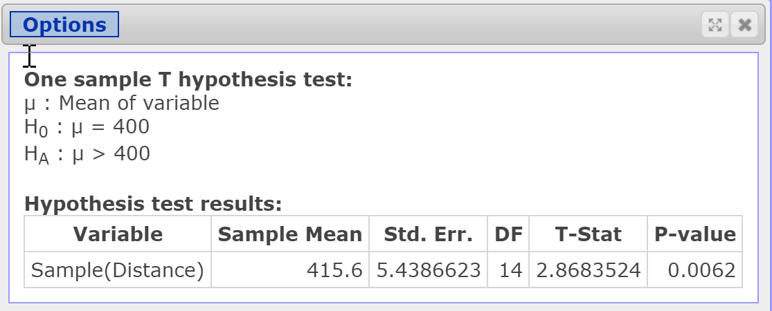
Repeat the simulation with new sample data

Slide 10
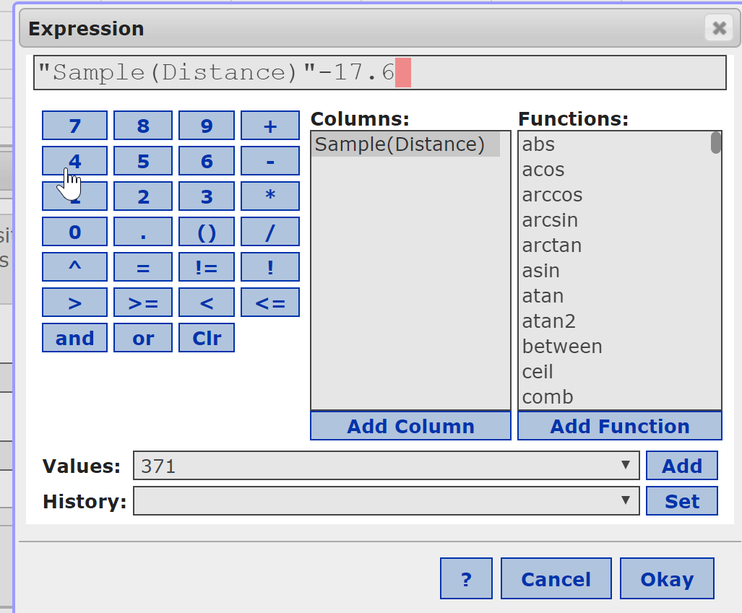
The bootstrap
Adjust the data so that the mean of the sample data equals the mean stated in the null hypothesis.
Notes:
Notice in the proxy for the sampling distribution from our simulation that the distribution of the sample means is centered at the population mean, 400.0 feet. The standard error from the proxy is slightly lower than the theoretical standard error (6.54 versus 6.6357). Why would this occur? Random chance.
However, we were able to obtain an estimate of the standard error because we were able to obtain many, many samples from the population data. What if we don’t have access to the population data (as is often the case)? The bootstrap says to use the sample data as a proxy for the population data. Take many samples (Hesterberg recommends at least 10,000) of size n with replacement from the sample data. Compute the stat of interest for each sample. Use the sample stat to approximate the center and spread of the distribution.

Slide 11
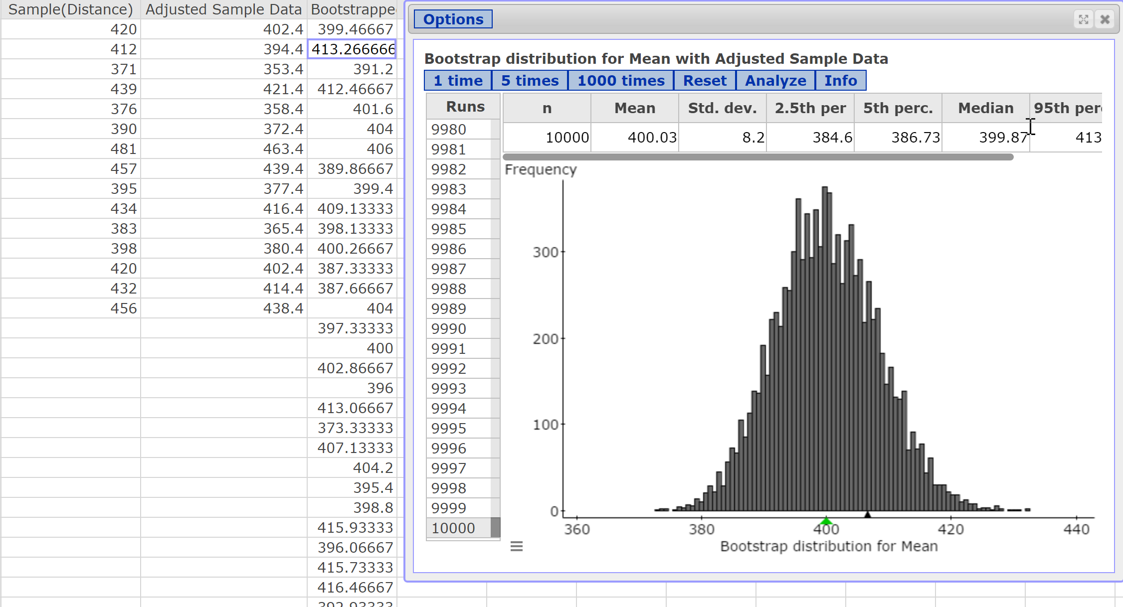
Notes:
Column 2 shows sample data minus 17.6 (the difference between the mean of the sample data (417.6) and the mean stated in the null. Now, the mean of the adjusted data equals 400. Run the Bootstrap applet 10,000 times. Click Analyze to export the data to the StatCrunch spreadsheet.

Slide 12
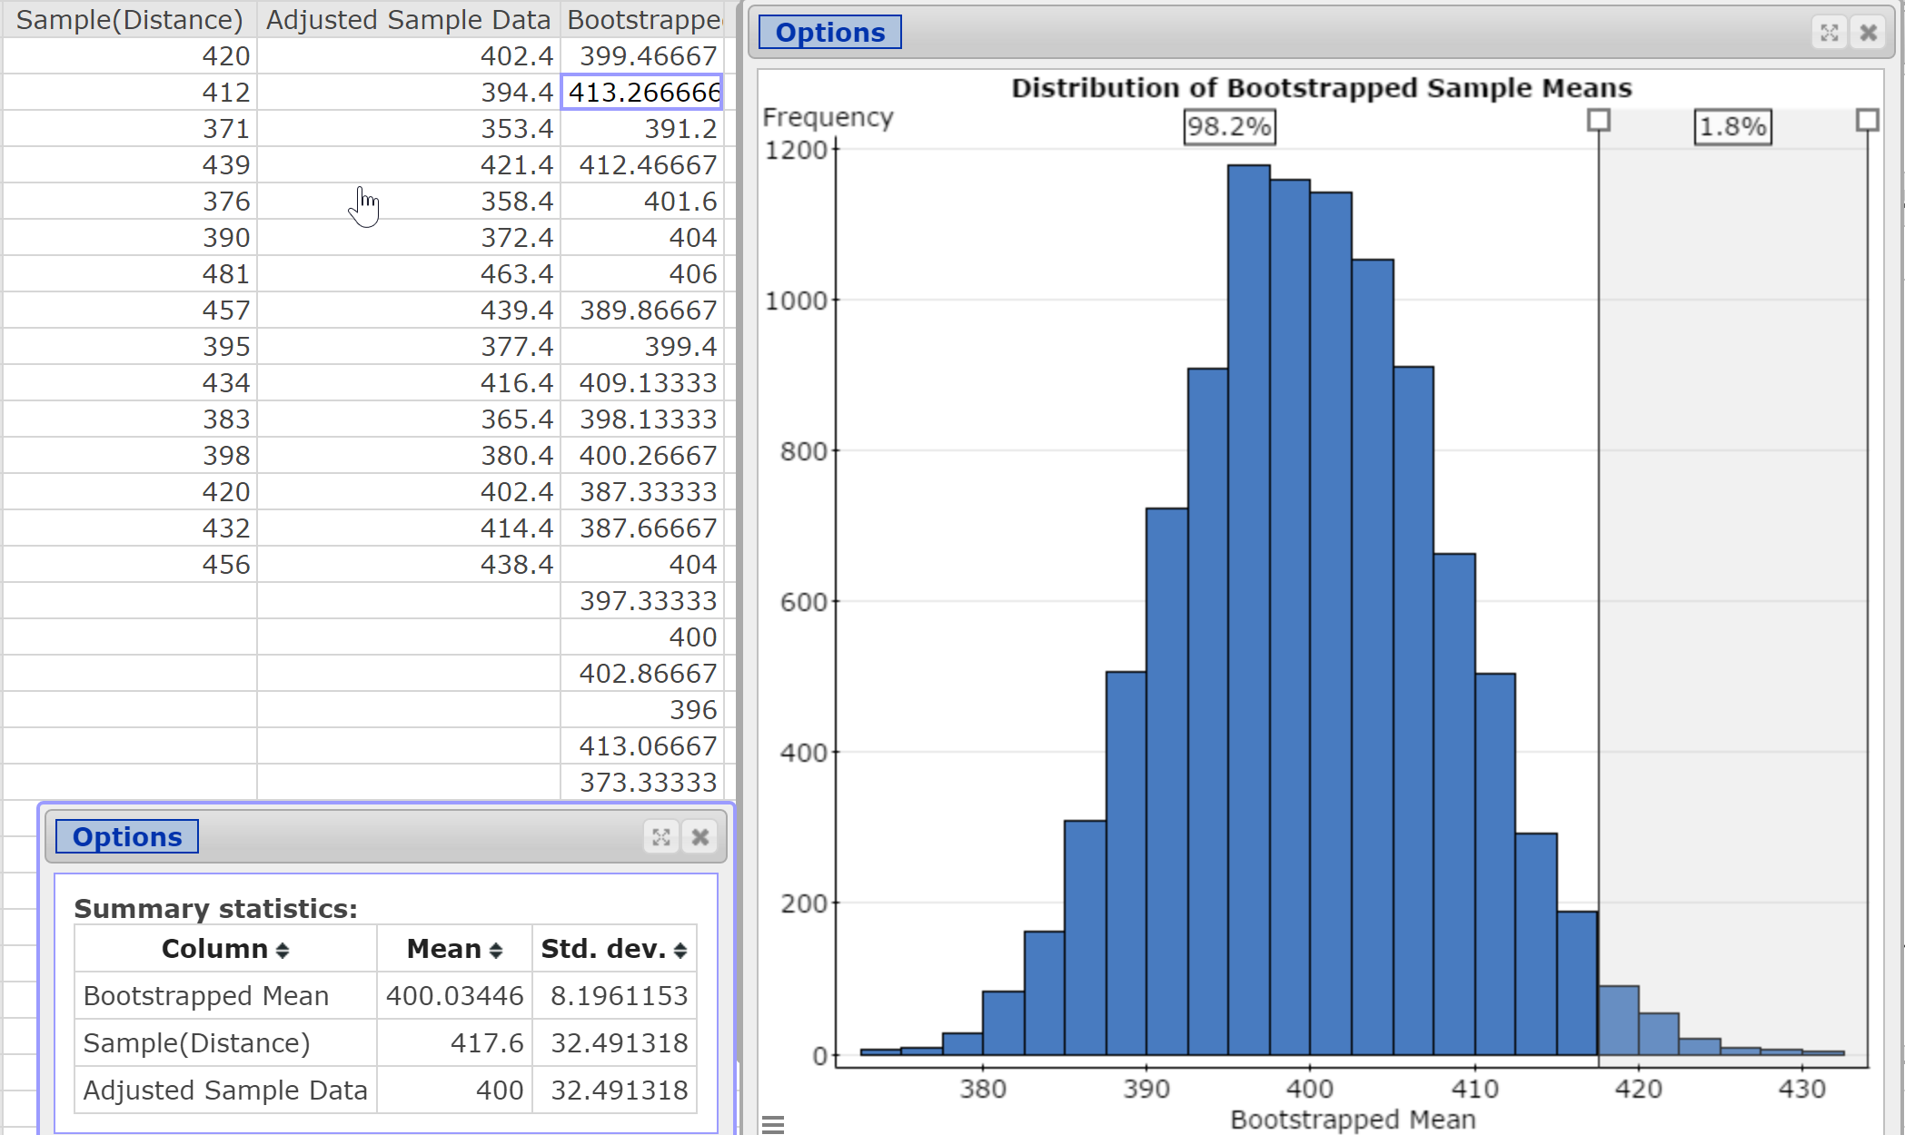
Notes:
We get a P-value of 0.018 compared with a P-value of 0.0273 using Student’s t-distribution. Again, this result occurs because the 15 observations in the sample have quite a bit of variability in them.

Slide 13
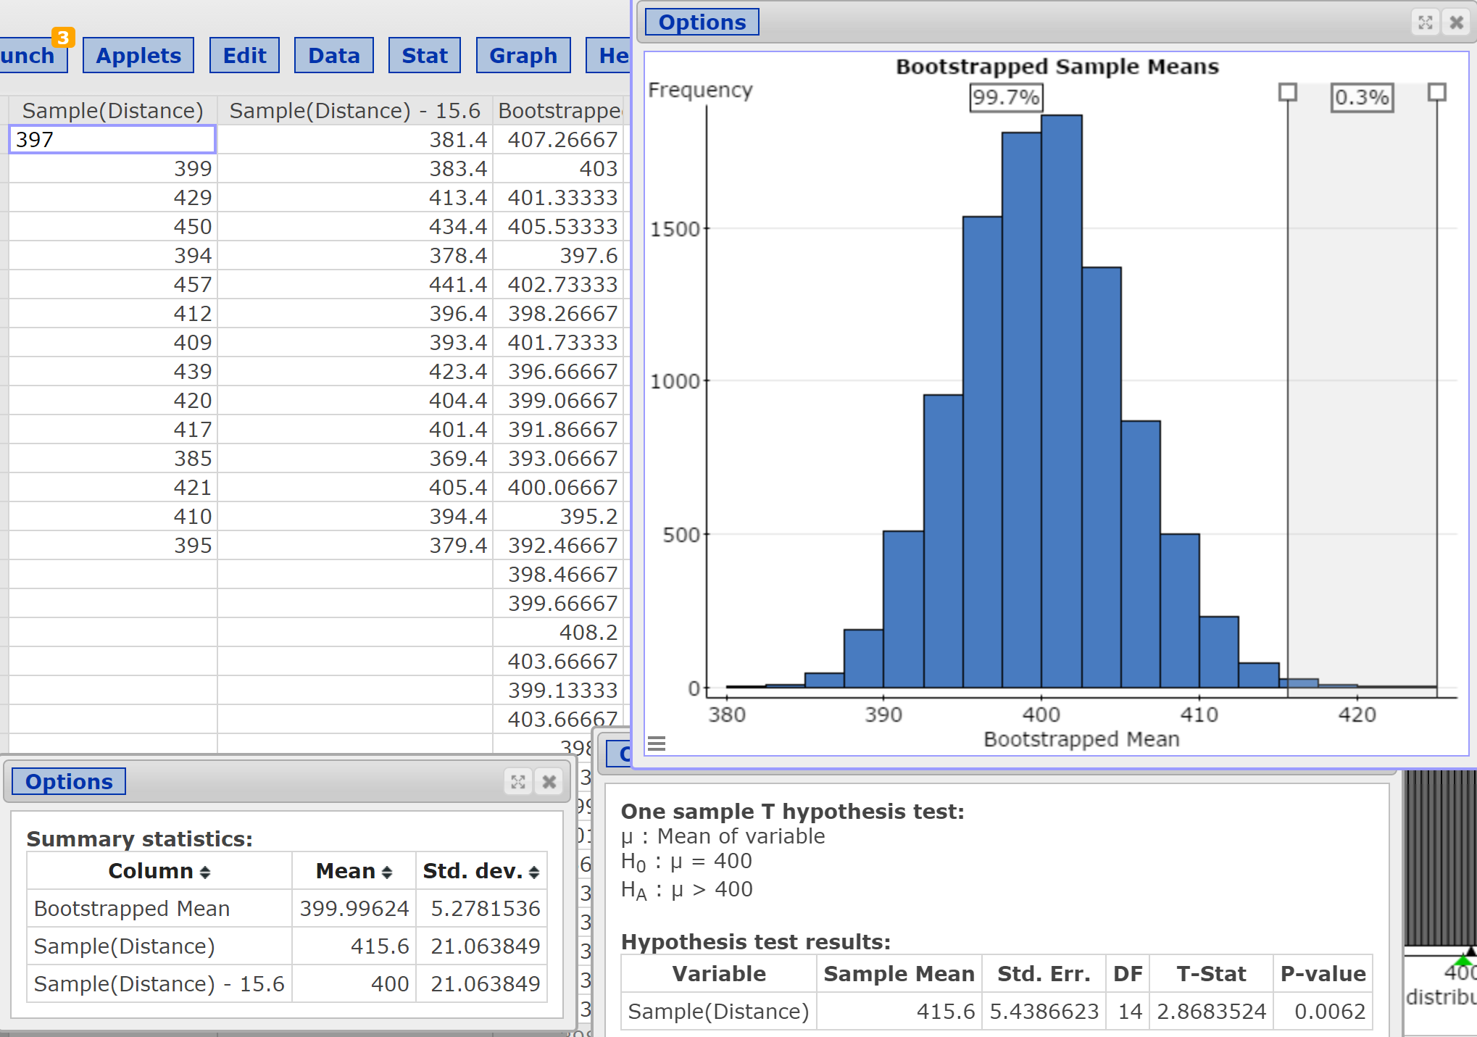
Notes:
Using a different set of sample data, we obtain the results shown.

