Slide 1
Activities that enhance the conceptual understanding of statistics
Michael Sullivan
Joliet Junior College
sullystats@gmail.com or msulliva@jjc.edu
sullystats.com

Slide 2
Getting data
The Omnipresence of Data
Some data is easy to obtain (*.csv or *.txt files)
Other data must be extracted from a webpage.

Slide 3
deviations
For each of the following data sets, decide which has the higher standard deviation, if any, without doing any computation. Explain the rationale behind your choice. Then, verify your choice by computing the standard deviation by hand.

Slide 4
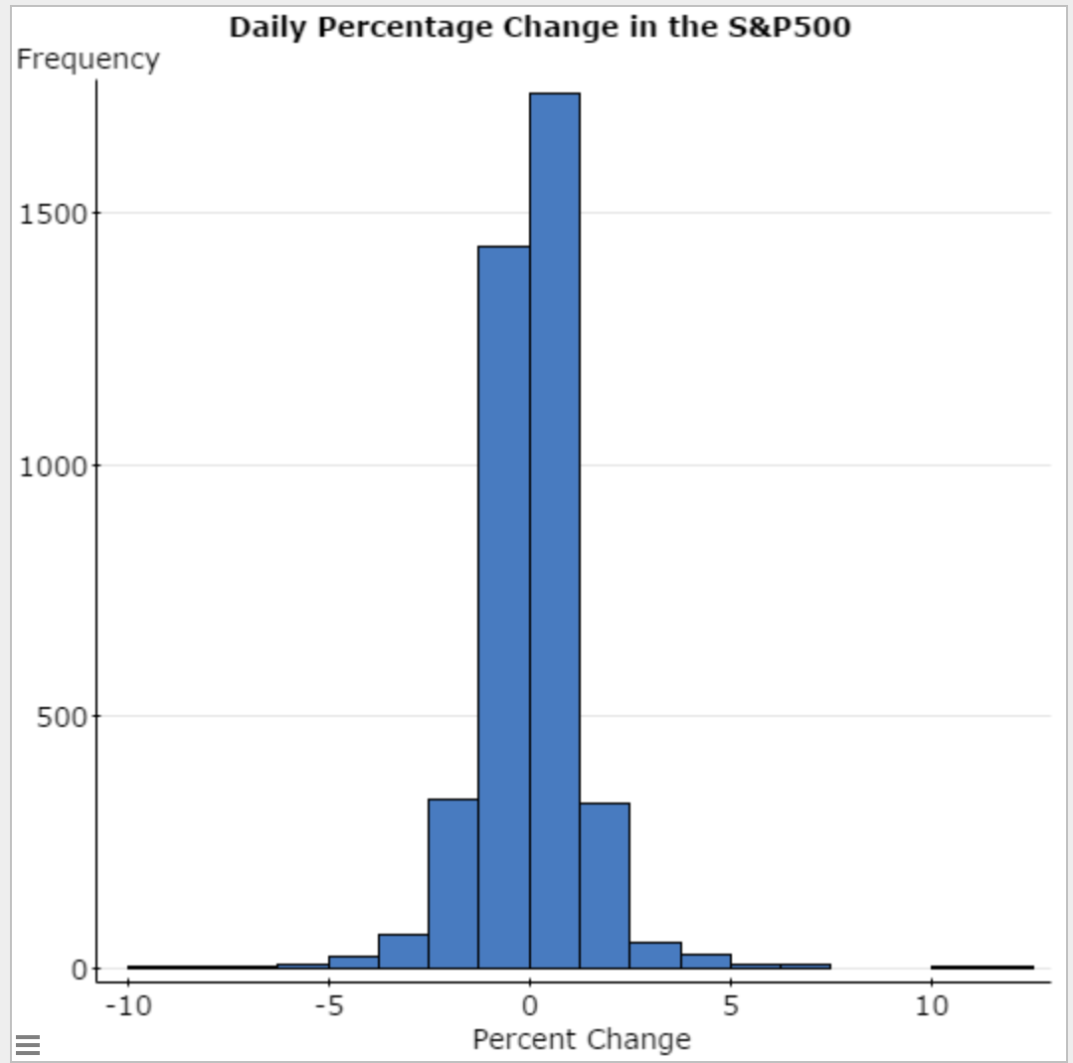
The black swan
Open the data file “Daily Percentage Change in S&P500” in StatCrunch.
Draw a histogram of the variable “Percentage Change.” Describe the shape of the distribution.
Compute the mean and standard deviation percentage change.

Slide 5
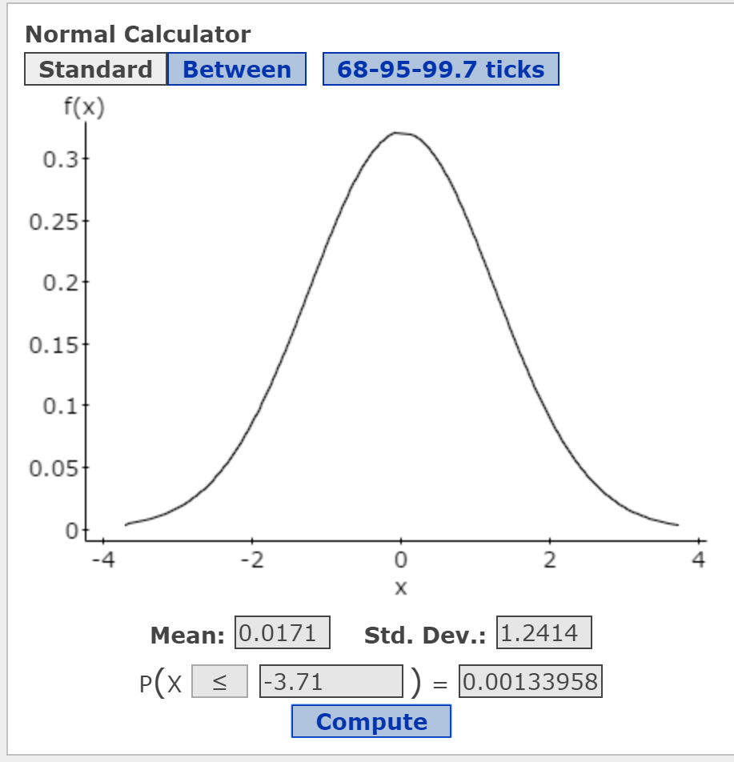
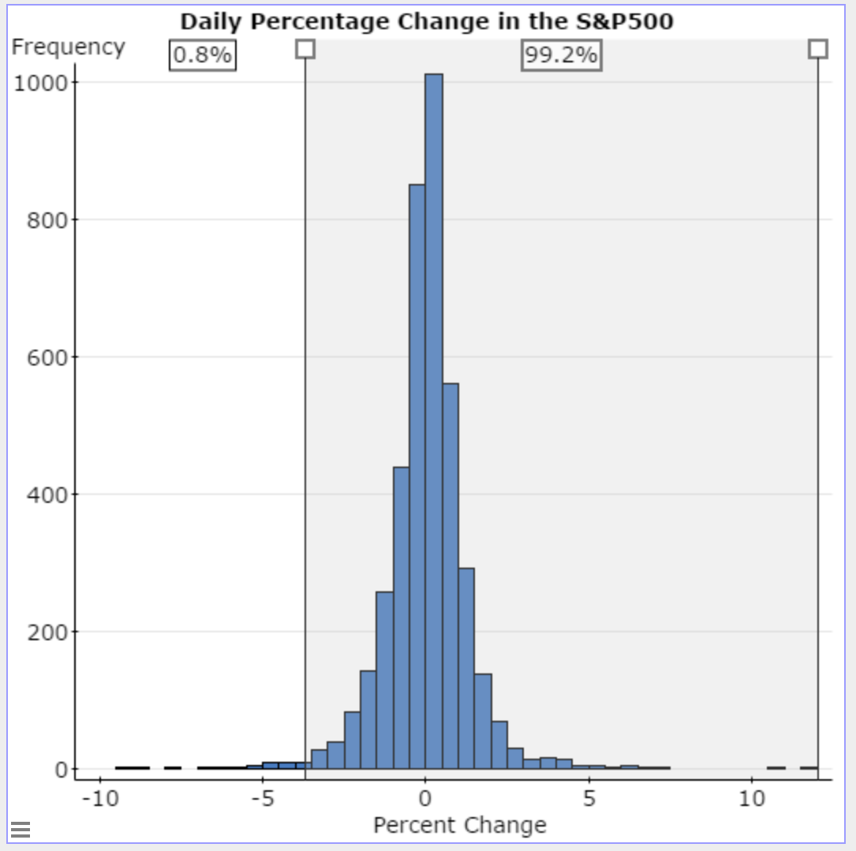
The Black Swan
(c) Determine the percentage change value for
Use the normal model to determine the proportion of observations that should be less than three standard deviations below the mean.
Redraw the histogram with a lower class limit of the first class of -10 and a class width of 0.5. In StatCrunch, there is an option called “Dividers” in the histogram dialogue box. Select the Percent radio button. Click Compute! Double-click on the left-most divider and enter the value found in part (c). What proportion of observations are less than this value? Is this close to the value given by the normal model?
Ans: -3.71

Slide 6
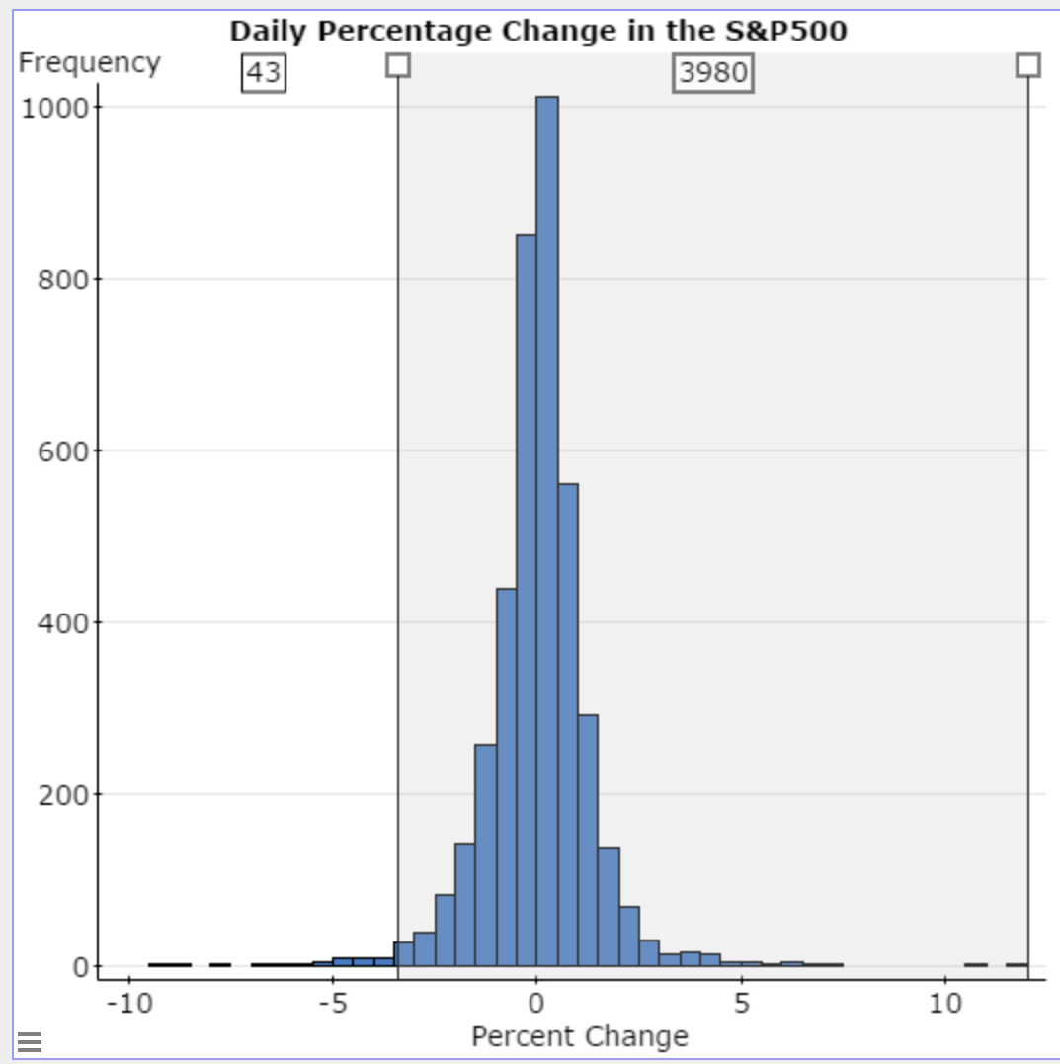
The black swan
(f) In his book The Black Swan, author Nassim Nicholas Taleb warns of using the normal model for financial markets. According to the normal model, what proportion of the days should the percentage change of the S&P 500 be less than -7.0%? Ans: 0.0000000073
(g) The number of days one should expect to wait before observing an event equals 1/p where p is the probability of observing the event. Use the result of part (f) to determine the number of days one should expect to wait before observing a percentage change in the S&P500 of -7.0 or less. Ans: 136,986,301
(h) There were 4023 trading days from 11/7/00 to 11/3/2016. How many of these days had a percentage change in the S&P500 of -7.0 or less? What does this result suggest?

Slide 7
Student’s t-Distribution

Slide 8
Intro to hypothesis testing
The proportion of the human population that is left-handed is 0.12. Mensa is an organization of high-IQ individuals (to qualify to be a member of Mensa one’s IQ must be at the 98th percentile). In a random sample of 20 members of Mensa, it was found that 4 were left-handed. Does this result suggest that a higher proportion of Mensa members are left-handed that the general population?
What is the variable of interest in this study? Is it qualitative or quantitative?
What are the null and alternative hypotheses?
Why can’t a fair coin be used to simulate the outcomes of this study?
Use the Urn applet in StatCrunch to build a null model that could be used to simulate the outcomes of the study. Hint: There are approximately 120,000 members of Mensa worldwide. Under the assumption the null hypothesis from part (b) is true, how many of the 120,000 Mensa members would be left-handed? How many would not be left-handed?
Use the Urn applet built in part (d) to simulate 1 repetition of this study. Explain what the result represents.
Use the Urn applet built in part (d) to simulate 2000 more repetitions of this study. What does the result suggest?
Use the binomial probability distribution function to find P(X > 4) where n = 20 and p = 0.12.
Notes:
Sample proportion = 4/20 = 0.2.
We want to test H0: p = 0.12 versus H1: p > 0.12
120,000(0.12) = 14,400 left-handed; 120,000(0.88) = 105,600

Slide 9
Intro to hypothesis testing
The proportion of the human population that is left-handed is 0.12. Mensa is an organization of high-IQ individuals (to qualify to be a member of Mensa one’s IQ must be at the 98th percentile). In a random sample of 120 members of Mensa, it was found that 24 were left-handed. Does this result suggest that a higher proportion of Mensa members are left-handed that the general population?
Build the Urn applet again and run 2000 simulations. Be sure to select proportions.
Click Analyze. Find the mean and standard deviation of the 2000 sample proportions.
Determine the theoretical mean and standard deviation of the sample proportion assuming p = 0.12. Compare to part (b).
Use the normal model to find the probability of observing 24 or more left-handers from a population whose proportion is 0.12.

Slide 10
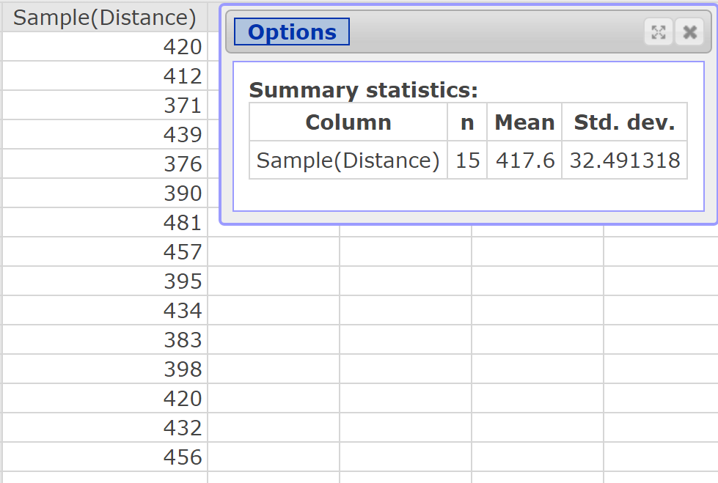
Testing a Hypothesis about a Population Mean: Simulation
Coors Field is home to the Colorado Rockies baseball team and is located in Denver, Colorado. Denver is approximately one mile above sea level where the air is thinner. Therefore, baseballs are thought to travel farther in this stadium. Does the evidence support this belief? In a random sample of 15 homeruns hit in Coors Field, the mean distance the ball traveled was 417.6 feet. Does this represent evidence to suggest that the ball travels farther in Coors Field than it does in the other Major League ballparks?

Slide 11
Testing a Hypothesis about a Population Mean: Simulation

Slide 12
Testing a Hypothesis about a Population Mean: Simulation
To do this, we will obtain 1000 simple random samples of size n = 15 from the population.
Data > Sample
Select the variable “Distance”. Enter 15 for the sample size. Check the radio button “Stacked with sample ID”. Open in new data table.
Compute the mean of each sample by selecting Stat > Summary Stats > Columns Select Distance(Sample) for the variable; group by Sample. Only compute the mean.

Slide 13
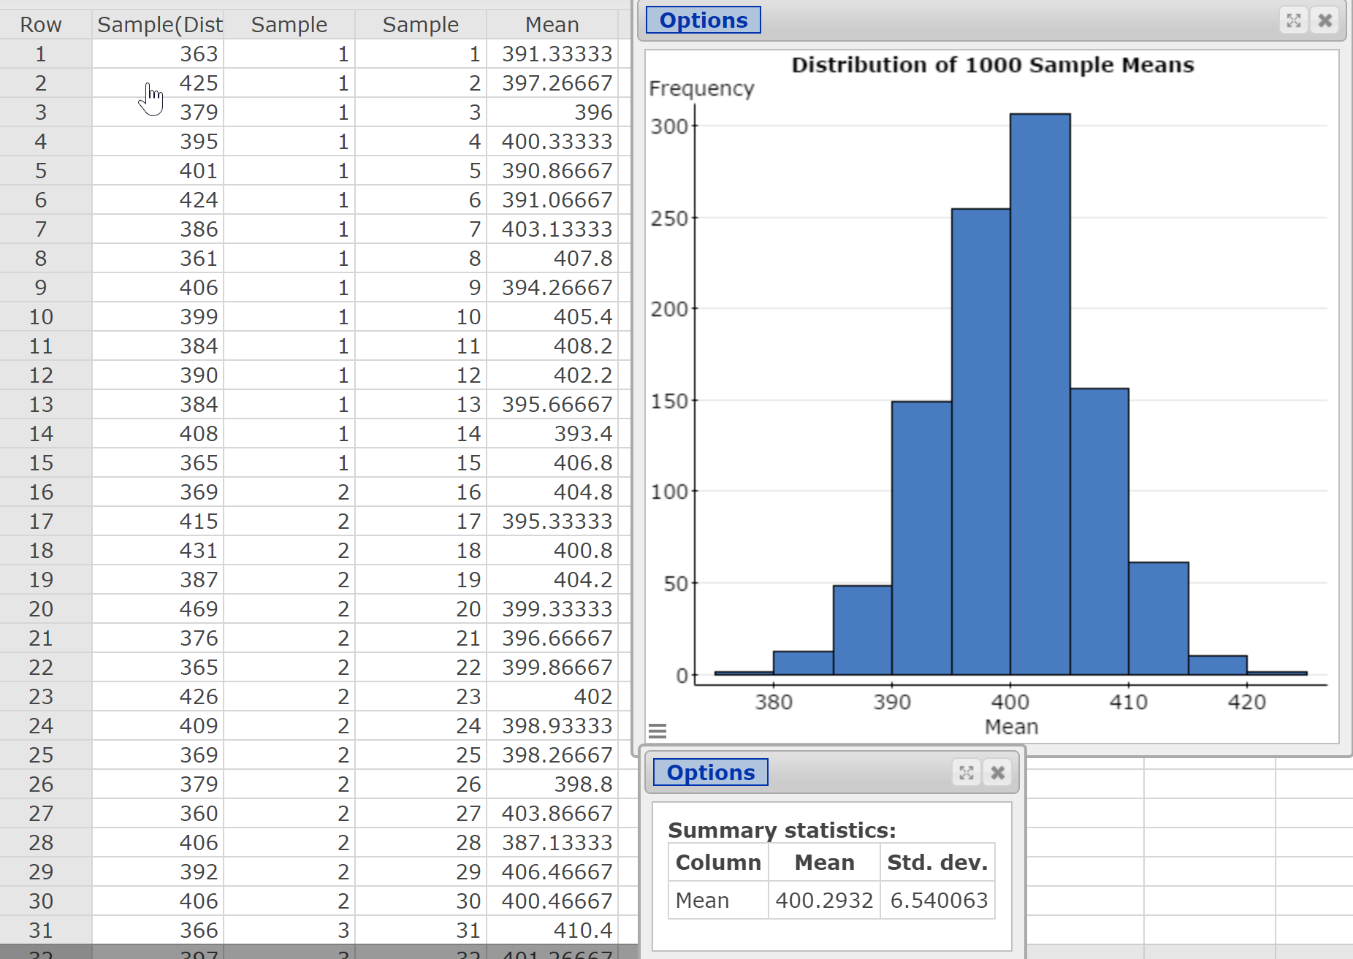

Slide 14
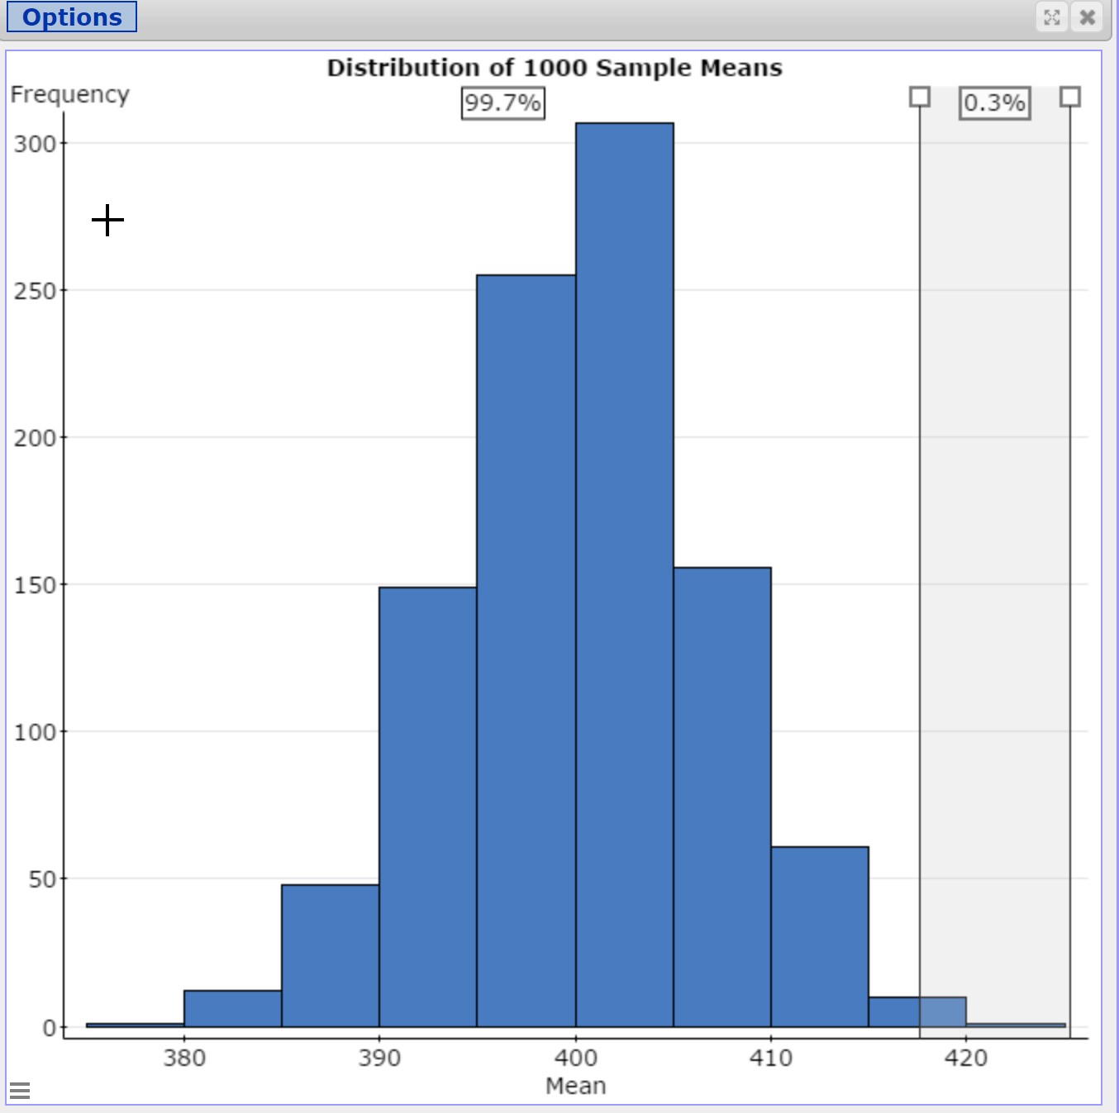

Slide 15
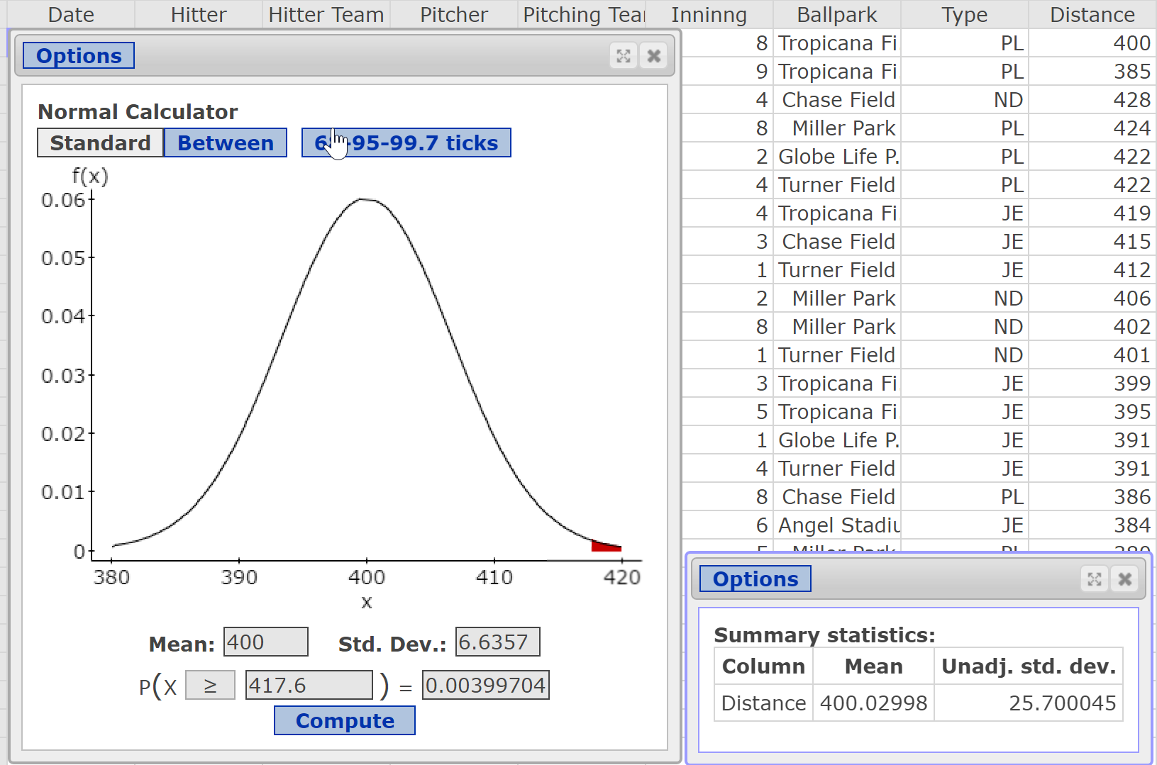

Slide 16
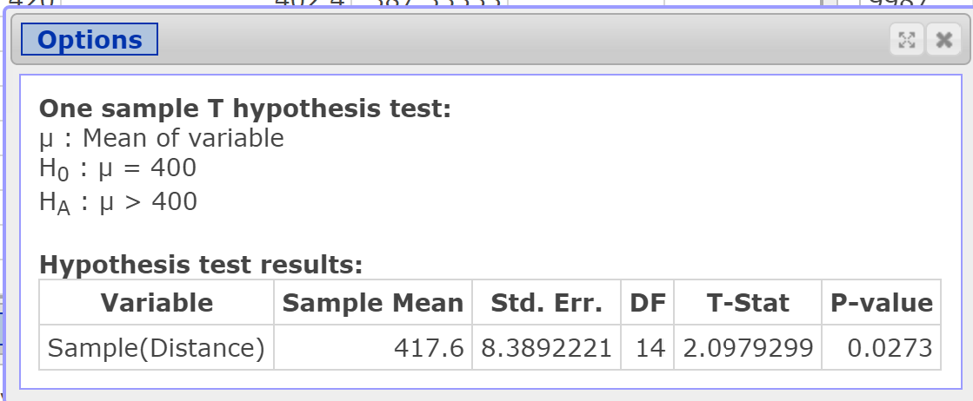
Why is the P-value so much larger using Student’s t-distribution?

Slide 17
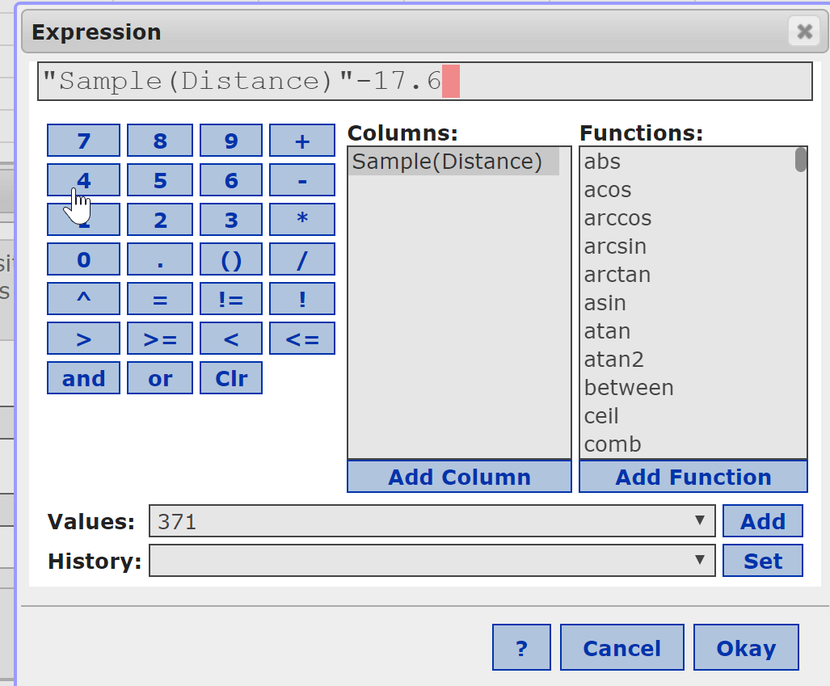
The Bootstrap
Adjust the data so that the mean of the sample data equals the mean stated in the null hypothesis.

Slide 18
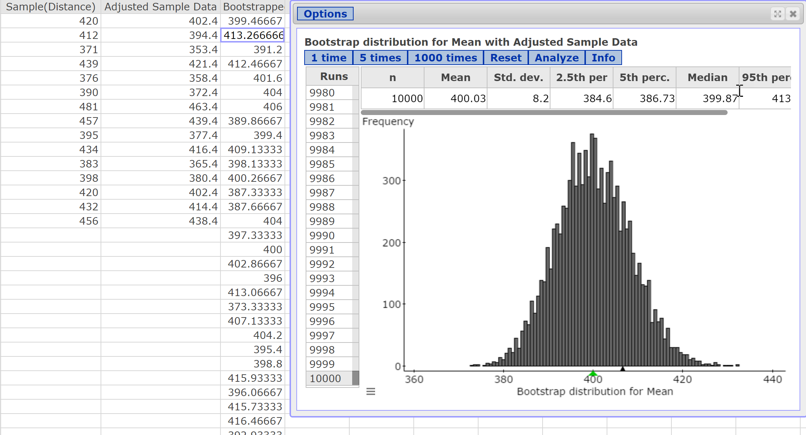
Notes:
Obtain a 10,000 bootstrap samples. Click Analyze to export the results to the spreadsheet.

Slide 19
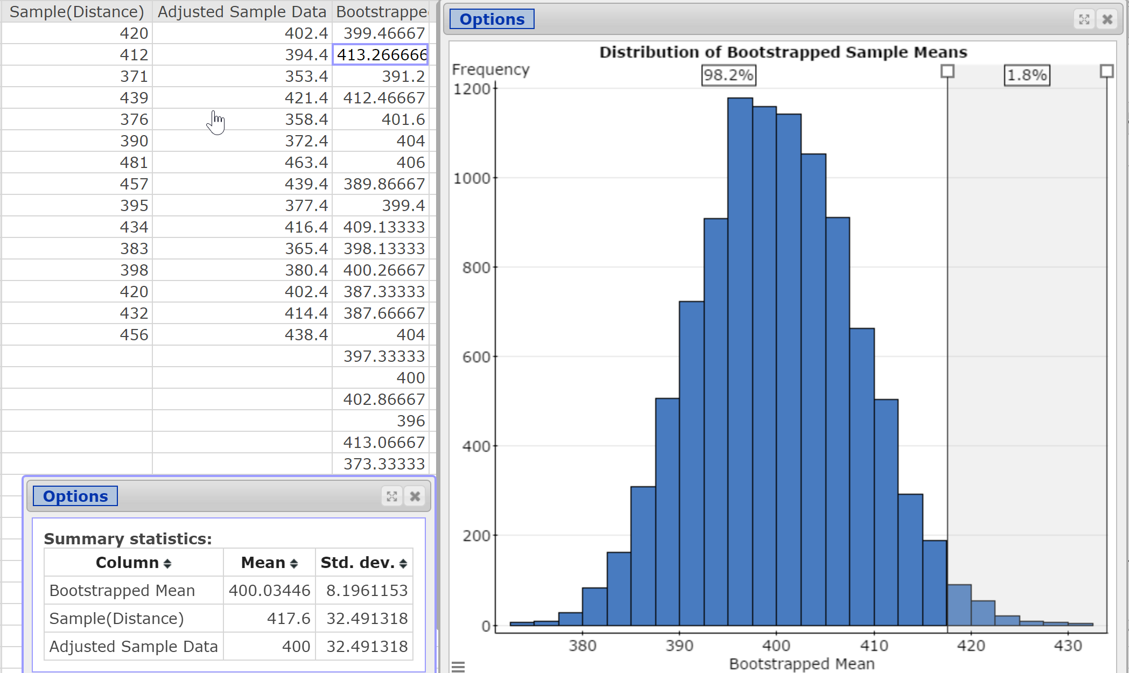
Notes:
Compute the mean and standard deviation of the bootstrapped means. Compare the standard deviation of the bootstrapped means to s/sqrt(n) where n = 15. They should be close. Remember, bootstrap standard errors tend to be smaller (narrowness bias).

Slide 20
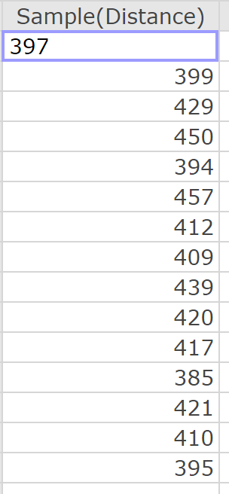
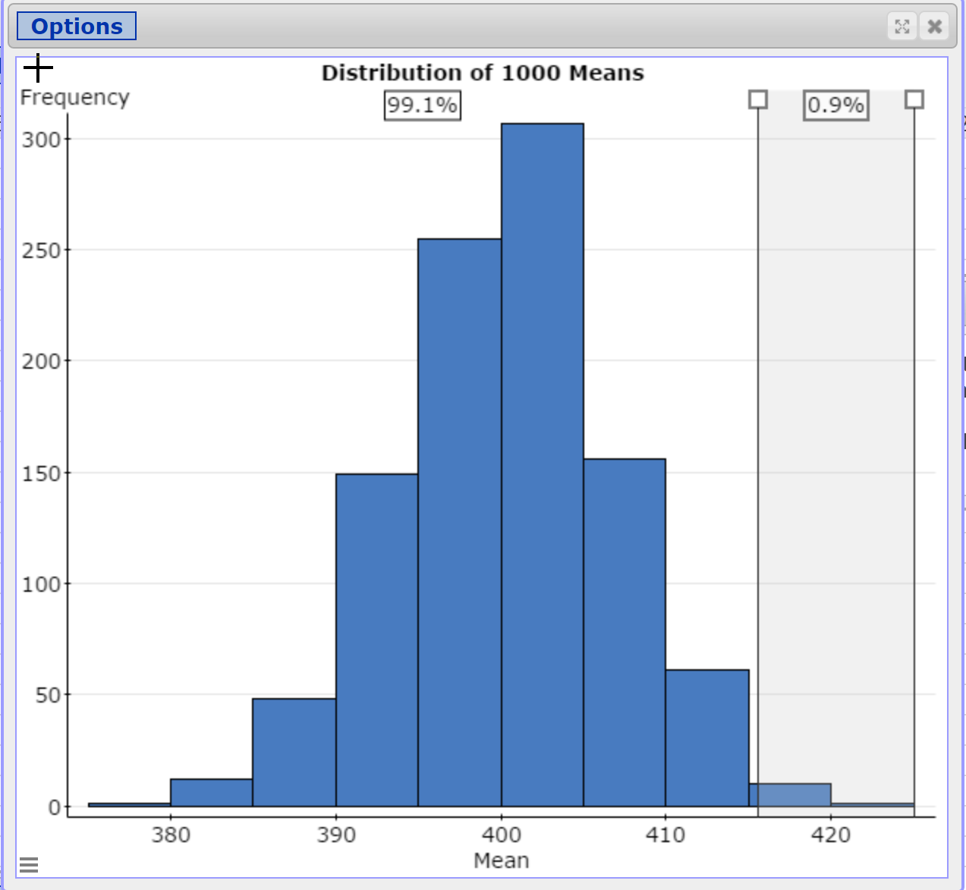
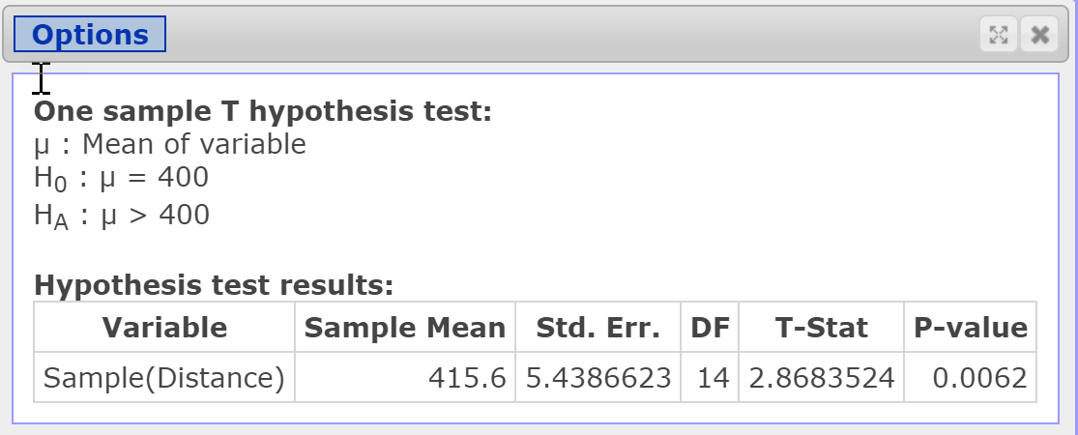
Repeat the Simulation with New Sample Data

Slide 21
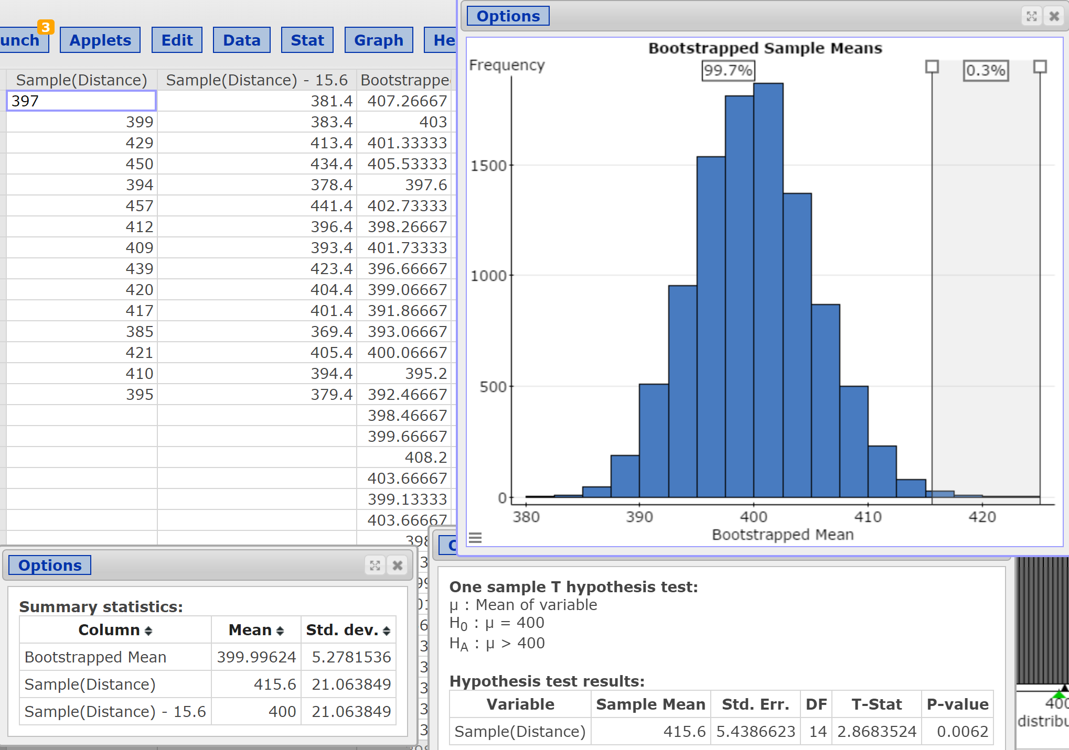
Bootstrap of New Data

