Slide 1
Co-Requisites
Michael Sullivan
sullystats@gmail.com msulliva@jjc.edu www.sullystats.com

Slide 2
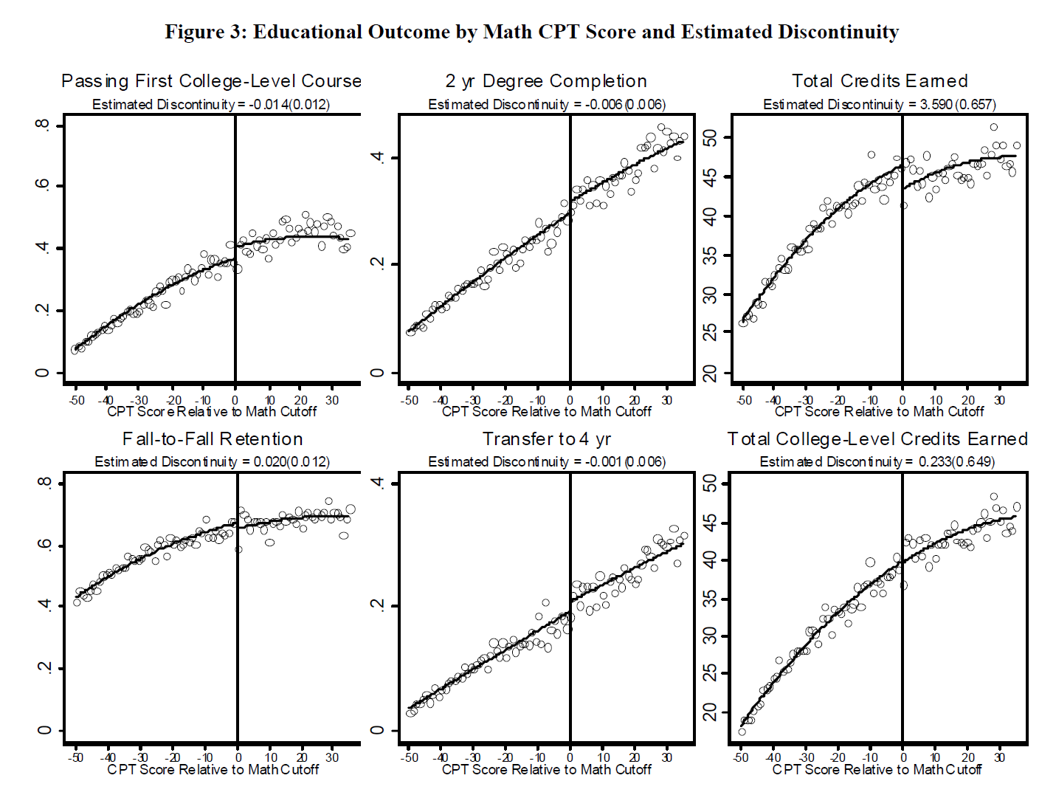
What’s the problem?
Notes:
A study by Calcagno showed that students who placed just below the cut-off score needed to enroll in college-level math actually had pass rates below those who placed slightly higher than the cut-off. These students do not differ much in terms of ability based on their placement scores, so one would think the dev math course would improve (or at least not hurt) their chances of passing college level math. Not so. Notice the discontinuity in the graphic in the upper left corner.
However, placement into dev math increases fall-to-fall retention, but decreases transfer to 4 year schools. Thoughts on this?
Of course, total credits earned is higher at the cut-off, but college credits earned is not.

Slide 3
What’s the problem – placement exams

Slide 4
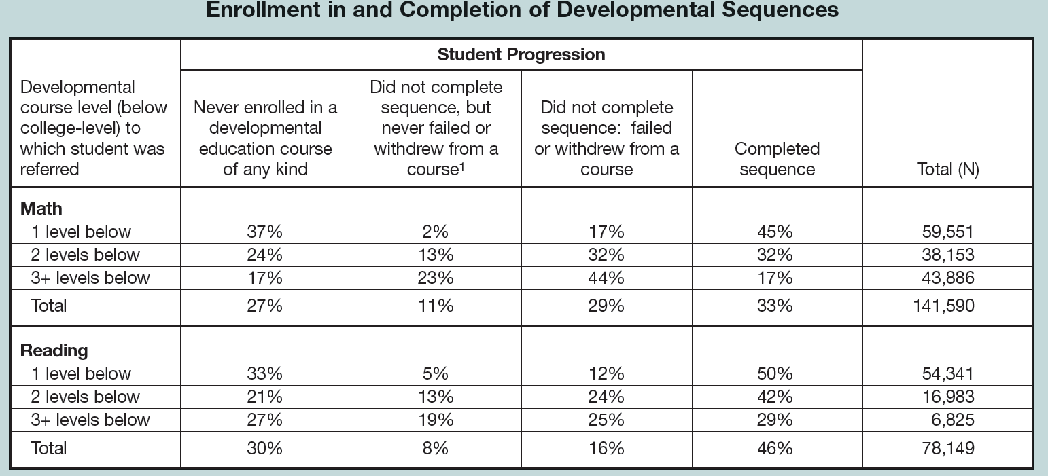
Notes:
Among students who place into a developmental math sequence, only 33% complete the sequence.
29% of all students exited the sequence after failing or withdrawing, 11% exited the sequence even though they did not fail or withdraw.
Overall about 2 of every 3 students do not complete the sequence because they never enroll, don’t complete but never fail, or do not complete because fail/withdraw.
This is data from Achieving the Dream colleges.
From: Bailey at the Community College Research Center
Bailey, T. (2010) Student Progression Through Developmental Sequences in Community Colleges Community College Research Center

Slide 5
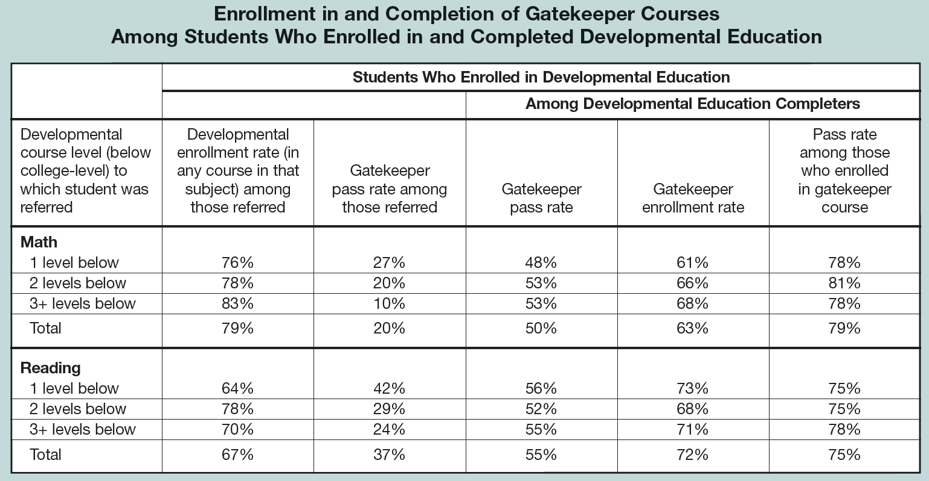
Notes:
only 20% of students who placed into a developmental math course successfully completed the corresponding college level (so-called gatekeeper) course. Of course, the more dev math one has to take, the less likely you are of passing the gatekeeper course.
1 Level Below in Math: 27% of students who complied with the placement results ended up completing a college level math. Wow!
2 Levels: 20%
3+ Levels: 10%
Encouraging that once a student completes the dev math sequence, the pass rate is high (79%).

Slide 6
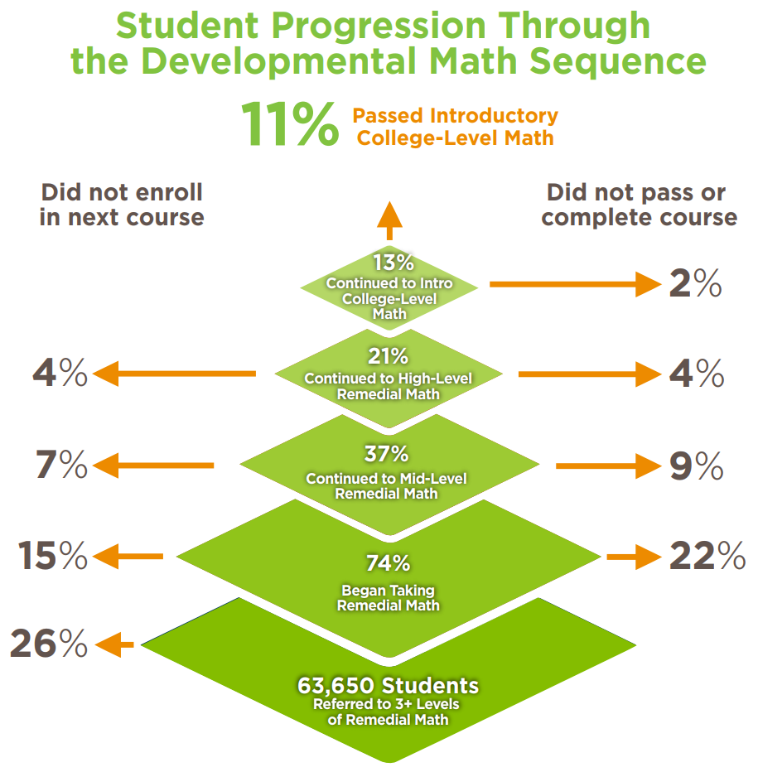
What’s the problem?
Source: Community College Research Center's What We Know About Developmental Education Outcomes.

Slide 7
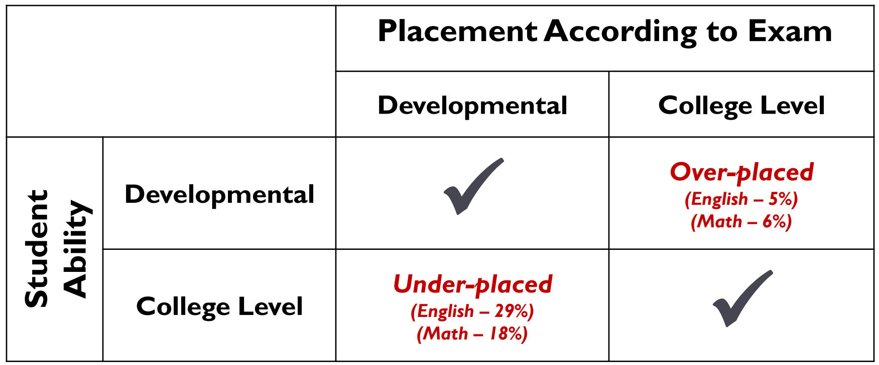
Incorrect placement
https://ccrc.tc.columbia.edu/media/k2/attachments/moving-beyond-placement-test-multiple-measures.pdf
Notes:
Use of HS GPA tends to be the best single predictor of success in college level mathematics

Slide 8
What’s the Problem?
The Data from Complete College America
Notes:
Show percentage of students who complete the degree in 100% time; 150% time
Click Time and Credits to Degree
Show Gateway Success

Slide 9
Potential Solutions
Emporium-Style Remediation
Modules – only present material needed by student
Developmental Math over multiple semesters
Boot Camps to Improve Scores on Placement Test
Aligned Pre-requisite Courses
Co-Requisites
Notes:
aligned prerequisites,” e.g., requiring future statistics students to take a pre-stats course rather than Intermediate Algebra.

Slide 10
Problem with emporium
Notes:
Even

Slide 11
Problem with emporium

Slide 12
What Is Co-Requisite Remediation?
Co-requisite remediation is an approach to developmental education that places students in entry-level college courses while they simultaneously receive remedial academic support.

Slide 13
Why Co-Requisite?
City University of New York
Complete College America Report includes Case Studies from states that have implemented co-requisite models and a blueprint for developing a co-requisite model.
Notes:
Students were randomly assigned to one of the three course types (Group 1: traditional elementary algebra, Group 2: traditional elementary algebra plus a weekly workshop, or Group 3: college-level, credit-bearing, introductory statistics plus a weekly workshop)
Pass Rates
Group 1 38%
Group 2 45%
Group 3 56%
Typical pass rate for Elementary Stats is 69%

Slide 14
Tennessee Community Colleges Gateway Math Success in One Year
Tennessee Board of Regents Brief #3: Co-requisite Remediation Full Implementation 2015-16

Slide 15
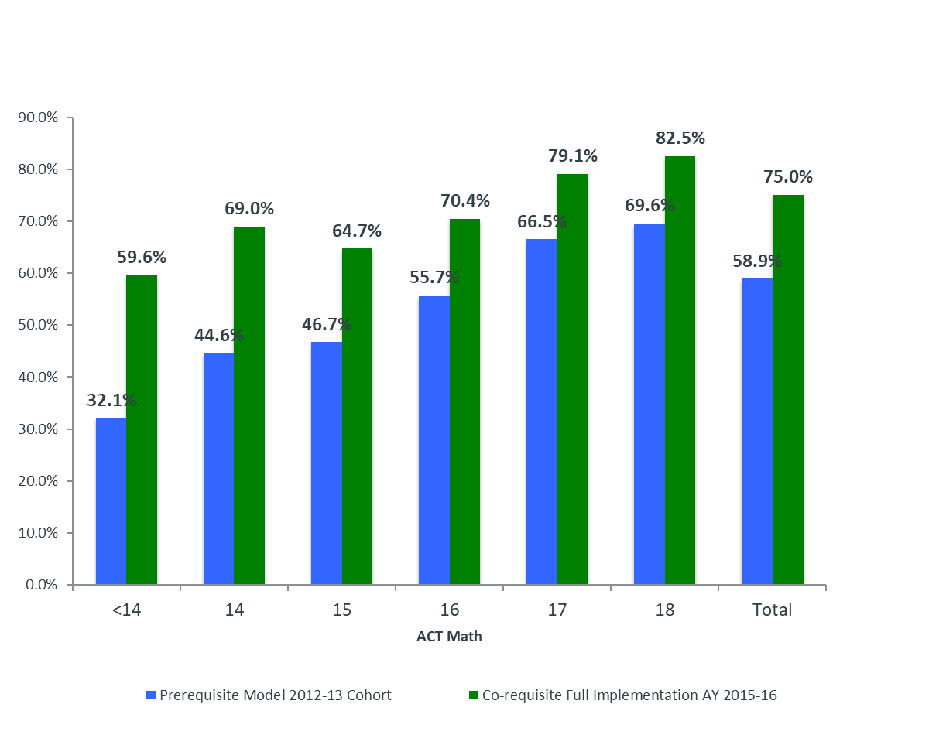
Tennessee Universities Gateway Math Success in One Year
Tennessee Board of Regents Brief #3: Co-requisite Remediation Full Implementation 2015-16

Slide 16
Cost Effectiveness
Whole report at
http://ccrc.tc.columbia.edu/publications/corequisite-remediation-cost-effective-tennessee.html

Slide 17
Specific Co-Requisite Models
Southeast Missouri State University
Western Kentucky Community & Technical College
Jackson State Community College (TN)
Joliet Junior College
Notes:
Be sure to mention the various types of Co-Reqs that exist (sequential/simultaneous) Heterogenous/Homogeneous

Slide 18
Southeast Missouri State University

Slide 19
Southeast Missouri State University

Slide 20
Southeast Missouri State University

Slide 21
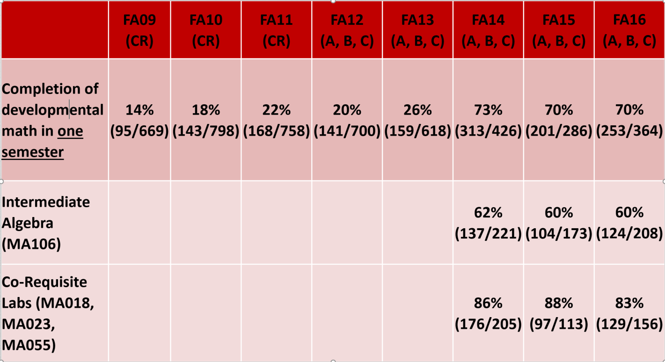
Southeast Missouri State University

Slide 22
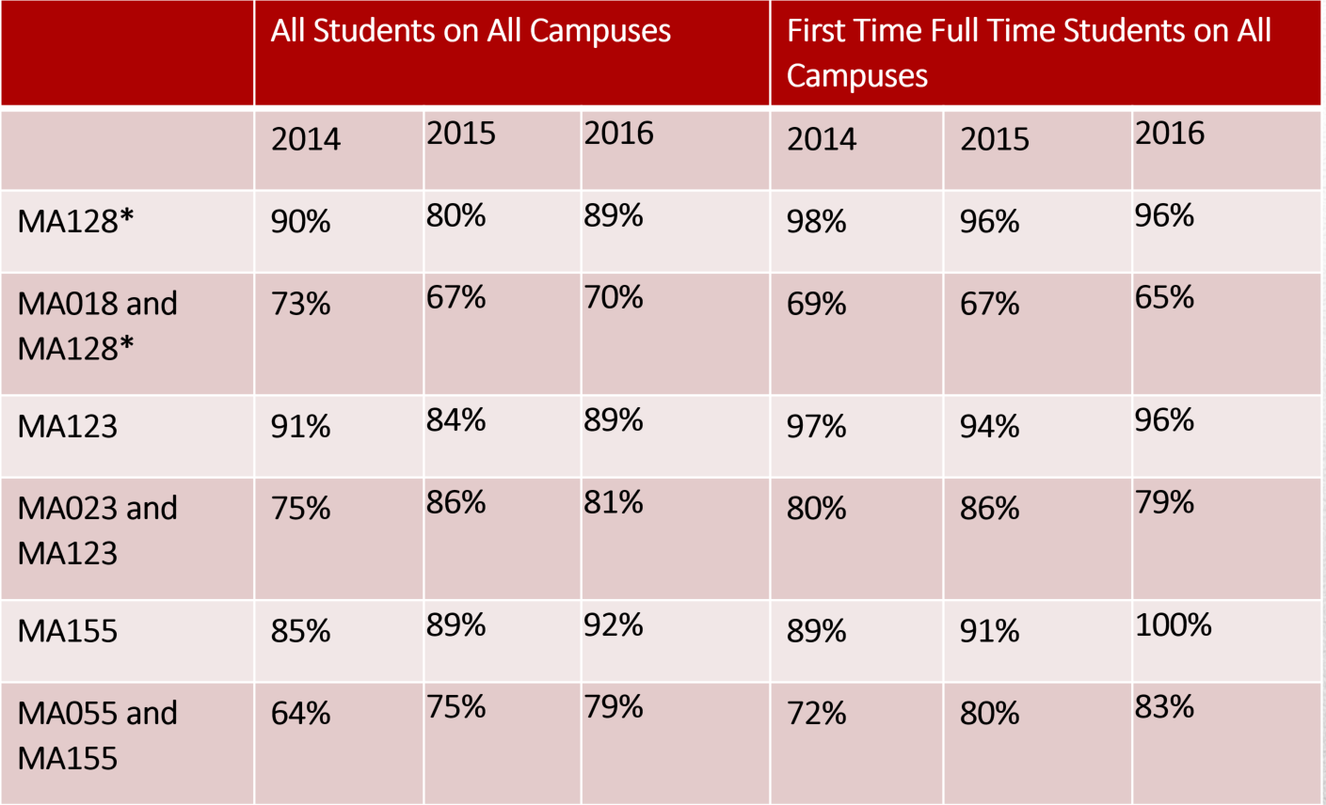
Southeast Missouri State University
Notes:
Math 128 – Number and Operations for Educators (Elem Ed Majors)
Math 123 – Survey of Mathematics (LAS Majors)
Math 155 – Statistical Reasoning

Slide 23
Western Kentucky Community and technical College
Notes:
Four levels of Math depending on ACT Math Score:
< 17 Enroll in Basic Algebra
17 – 18 Math150/100 with AY! Plus one supplemental hour with study coach
19 – 21 Math 100/150 with AY!
21 Traditional College Algebra
Math 100 (Workshop) and corresponding Math 150 (College Algebra) course. Same instructor for both 100 and 150.

Slide 24
Western Kentucky Community and technical College

Slide 25
Western Kentucky Community and technical College

Slide 26
Western Kentucky Community and technical College

Slide 27
Western Kentucky Community and technical College

Slide 28
Jackson State
Single co-req for Liberal Arts Math, Stats, and Bridge Math
Co-Req has S/U grade.
Notes:
Students may earn a “U” in co-req while passing college level. Prior to this policy students would automatically get S credit in co-req if they passed the college level course. This policy changed because students were not adequately prepared for courses which required math proficiency. Plus, some instructors were “blowing off” the co-req lab. If a student earns a U in co-req, they must retake and are blocked from taking any courses that requires the co-req course (such as Chem, Bio, some business).

Slide 29
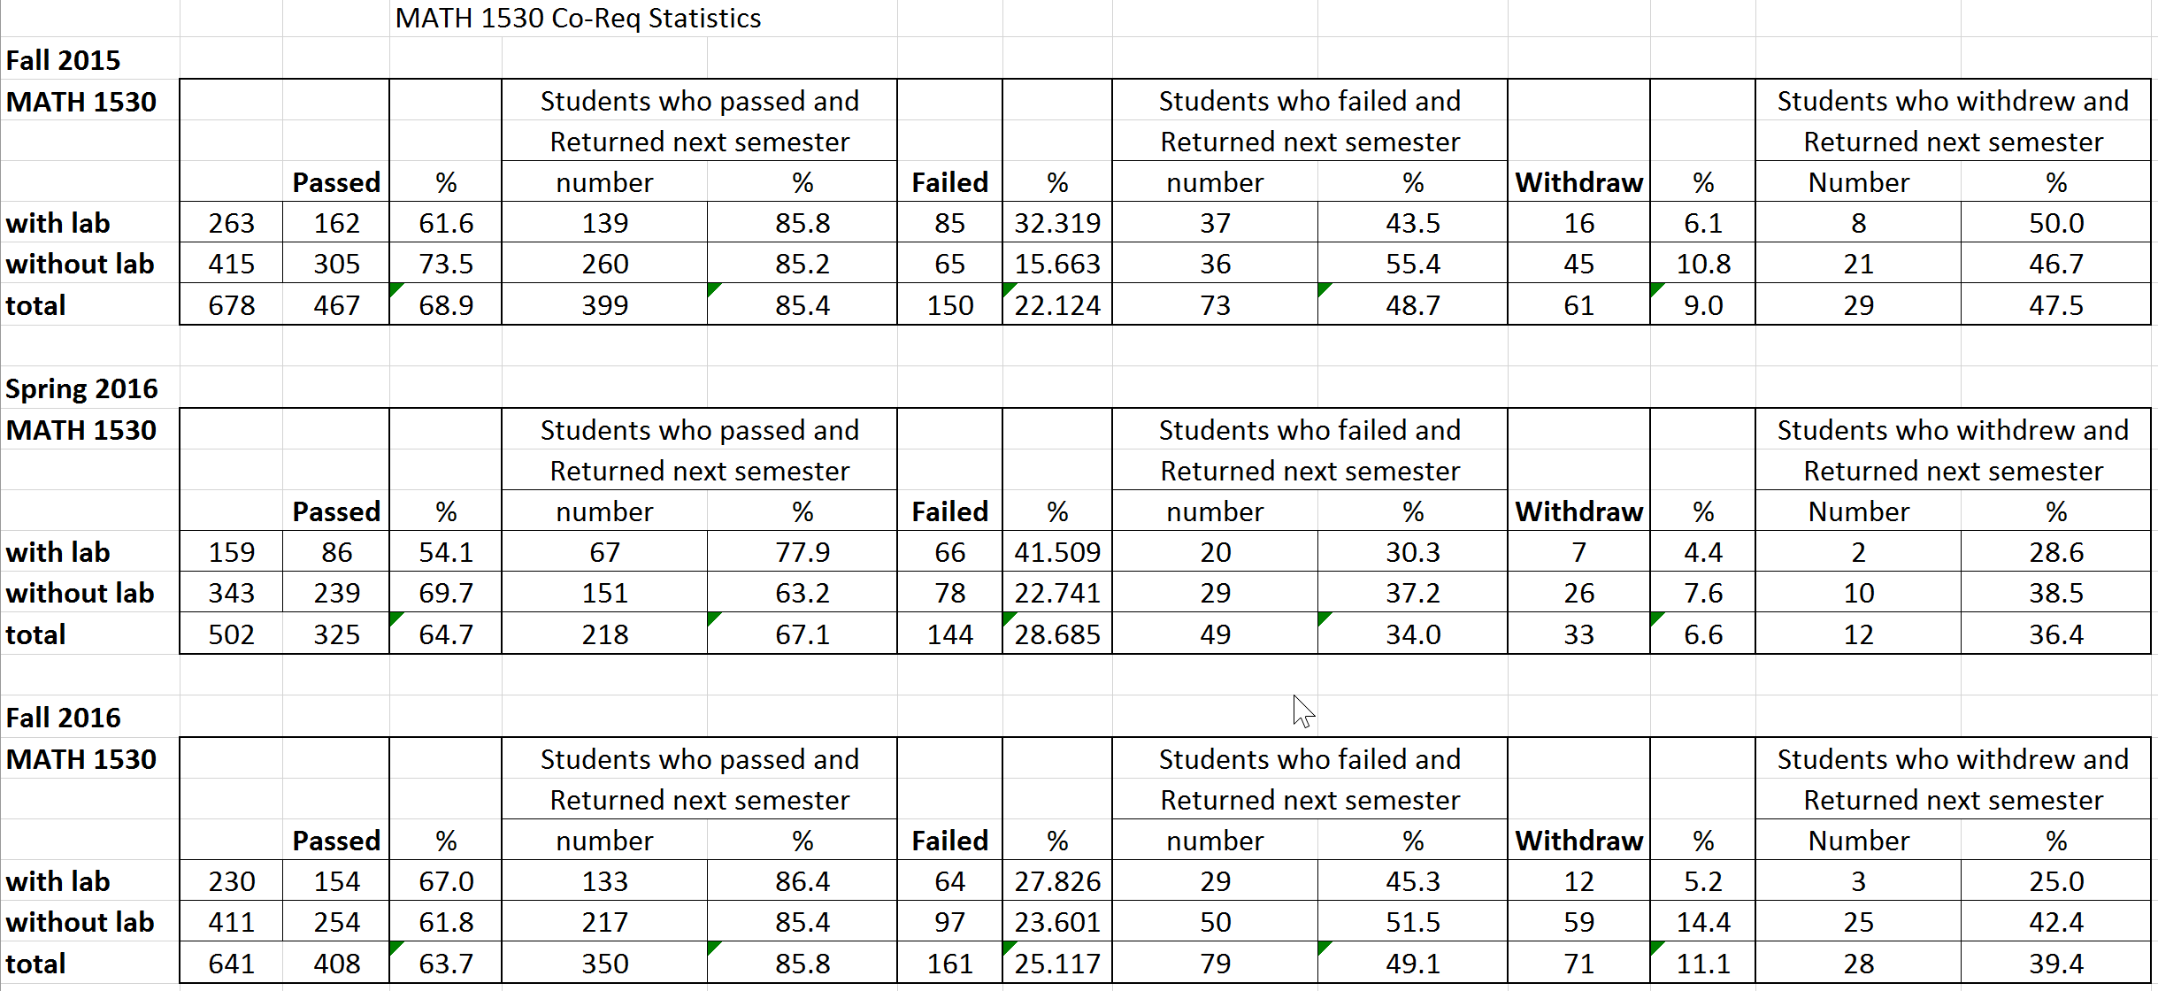
Jackson State Results

Slide 30
Roane State Results

Slide 31
Joliet Junior College
One hour supplementary instruction.
Each section has only co-req students.
Elementary Algebra pre-requisite.
Just added an 8-week Intermediate Algebra followed by 8-week College Algebra.

Slide 32
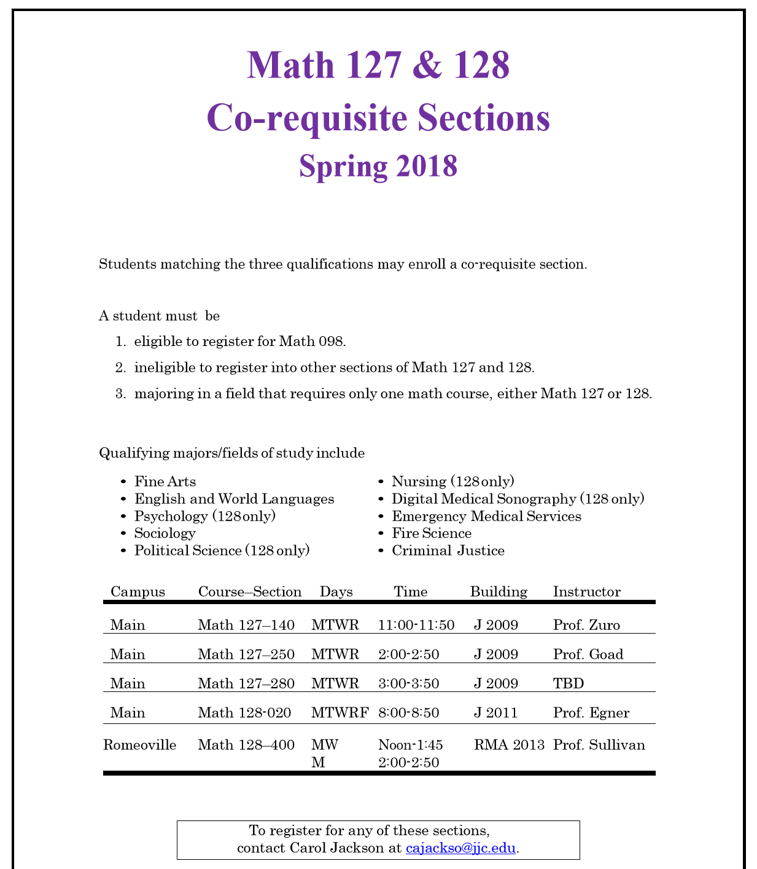

Slide 33
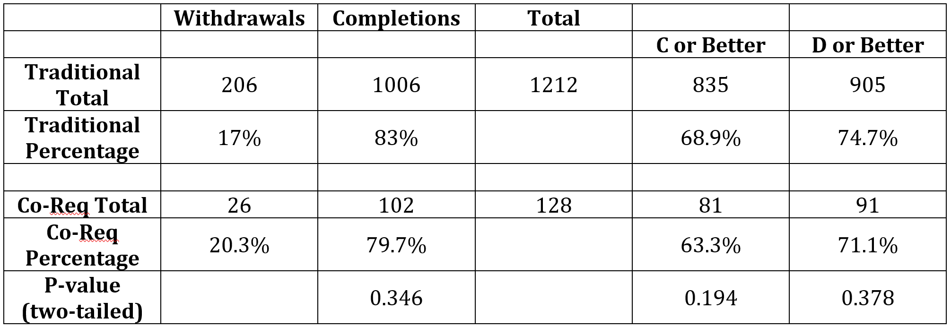
Results at JJC (Elementary Statistics) Fall, 2016 thru Fall, 2017

Slide 34
Results at JJC (Math for Liberal Arts) Spring, 2017 thru Fall, 2017

Slide 35
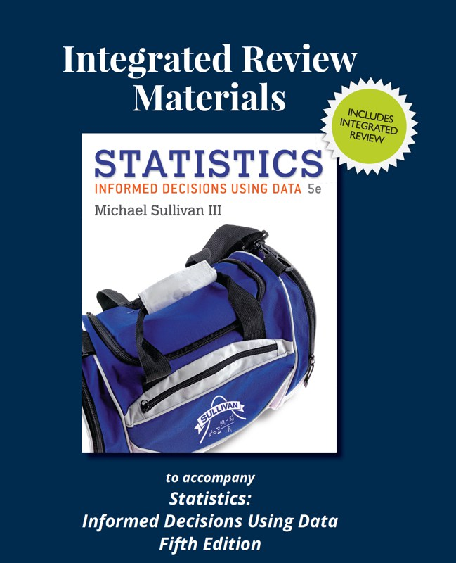
Integrated Review
Notes:
Page IR64 (1.IR7)
1.IR8
2.IR2 (page IR81, #51 and #83)
2.IR3
3.IR5 (Objective 3)

Slide 36
College Algebra co-req (using Enhanced with graphing utilities and Algebra Review)
showcase69858
showcase42395

Slide 37
Best Practices of a co-req
Attempt for low student-teacher ratio in the co-req course
Same instructor for both co-req section and college-course section
Avoid the heterogenous model. Compare to homogenous model, heterogenous had
Lower pass rates in subsequent college-level courses
A 3 percent decrease in persistence
A decrease of 0.5 courses completed
A decrease of 1.5 college credits earned
Source: Sung-Woo Cho, Community College Research Center

Slide 38
A Challenge of Co-Req: Tennessee Community Colleges
52% of students passed both courses
Earned hours as a percentage of attempted hours
3% of students passed only the credit course
36% of students failed both courses
Adapted from TBR Brief #3: Co-requisite Remediation Full Implementation 2015-16
Notes:
Let’s look a little closer at the successes and the failures.
Show main slide.
Note that the orange line indicates students who passed both the college-level course and the co-requisite support course.
Indicate the vertical axis label on the left. Students who passed both courses passed an average of 85% of their attempted hours.
Note that this is steady across all ACT scores.
Note that the blue line indicates students who FAILED both the college-level course and the co-requisite support course.
Indicate the vertical axis label on the left. Students who FAILED both courses passed an average of only about 20% of their attempted hours.
Note that this is steady across all ACT scores.
How many students are represented by each line?
52% of all co-requisite students passed both courses.
3% of students passed only the credit course (which combines to make the 55% total on the previous slide)
36% of all students failed both courses (and failed almost all of their courses).
There’s something more going on here that needs to be addressed separately – how to support students with multiple issues.
(FYI to facilitator – 3 percent passed college-level but failed the support course. 9% passed the support course but failed college-level.)
This is cc data but the percentages are similar for the university students. Bottom Line: Students who fail the college-level course and the support course tend to fail almost all of their courses – regardless of ACT score. This suggests the students are not “College Ready” as opposed to “Academically Ready”

Slide 39
College ready versus academically ready

