Slide 1
Using Simulation to Enhance Statistical Understanding
Michael Sullivan
Joliet Junior College
sullystats@gmail.com msulliva@jjc.edu www.sullystats.com

Slide 2
Randomness
The word random suggests an unpredictable result or outcome.
Three types of randomness are presented in Introductory Statistics
Random selection
Random assignment
Random process
Notes:
Random selection is where we randomly select individuals from a population and use these individuals to make judgements about a population.
Random assignment is where individuals who represent a group we want to study (such as those with alopecia) and randomly assign them to one of k treatment groups. Random assignment allows us to make statements of causality between the treatments and the response variable.
A random process represents scenarios where the outcome of any particular trial of an experiment is unknown, but the proportion (or relative frequency) a particular outcome is observed approaches a specific value.
Predicting outcomes in the face of uncertainty is a challenge. For example, it would be difficult to predict the outcome of a coin flip on a regular basis. However, over many flips, we may determine a long-run proportion of times we observe a head. The process of flipping a coin many times and recording the outcome is an example of a random process.

Slide 4
Random Selection
https://data.cityofchicago.org/
Go to Administration & Finance
Download the Salary Report
File Contains Salaried and Hourly Employees
Extract only the salaried employees
Find the population mean salary
Have each of your students find a simple random sample of n = 12 employees. What is the sample mean? Great discussion ensues regarding the fact that students are getting different results.
Find a second simple random sample of n = 12 employees. What is the sample mean?
Find 2000 SRS of size n = 12 and compute the sample mean of each. Draw a histogram.
Notes:
In StatCrunch, select Export. Export Columns of Variables we want Where “Salary or Hourly” = Salary

Slide 5
StatCrunch
Open the data “ChicagoSalaries” in StatCrunch (join the SullyStats group).
Data > Sample Select “Annual Salary” Enter 12 for Sample Size. Enter number of samples desired. If taking multiple samples, select the “Stacked with sample id” radio button. Decide on a dynamic or fixed seed. Check the box “Open in new data table”. Click Compute!
Stat > Summary Stats > Columns Select Sample(variable name). Group by” Sample. Choose the statistic you wish to compute (such as Mean). Check the box “Store in data table.” Click Compute! Note: StatCrunch may say “Whoa! Lots of data…” Click Cancel (do not bin the data).
Draw histograms of the sample means to show the variability. Note: To illustrate the properties of the random variable “xbar”, you could do things like find the mean and standard error of xbar and compare to the theoretical values.

Slide 6
Example of a Random Process
Red Light

Slide 7
The Law of Large Numbers
versus
The “Nonexistent” Law of Averages

Slide 8
Notes:
Video 4 (Section 5.1)

Slide 9
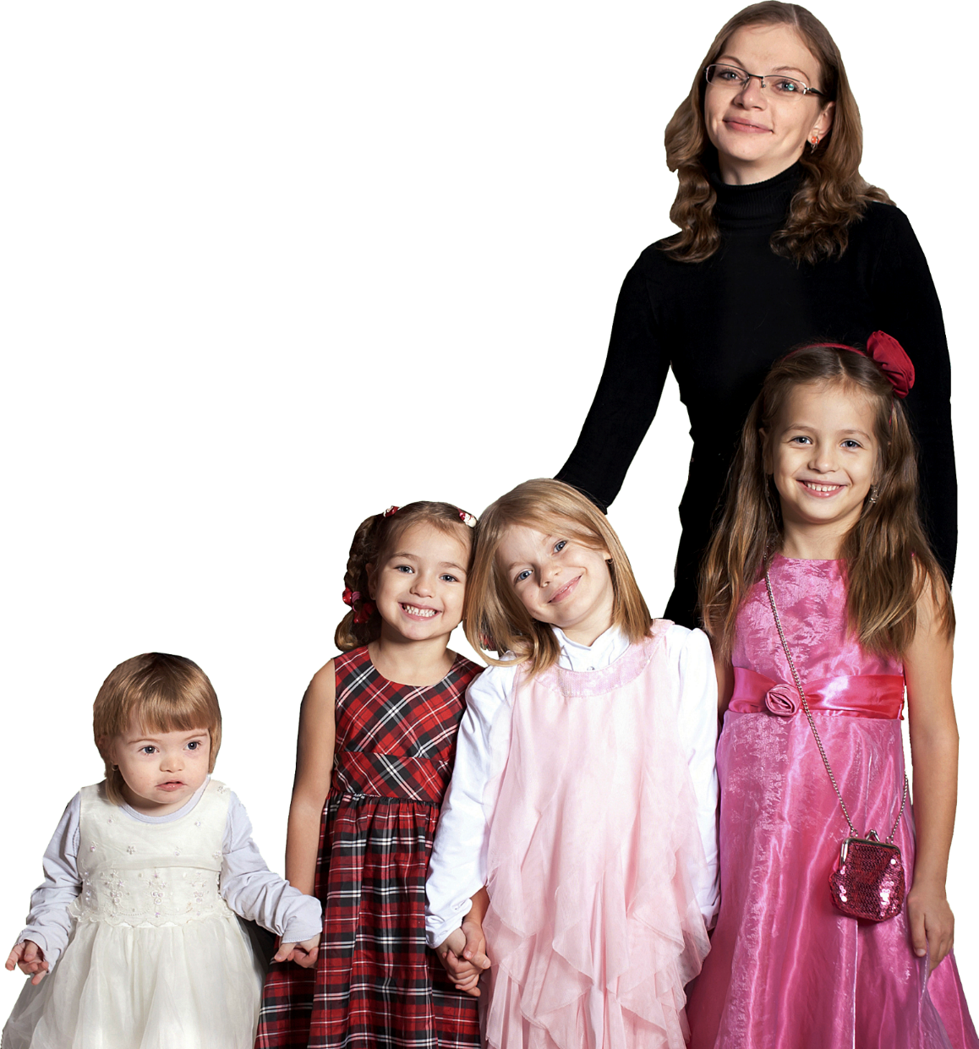
Notes:
Video 4 (Section 5.1)

Slide 10
StatCrunch
Open a StatCrunch spreadsheet.
Data > Simulate > Bernoulli
Enter the number of rows to generate (say 10,000 for 10,000 families). Enter 5 for columns (five children). Enter 0.5 for p. Decide on a dynamic or fixed seed. Click Compute!
Stat > Summary Stats > Rows Highlight Bernoulli1 thru Bernoulli4. Select “Sum” under Statistics. Check the box “Store in data table.” Click Compute!. Rename the column Girls.
Stat > Tables > Frequency Highlight Bernoulli5. Type “Girls = 4” in the Where box. Click Compute!

Slide 11
In a random process, the trials are memoryless.
Notes:
Many people believe in the fallacy of being “due for a hit” or “due for a boy”. We can use simulation to help folks see this is not a law at all.

Slide 12
Random Selection
Unplugging refers to eliminating the use of social media, cell phones, and other technology. According to Harris Interactive, the proportion of adult Americans (aged 18 or older) who attempt to “unplug” at least once a week is 0.45. There are approximately 241,000,000 adult Americans in the United States.
(a) Simulate obtaining a simple random sample of size 500 from the population of adult Americans. How many of the individuals sampled unplug? How many do not unplug? What proportion unplug at least once a week?
Notes:
When collecting data for an observational study, it is important that the individuals are randomly selected. This allows the results of the study to be extended to the population from which the individuals were randomly selected. Contrast this with collecting data for a designed experiment, where the individuals are randomly assigned to various treatment groups. Random assignment allows the researcher to make statements of causality. This example allows students to see the role of randomness in selecting individuals to be in a study.

Slide 13
Random Selection
(b) Simulate obtaining a second simple random sample of size 500 from the population of adult Americans. How many of the individuals sampled unplug? How many do not unplug? What proportion unplug at least once a week?
(c) Now simulate obtaining at least 2000 more simple random samples of size 500 from the population. Based on the simulation, what is the probability of obtaining a random sample where the proportion who unplug at least once a week is greater than 0.50?

Slide 14
StatCrunch
The Urn Applet
Select Applets > Simulation > Urn sampling
Decide on the color ball for Type 1 and the number of balls for Type 1; decide on the color ball for Type 2 and the number of balls for Type 2. Under Sampling, determine the number of balls to select. Under Tally type, decide if you want to track the number of Type 1 balls or proportion of Type 1 balls. Click Compute!

Slide 15
Sampling Distribution of the Slope
Find the least-squares regression model using the home run data treating speed off bat as the explanatory variable and distance as the response variable.
Find 1000 different SRS of size n = 15 for these data.
Find the least-squares regression model for each of the 1000 SRS.
Graph the distribution of the estimates of the slope. What is the mean of the 1000 different slopes?
Notice the slope standard error for each sample. Draw scatter diagrams of those with small standard errors versus large.

Slide 16
StatCrunch
Open “HomeRuns2017” in StatCrunch.
Stat > Regression > Simple Linear X-var: SpeedOffBat; Y-var: Distance Click Compute!
To find random samples: Data > Sample Select Distance & SpeedOffBat Enter a sample size (15) and number of samples (1000). Check the box “Sample all columns at one time” [this keeps the exp and response var together]. Select “Stacked with sample id” and check the box “Open in a new data table”. Click Compute!
Stat > Regression > Simple Linear X-var: Sample(SpeedOffBat); Y-var: Sample(Distance) Group by: Sample Be sure to save Model estimates. Click Compute!
Explore the regression coefficients. Draw a histogram or find the mean of the slope estimates.

Slide 17
The Normal Model
http://www.hittrackeronline.com/
Download all home runs hit in 2017
Draw a histogram of the variable “Distance” What is the shape?
Find the mean and standard deviation of the variable “Distance”.
Use the raw data to find the probability of randomly selecting a home run that travels over 415 feet.
Compare this result to that obtained using the normal model.

