Slide 1
The General’s Dilemma
Michael Sullivan
Joliet Junior College
sullystats@gmail.com msulliva@jjc.edu www.sullystats.com
Notes:
In a normal classroom setting, I would randomly assign Version I to half the students in class and Version II to the other half. Be sure that both versions look identical to the students. Ask them to choose either Route 1 or Route 2.
I recommend that this data be collected on Day 1 of classes. After you discuss data collection techniques, discuss aspects of the process. Role of randomization? Wording of questions. What if you gave Version I to all the students who arrive early and Version II to the later students. Confounding?

Slide 2
Version I
Threatened by a superior enemy force, the general faces a dilemma. His intelligence officers say his soldiers will be caught in an ambush in which 600 of them will die unless he leads them to safety by one of two available routes. If he takes the first route, 200 soldiers will be saved. If he takes the second, there is a one-third chance that 600 soldiers will be saved, and a two-thirds chance that none will be saved. Which route should he take?

Slide 3
Version II
Threatened by a superior enemy force, the general faces a dilemma. His intelligence officers say his soldiers will be caught in an ambush in which 600 of them will die unless he leads them to safety by one of two available routes. If he takes the first route, 400 soldiers will die. If he takes the second, there is a one-third chance that no soldiers will die, and a two-thirds chance that 600 soldiers will die. Which route should he take?
Notes:
Show students both versions. Version I might be called the “Saving Lives” version and Version II the “Deaths” version. Explain why Route 1 might be called the “Risk Averse” (that is, avoid risks to save lives) option and Route 2 the “Risk-Seeking” (choose risk to avoid sure losses) option.
Carefully compare the outcomes of both versions. Notice they are the same. If Route 1 is taken in Version I, 200 (out of the 600) will be saved; if Route 1 is taken in Version II, 400 (out of the 600) will die. If Route 2 is taken in Version II, there is a 1/3 chance that 600 soldiers will be saved; if Route 2 is taken in Version II, there is a 1/3 chance that no soldiers will die.
Bottom line – because both Routes yield the same outcome, we would expect the proportion of individuals who choose Route 1 is the same for both versions.

Slide 4
Data Collection
Use a survey to collect student data

Slide 5
Analysis
The raw data.
Organize the data in a two-way contingency table. Let the row variable represent the version and let the column variable represent the route.
Determine the conditional distribution of route selected by version.
The research objective is to determine if there is a difference in route selected depending upon the version read. Based on this, determine the null and alternative hypotheses.
Using the randomization test for two proportions applet in StatCrunch to approximate a P-value for this hypothesis test. Based on the result, what do you conclude?
Notes:
This analysis is completed based on results obtained from one of my classes.

Slide 6
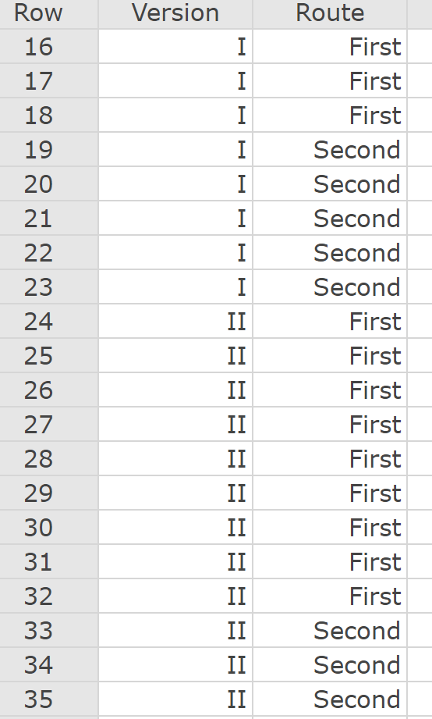
Data
Notes:
This is data from my students.

Slide 7
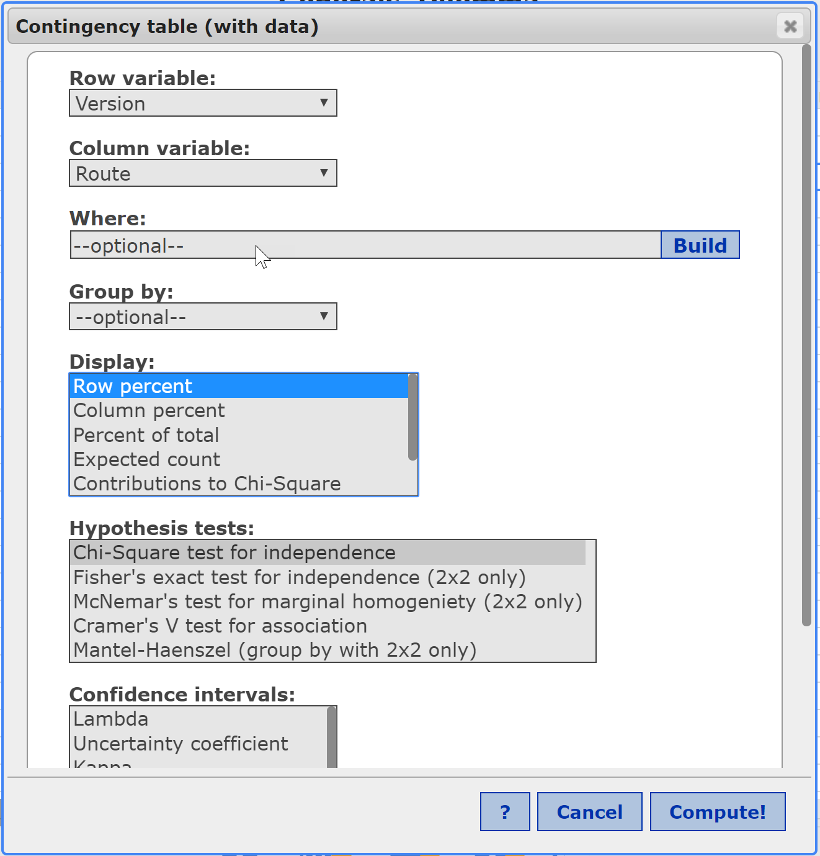
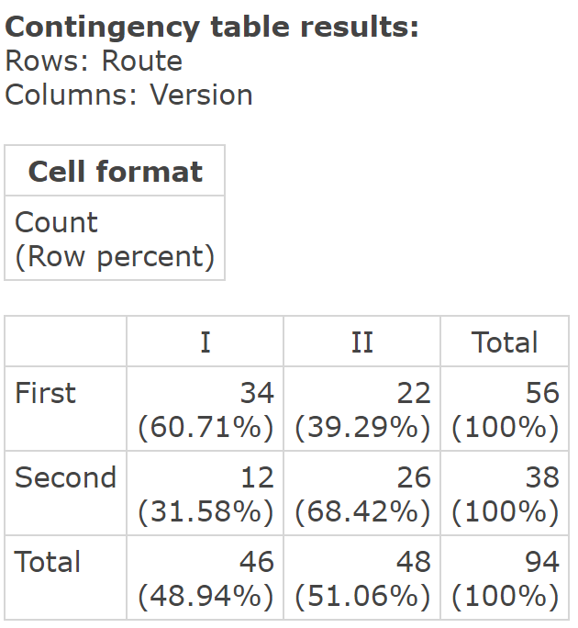
Contingency Table
Notes:
Do this analysis while introducing relations between two qualitative variables.
78.3% of the individuals given Version I question chose Route 1 (save 200 soldiers), while 37.5% of individuals given Version II chose Route 1 (400 die).
Suggests folks would rather see 200 saved than 400 die (although equivalent). Folks tend to be risk averse when presented with options in a more positive light (save), but are risk seeking when presented options in a negative light (death).

Slide 8
Analysis
The difference between those choosing the first route between the two versions of 0.783 - 0.375 = 0.408 seems significant. Is there a difference in the proportion of individuals who chose the first route? Or, is it possible the 27 who chose the first route would have regardless of which version they were given and more of these students ended up with Version I?
(1) the version does not matter and a higher proportion chose the first route with Version I due to chance.
(2) The version does matter and this explains the difference in the proportion choosing the first route.

Slide 9
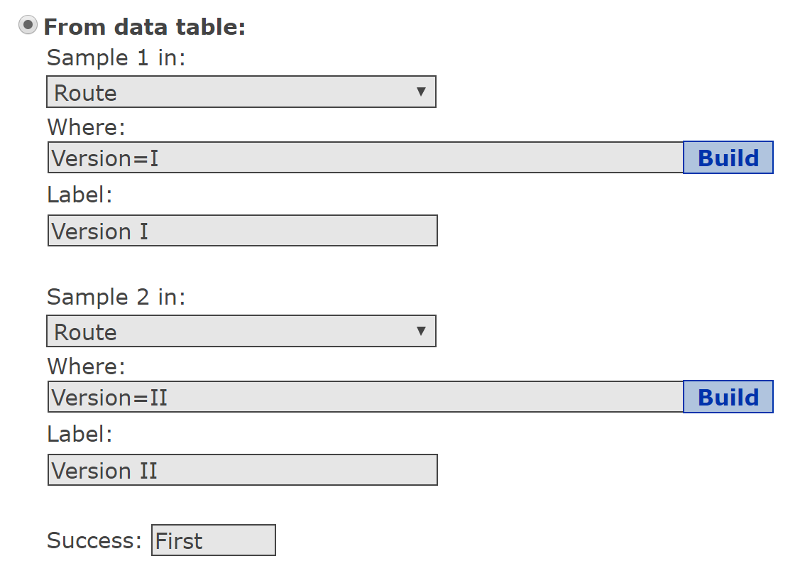
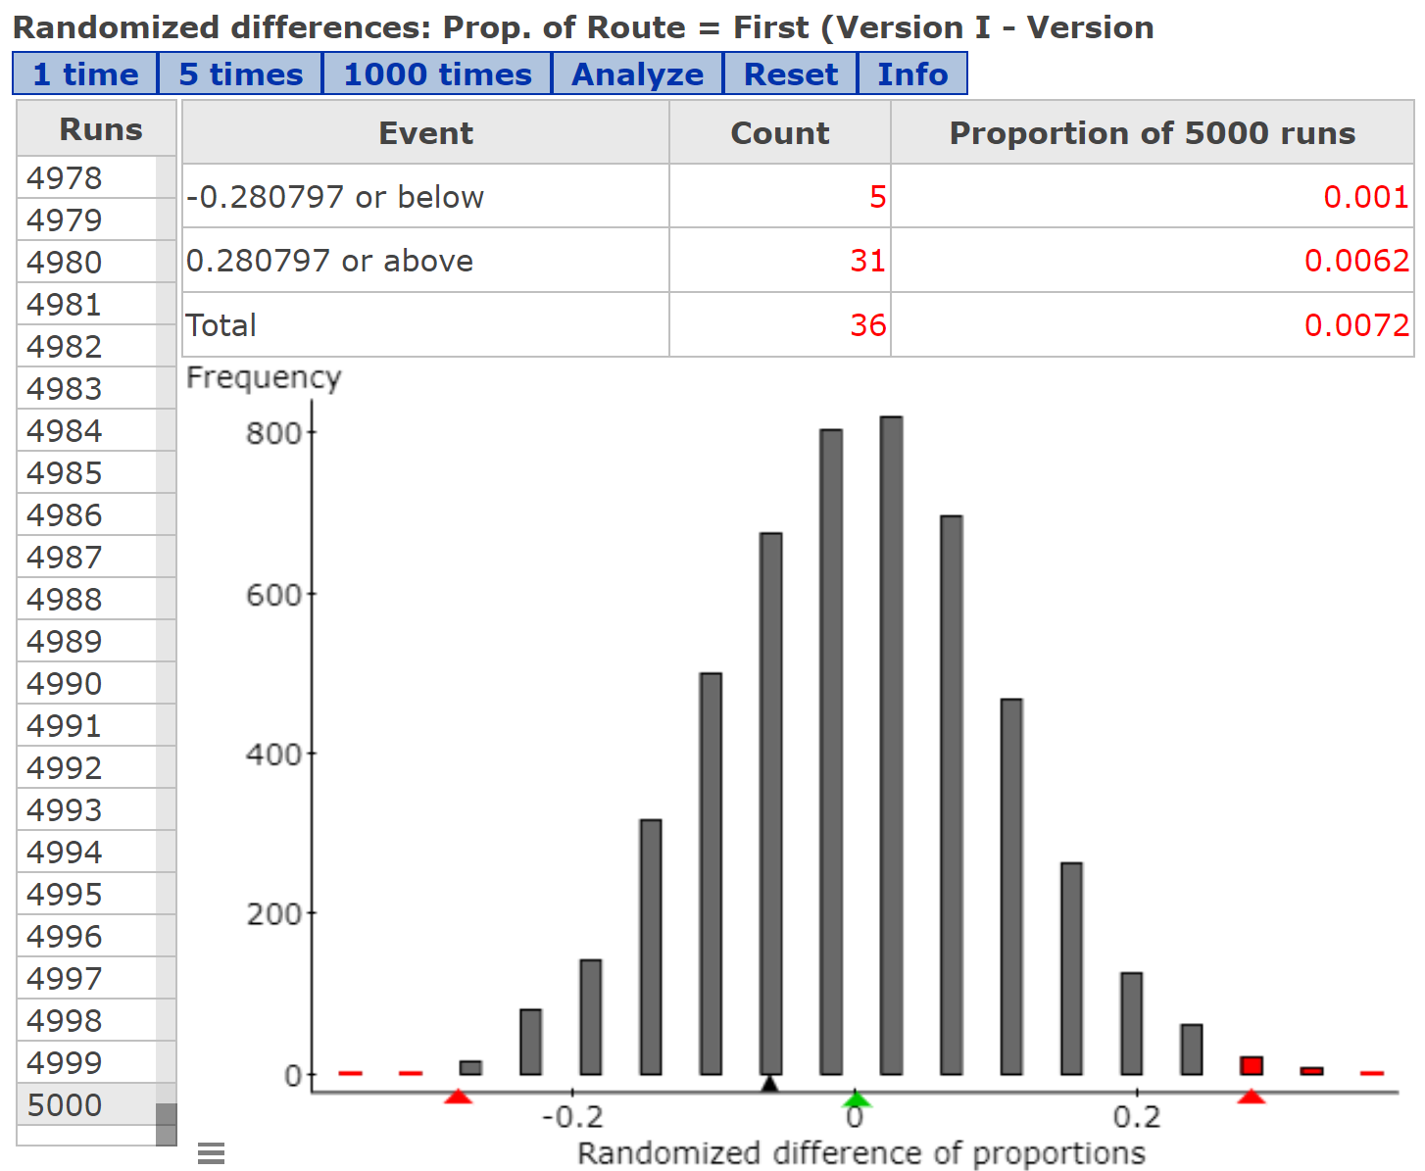
Randomization Test
Notes:
In StatCrunch, select Applets > Resampling > Randomization test for two proportions
Because this is a two-tailed test, do this after introducing randomization with one-tailed tests. If you want, analyze the data from your class only first, then analyze aggregate data, allows for discussion of the role of sample size. Ability to reject the null with small samples.

Slide 10
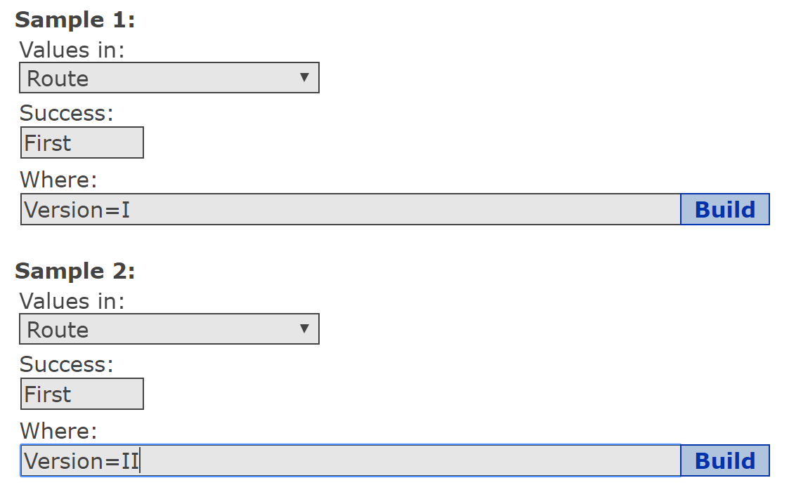
Comparing Two Proportions
Notes:
My data set is small. But you could aggregate data from other classes and then you would likely have enough observations for the normality condition to be satisfied. Then, click “Analyze” from the applet and find the mean and standard deviation. Compare to theoretical values. Also, run the two sample proportion test to find the P-value.
Normality condition not satisfied, but if you had a larger sample size you could compare the randomization method to the P-value using the normal model.

Slide 11
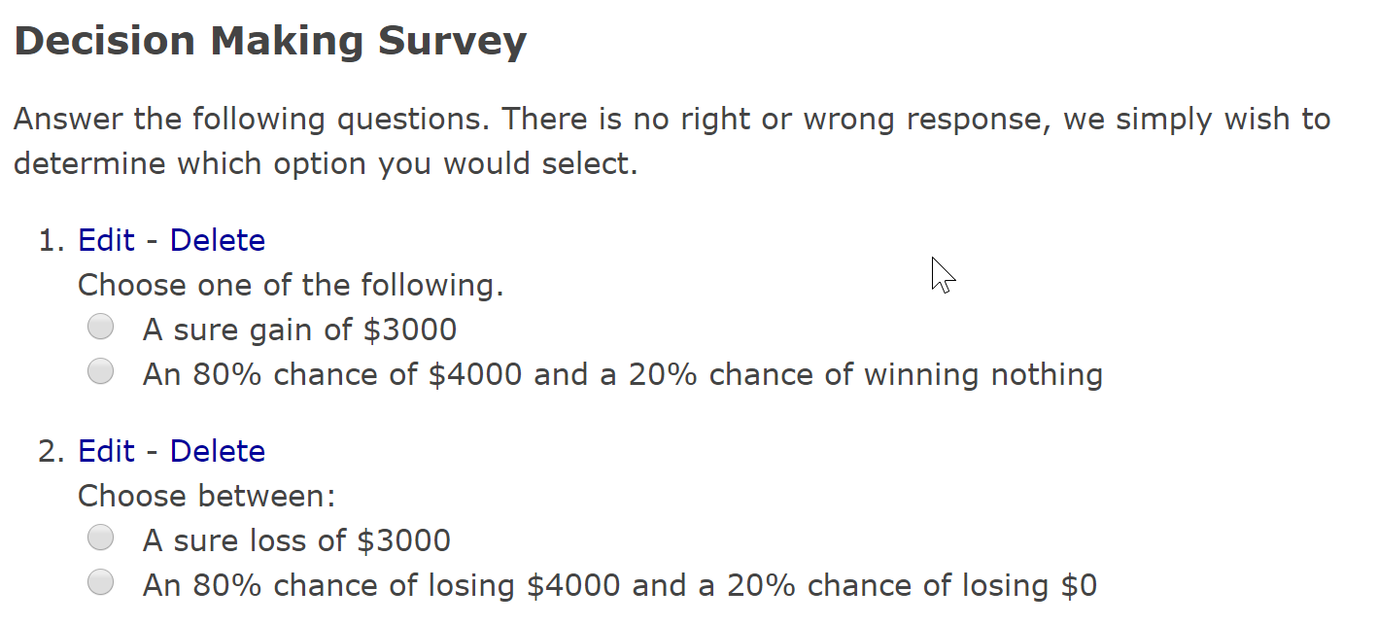
A Follow-Up Study
Notes:
The data for the General’s Dilemma dealt with independent samples. Suppose you happen to assign the Version I version to Risk Averse individuals (arrive to class early; sit in the front). What is the role of confounding? Here is a follow-up study that addresses the same issue, but with a dependent sample.

Slide 12
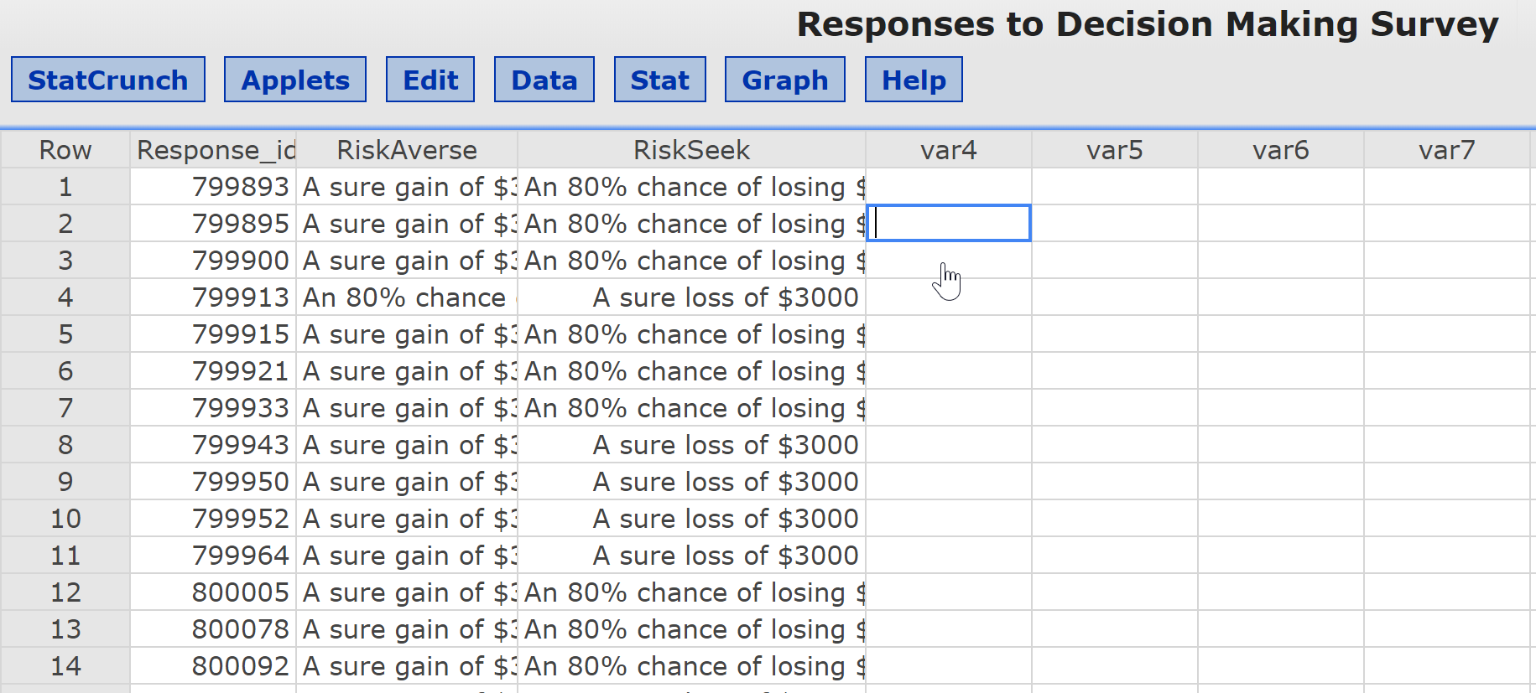
The Data

Slide 13
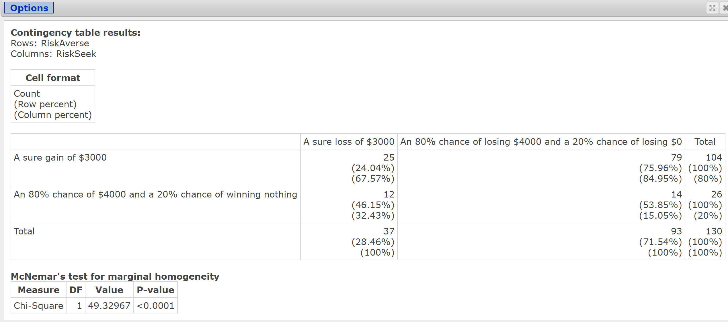
Analysis – McNemar’s Test
Notes:
80% of individuals chose a sure gain of $3000 (risk averse), while only 28.5% chose a sure loss of $3000 (Risk Seeker). This results conforms to the General’s Dilemma. In a positive situation (sure gain of $3000) folks are risk averse; in a negative situation (sure losses), folks are risk seekers.

