Slide 1
Transitioning to a Corequisite statistics model
Michael Sullivan George Woodbury
sullystats@gmail.com georgew@cos.edu
Sullystats.com georgewoodbury.com
Notes:
George – who we are addressing, challenges we face, attempt to address them in ways we teach and the products we have.

Slide 2
How Is Statistics Different?
The GAISE Report
https://www.amstat.org/asa/files/pdfs/GAISE/GaiseCollege_Full.pdf
Notes:
George – ask all instructors to download and read this report. Endorsed by the American Statistical Association and AMATYC.

Slide 3
GAISE Report
Six Recommendations
Teach statistical thinking
Focus on conceptual understanding
Integrate real data with a context and purpose
Foster active learning
Use technology to explore concepts and analyze data
Use assessments to improve and evaluate student learning
Notes:
George -- Emphasize that the text was written with these recommendations at the forefront. It is important to emphasize the use of technology suggests that “by hand” computation be de-emphasized, but also that technology can (and should) be used to develop conceptual understanding (through the use of resources such as applets). Instructors should not attempt to teach Intro Stats as if it was a math class. STATISTICS is NOT MATHEMATICS.

Slide 4
Interactive Statistics 2/e
by
Michael Sullivan, III
George Woodbury
Notes:
Mike – The overall philosophy of this text is “Read a little, watch a little, do a little.” This product may be used to assist adjuncts and professors new to the subject of statistics in learning the material. Many instructors being asked to teach statistics are doing so for the first time. Their only experience with Stats might be their graduate course – we don’t do moment generating functions and maximum likelihood estimators in this course. The intro course is about the process of statistics – from identifying a research objective to data collection to descriptive statistics to inference. The material in the course will get you ready for Day 1, and allow your students to be engaged in learning statistics.

Slide 5
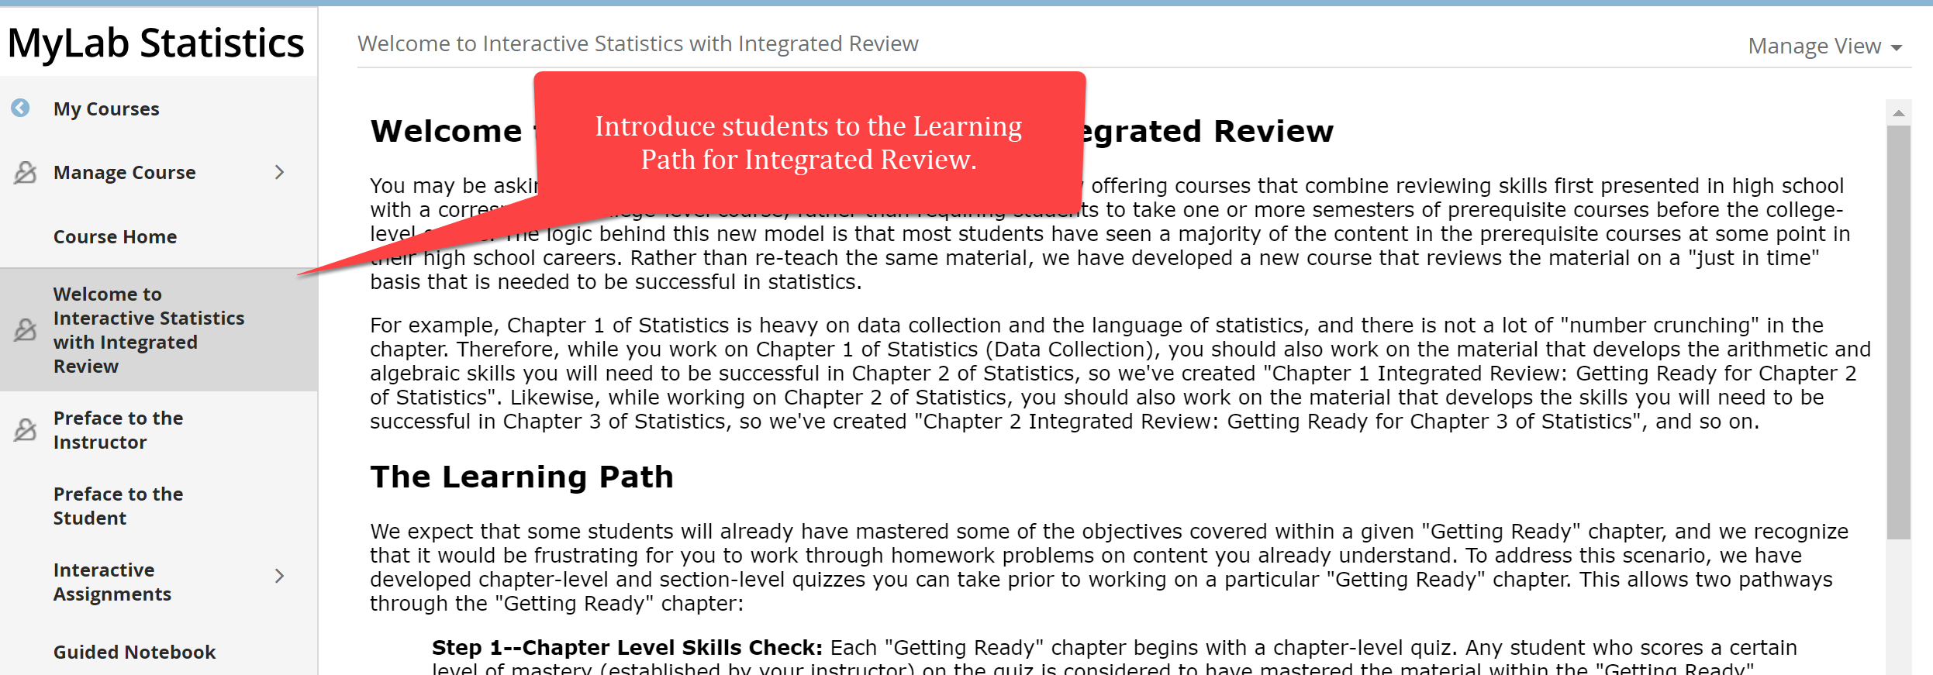
Interactive Statistics 2/e
Notes:
Be sure to have the Interactive Stats w Integrated Review course open.

Slide 6
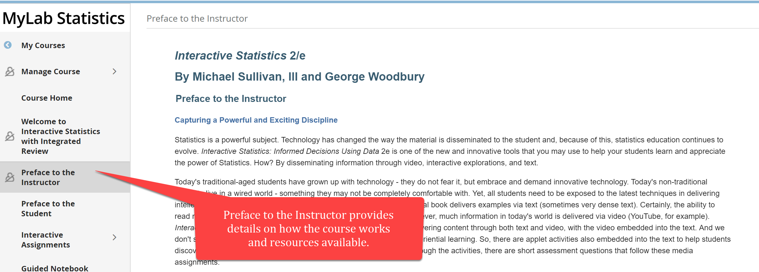
Interactive Statistics 2/e

Slide 7
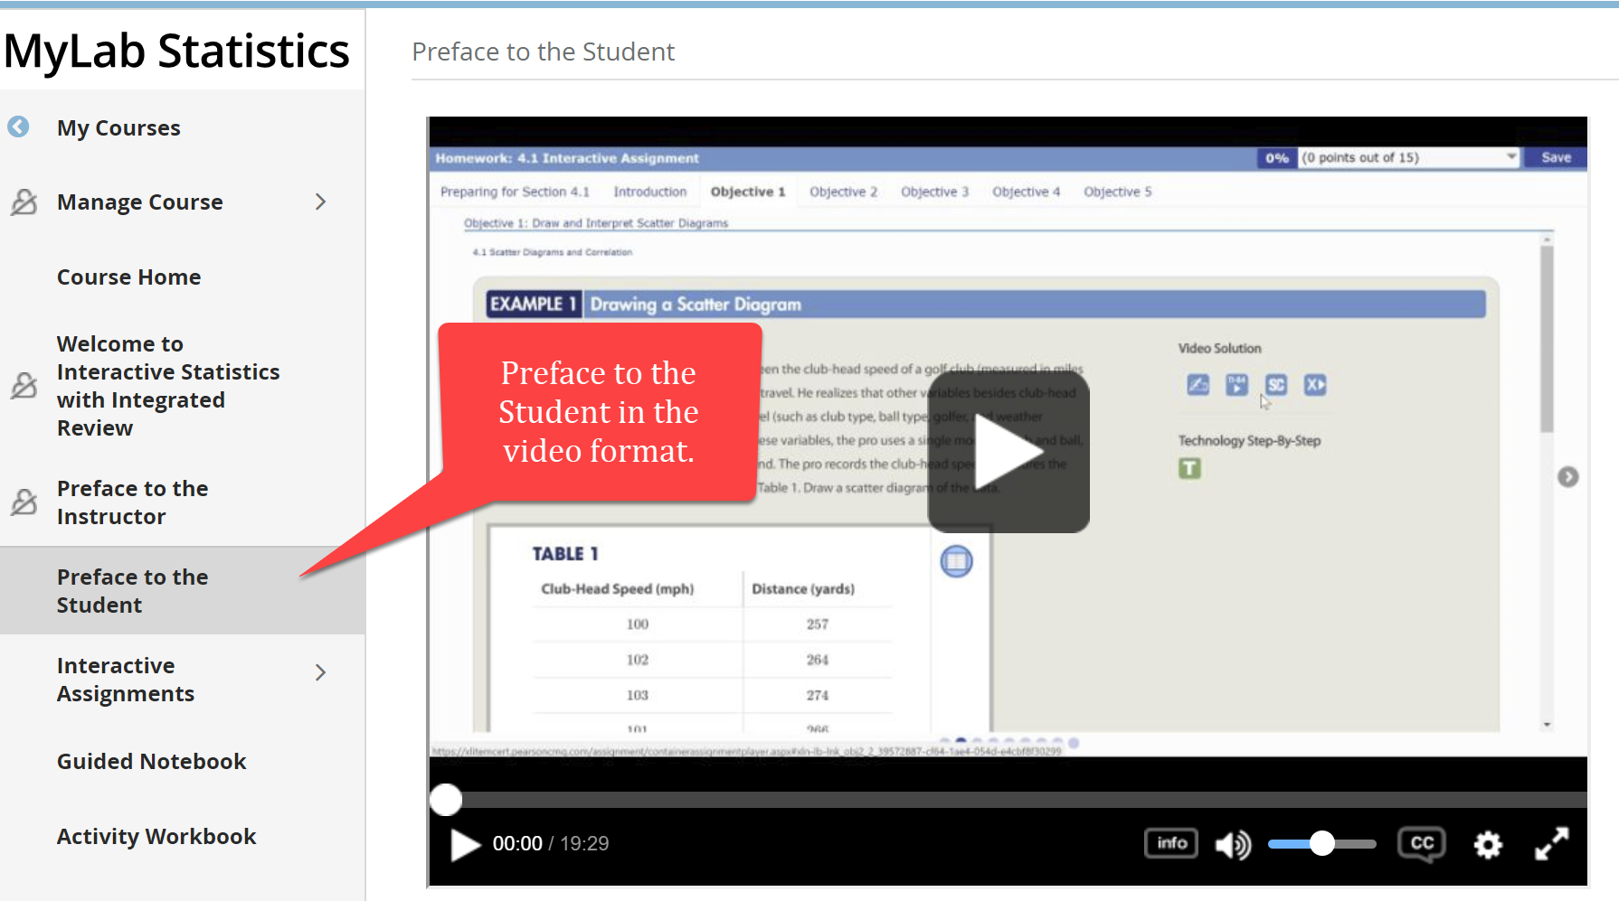
Interactive Statistics 2/e

Slide 8
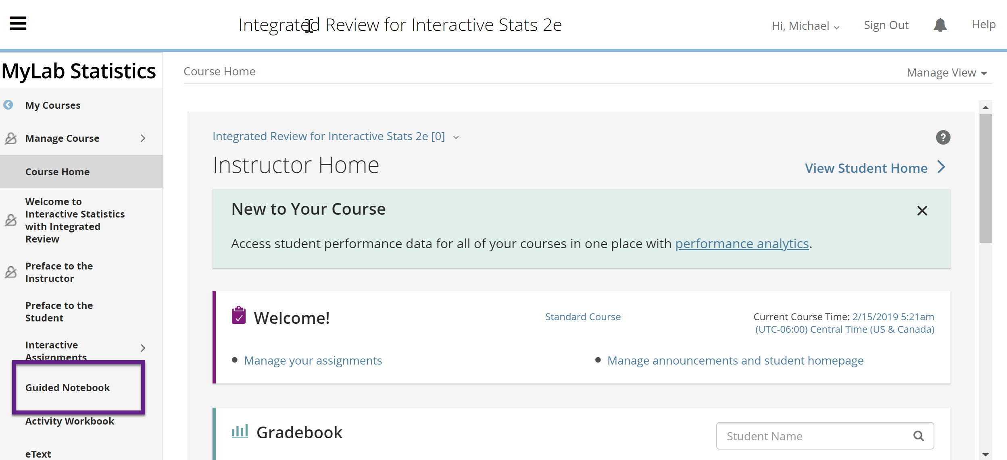
Guided Notebook
Notes:
George should elaborate on this -- Be sure to have Ch 4 of the guided notebook open. Written by George and includes an instructor guide (which is a filled in guided notebook).

Slide 9
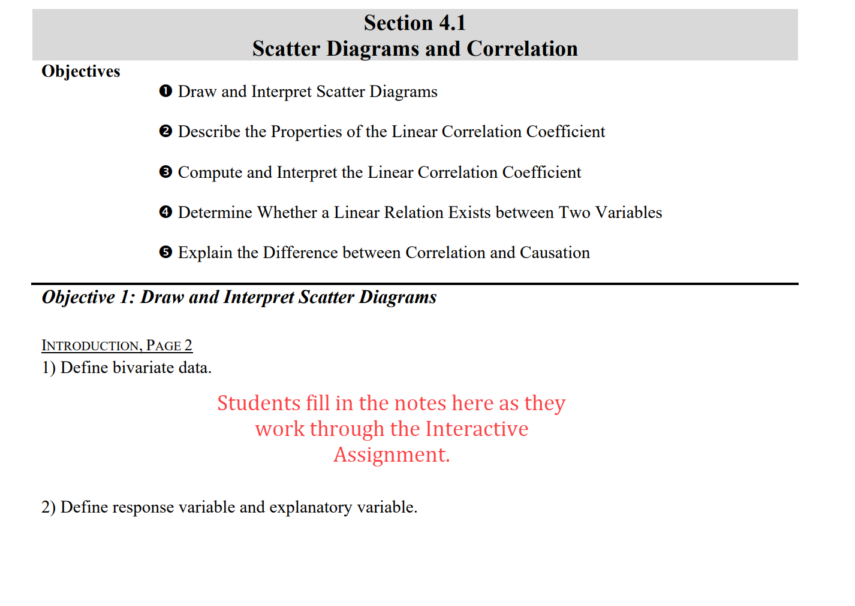
GUIDED Notebook

Slide 10
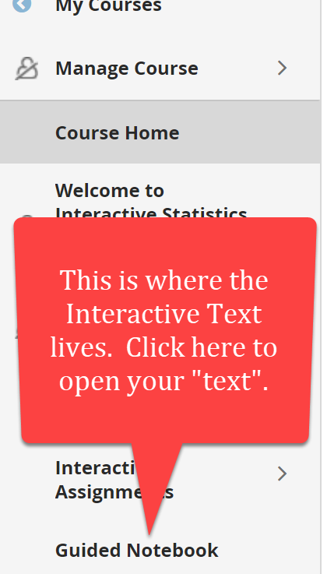
Interactive statistics 2/e
Let’s explore an interactive assignment.
Notes:
At this point, I will go into Section 4.1 of the Interactive Assignment.

Slide 11
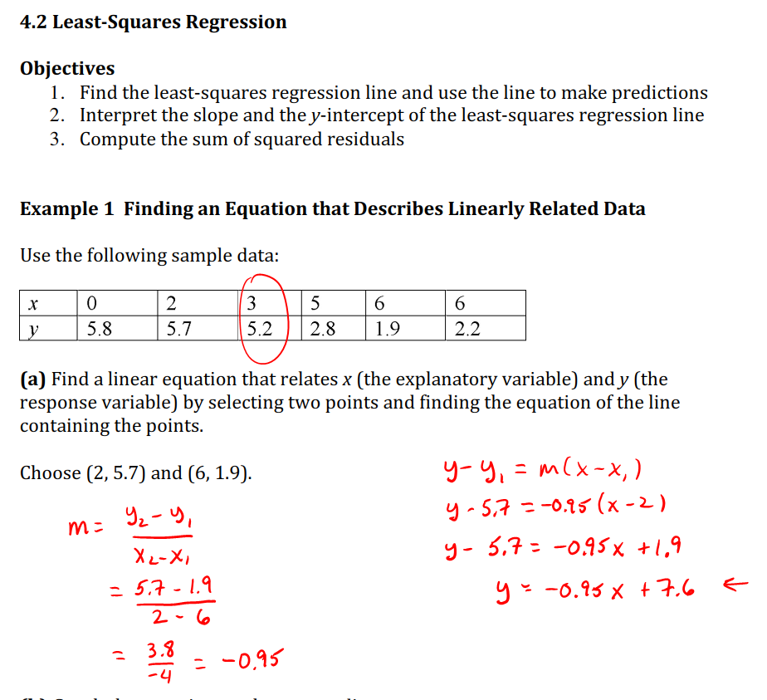
Classroom Lecture Notes
Notes:
Mike -- Interactive Statistics is written to provide the instructor with the utmost in flexibility. While I currently use it in a flipped classroom environment and in an online environment, in the past, I used it for traditional lecture. This is where the idea of classroom lecture notes came from. These notes are available to your students to print out. They contain definitions, theorems, procedures, examples different from the text, and activities. I recommend that instructors teaching stats for the first time utilize these notes in a lecture format. We all know the way to really learn content is through teaching. I used a tablet at the front of class and worked my way through the lecture notes. Filled in notes are available from my course. I will share my coursed for this course later.

Slide 12
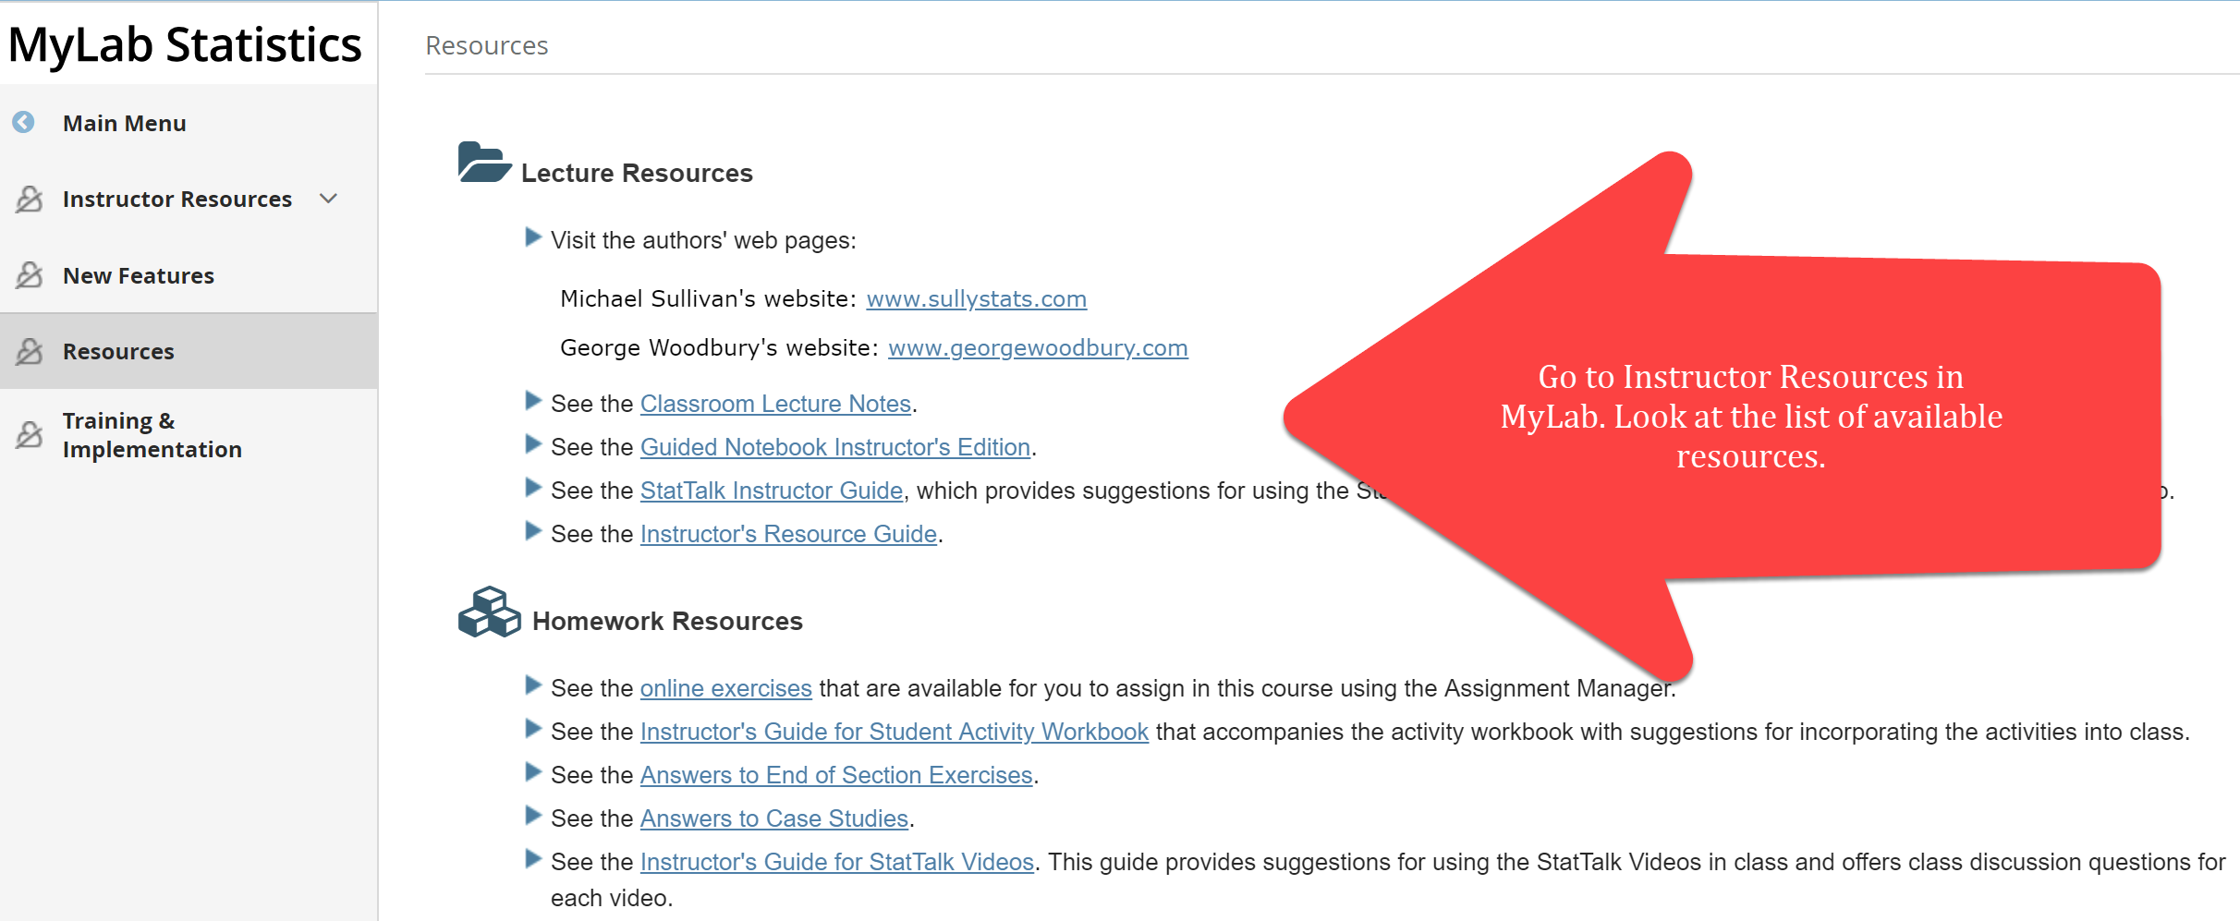
Instructor ResourceS
Notes:
George

Slide 13
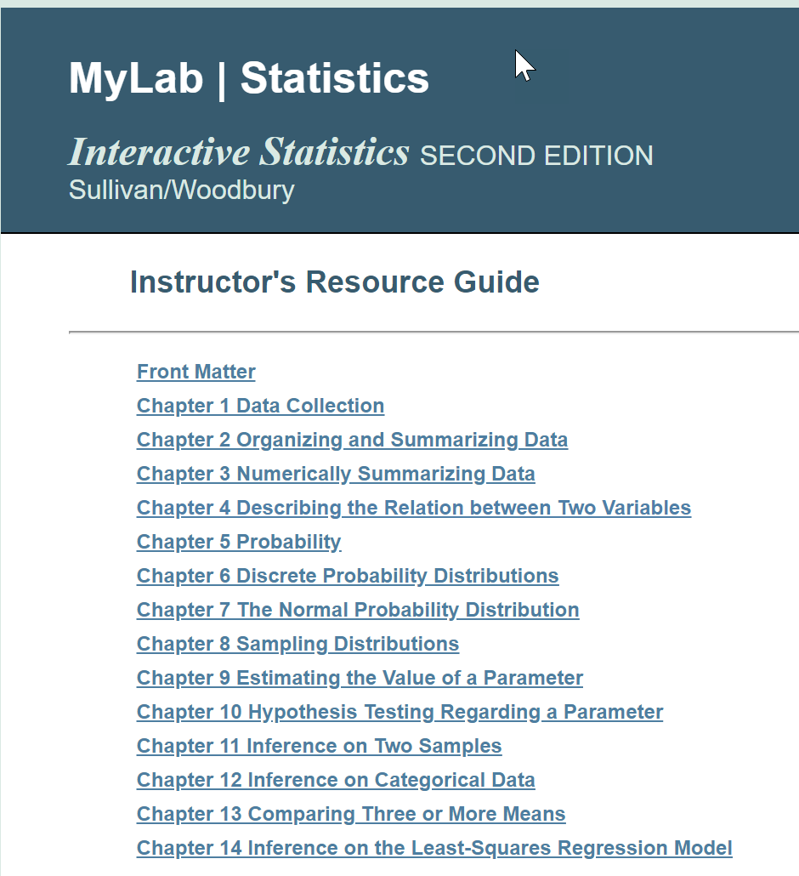
Instructor’s resource guide
Notes:
GEORGE __ The Instructor’s Resource Guide, written by Mike, includes tips on teaching material; sections or objectives that might be considered optional; and additional classroom examples.

Slide 14
Instructor’s resource guide
Notes:
Show the Instructor Resource Guide for Chapter 4. Show the extra examples.

Slide 15
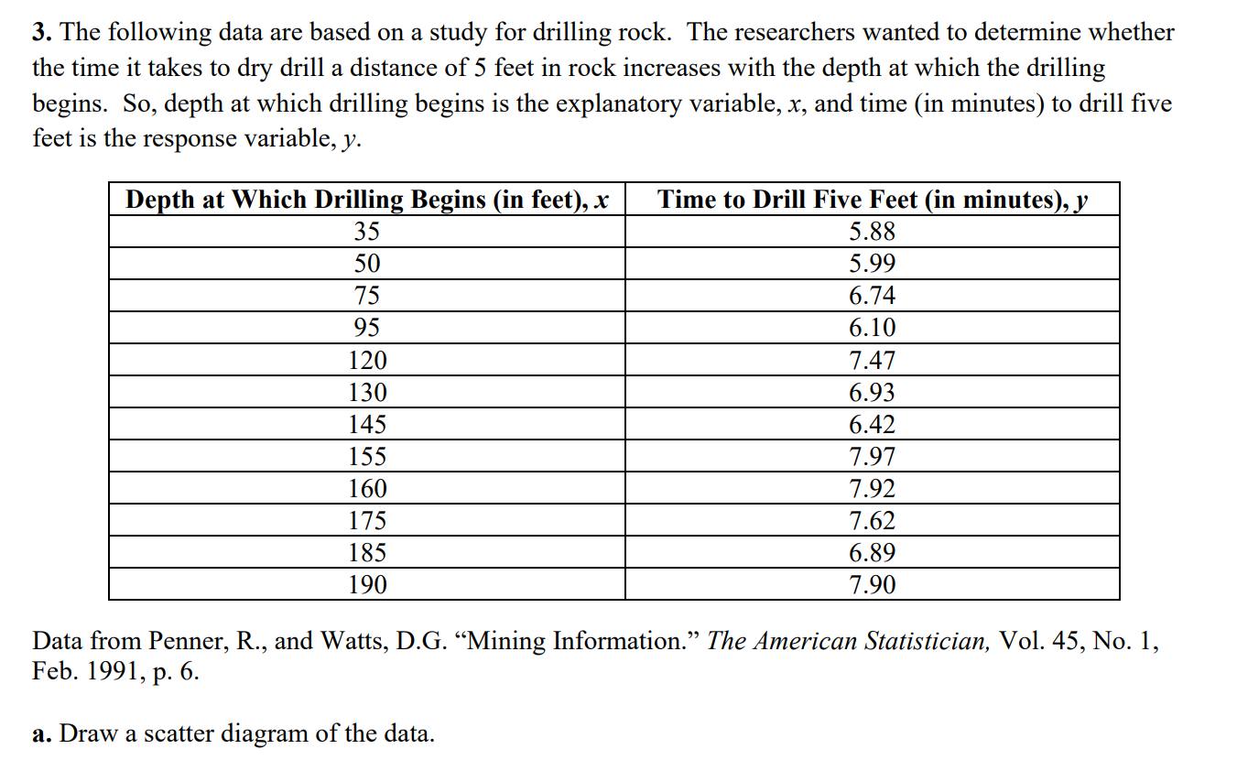
Instructor’s resource guide
Notes:
Show the Instructor Resource Guide for Chapter 4. Show the extra examples.

Slide 16
Learning Catalytics
Notes:
George -- Be sure to ask folks to email us if they want a copy of the course.

Slide 17
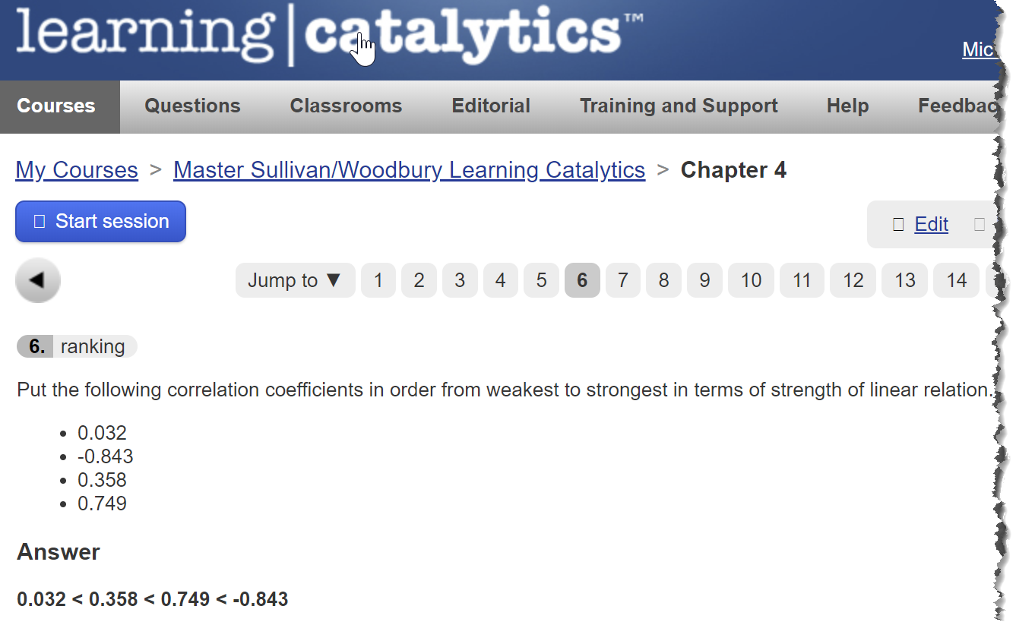
Learning Catalytics
Notes:
There are a wide variety of questions types including ranking (shown here), numerical, expression, many choice, graphing, and, of course, multiple choice.

Slide 18
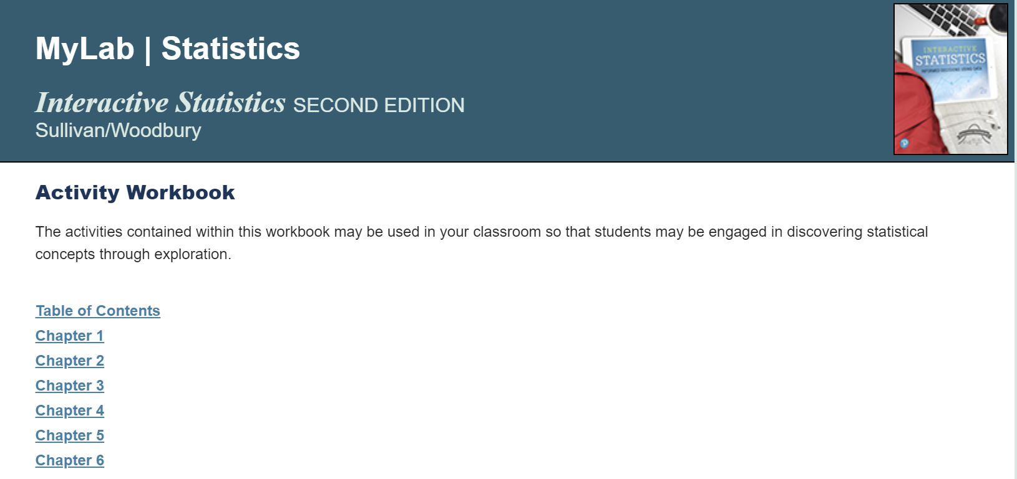
Student activity workbook
Notes:
Mike – Every chapter has classroom activities that you could use for discovery based groupwork, or as a classroom demonstration. The activity workbook comes with an instructor’s guide that tells you how long an activity should take and provides suggested answers.

Slide 19
Our Course IDS
George
mike
woodbury17446
Sullivan-pearson10924

Slide 20
Resources from Our Websites
www.sullystats.com
www.georgewoodbury.com

Slide 21
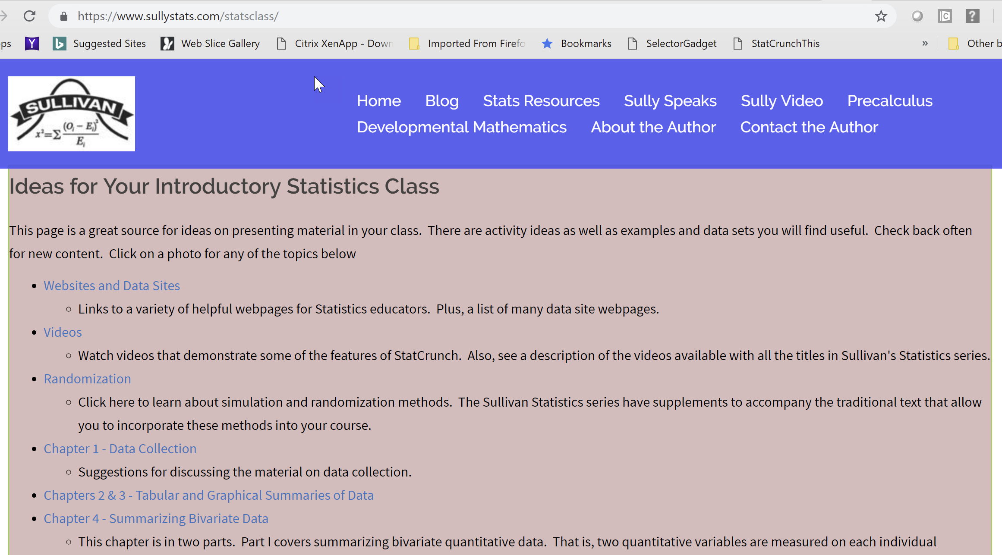

Slide 23
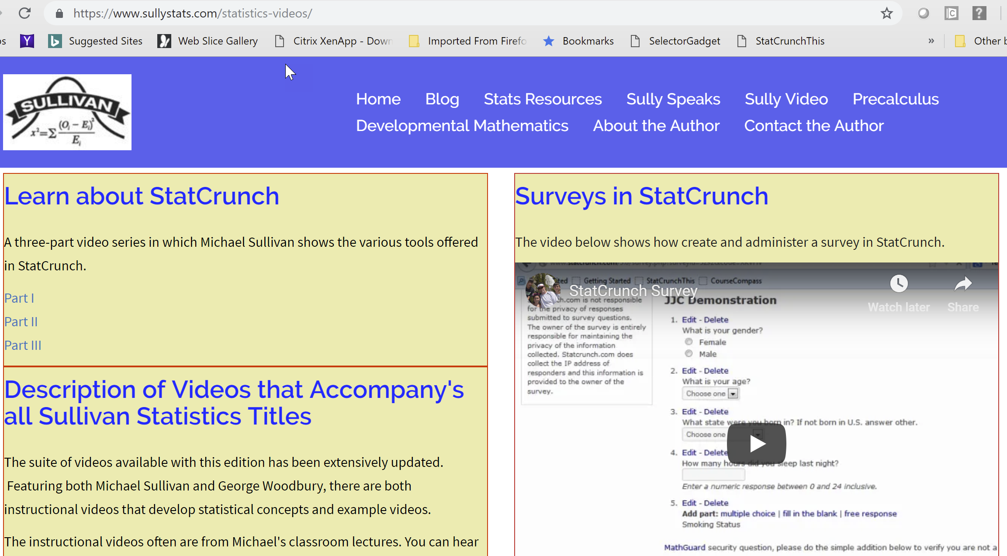

Slide 24
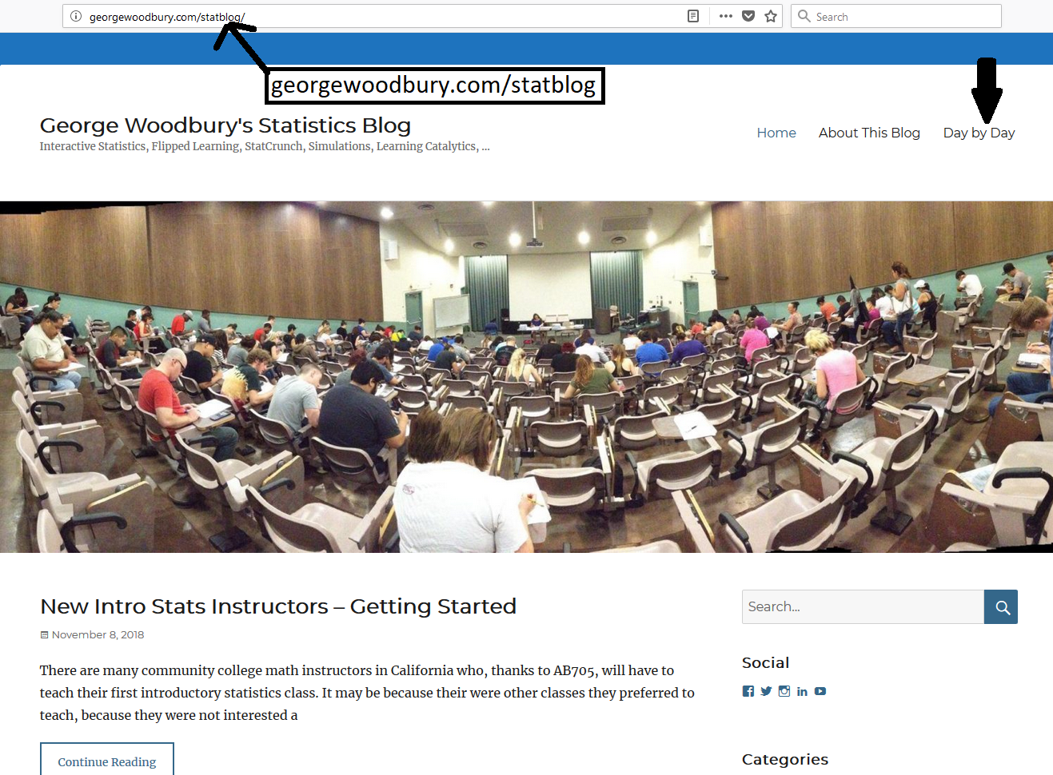

Slide 25
CoRequisite Support
George
mike
Four hour stat course plus Two hour Support course
Coreq just-in-time, plus mindsets and Study Skills
Homogeneous grouping
Same instructor
Four hour stat course plus one hour supplement instruction
Coreq just-in-time
Homogeneous grouping
Same instructor

Slide 26
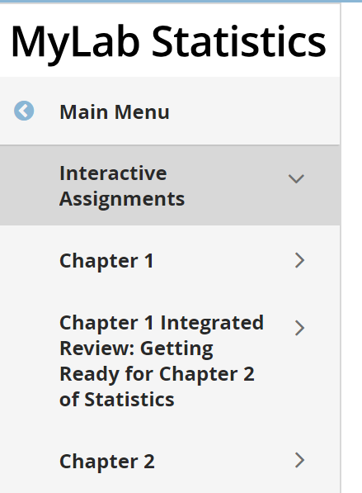
CoRequisite Materials
Notes:
Mike - Because Ch 1 of stats does not require any remediation material, the student may work on the CoRequisite material to prepare for Ch 2 while also working on Ch 1 of stats. This learning path continues throughout the course.

Slide 27
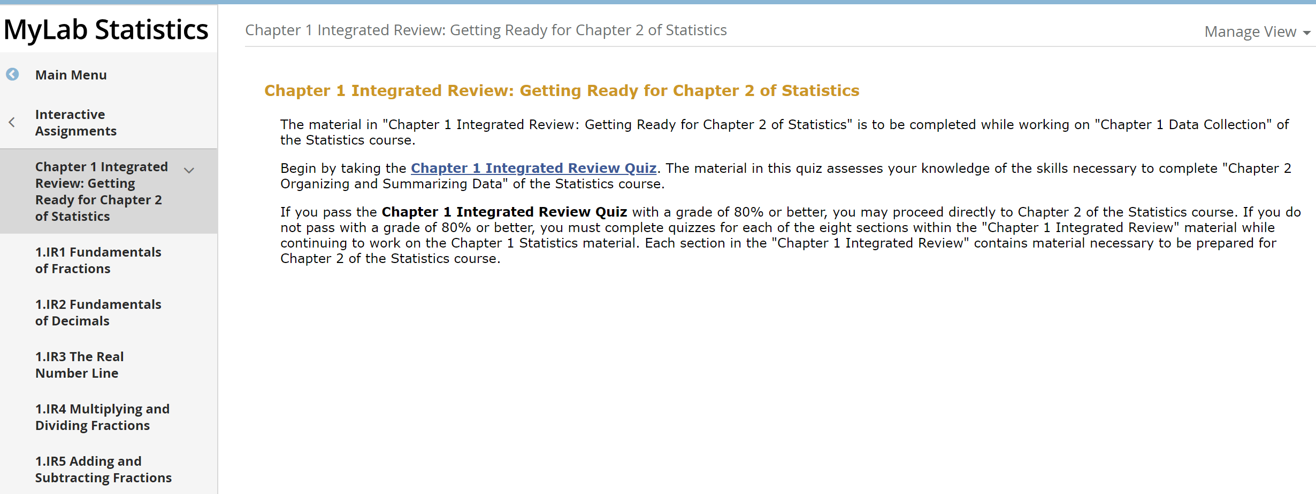
CoRequisite Materials
Notes:
Students in CoReq courses are heterogenous in terms of their skills. So, we assess student content knowledge with an quiz. Notice the learning path is clearly laid out for the student.

Slide 28
CoRequisite Materials
Notes:
Within any given section, the student has resources available. The two main resources are the eText and Lecture Videos.

Slide 29
CoRequisite Materials - text
Notes:
Within any given section, the student has resources available. The two main resources are the eText and Lecture Videos.

Slide 30
CoRequisite Materials - text
Notes:
The eText is a full text based on Sullivan’s Developmental math series. However, the material was written to address the particular needs of Introductory Statistics students.

Slide 31
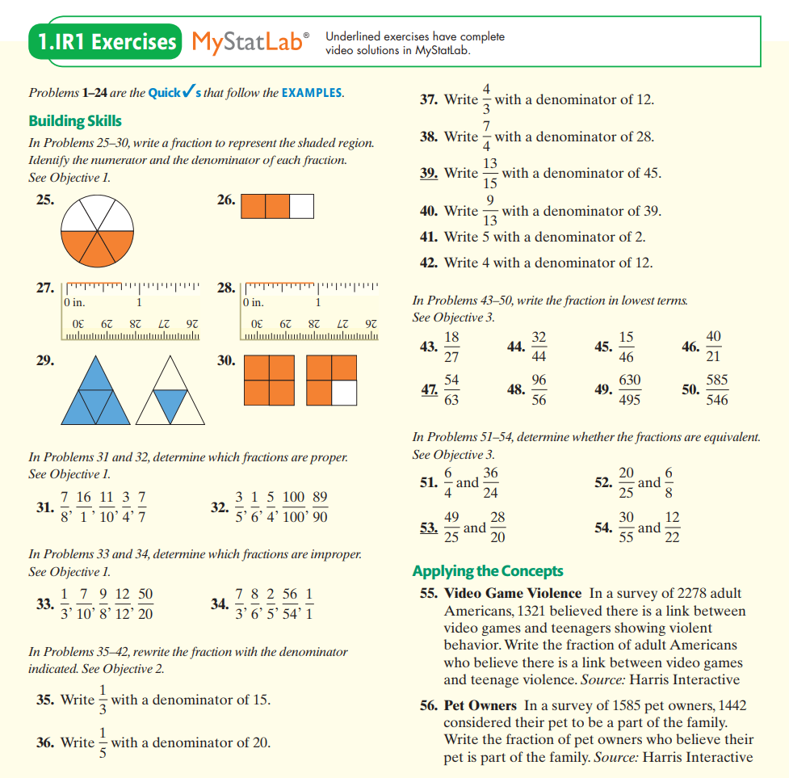
CoRequisite Materials - text
Notes:
There are also end of section exercises and each odd problem is programmed into MyLab. Look at Problems 55 and 56.

Slide 32
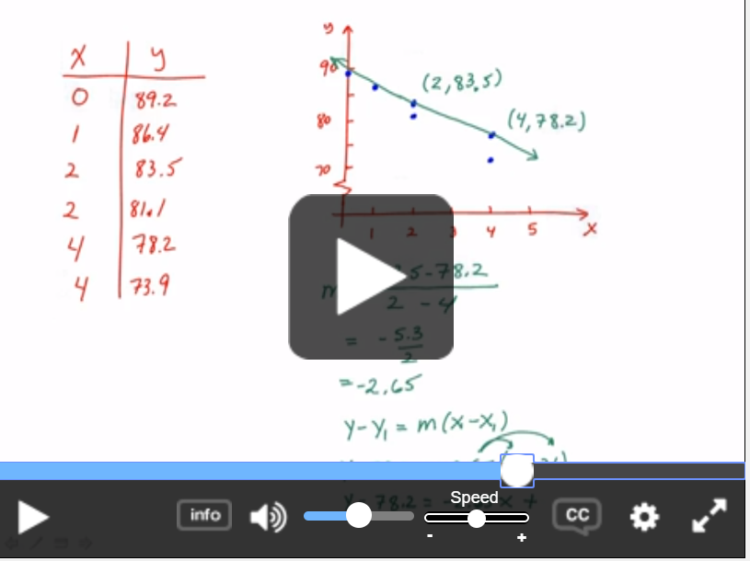
CoRequisite Materials - Video
Notes:
The videos for the CoReq piece are mostly from Sullivan’s actual classroom lectures. Here, we are using the point-slope formula to fit an equation to data (absences versus exam score).

Slide 33
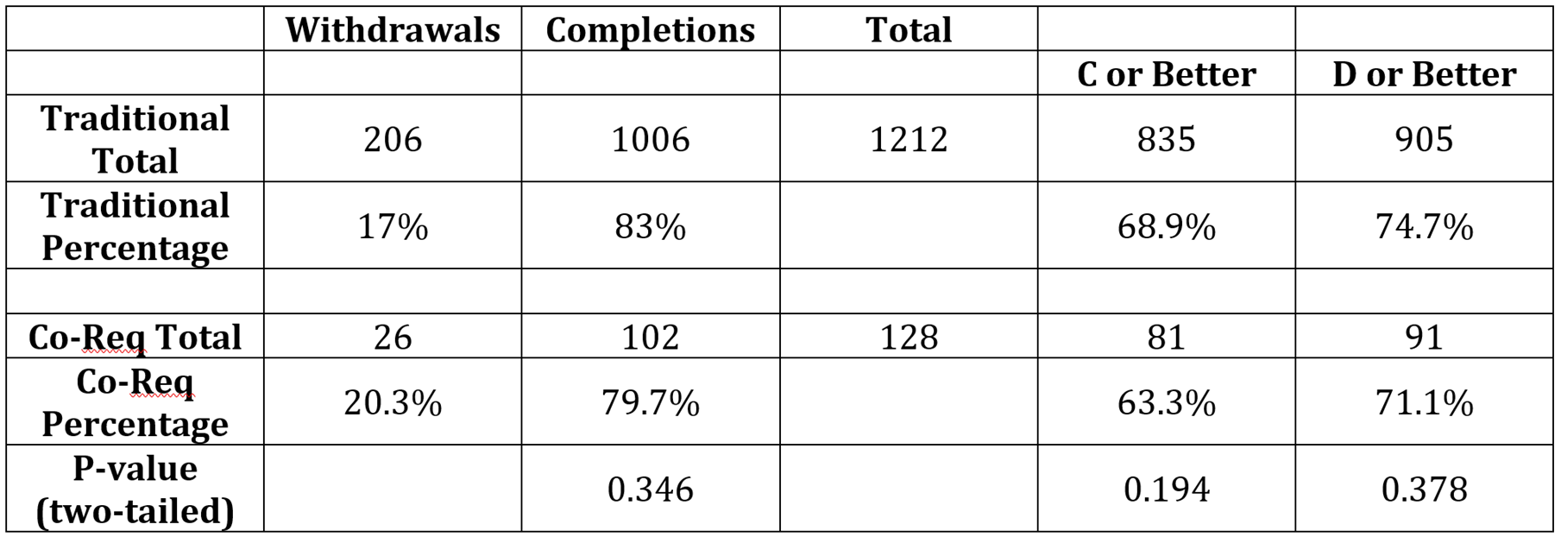
Results at Joliet Junior College
Notes:
Mike & George.

