Slide 1
My experiences with corequisite college algebra and statistics
Michael Sullivan
sullystats@gmail.com msulliva@jjc.edu www.sullystats.com

Slide 2
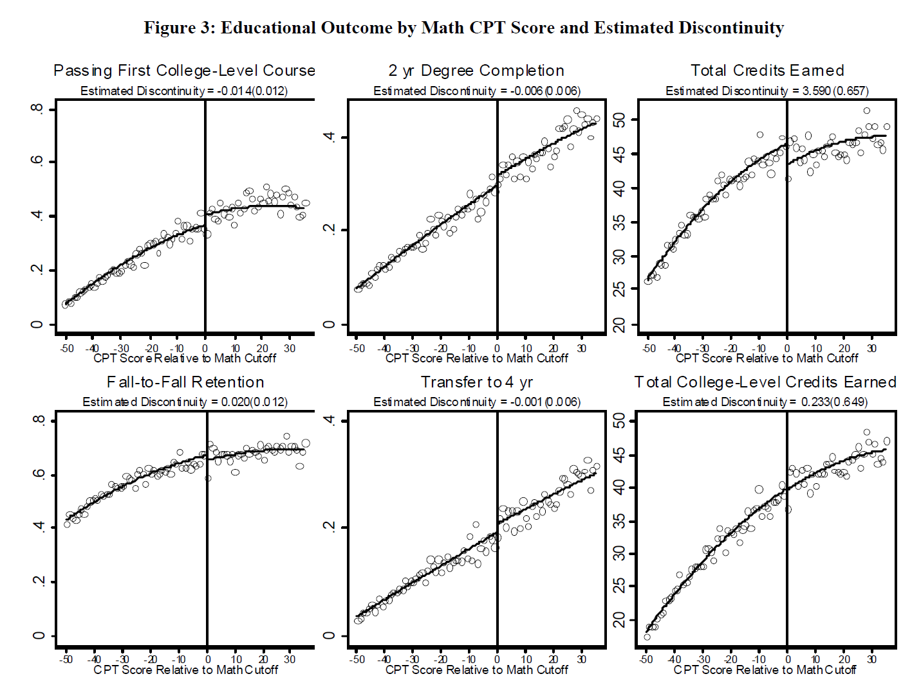
What’s the problem?
Notes:
A study by Calcagno showed that students who placed just below the cut-off score needed to enroll in college-level math actually had pass rates below those who placed slightly higher than the cut-off. These students do not differ much in terms of ability based on their placement scores, so one would think the dev math course would improve (or at least not hurt) their chances of passing college level math. Not so. Notice the discontinuity in the graphic in the upper left corner.
However, placement into dev math increases fall-to-fall retention, but decreases transfer to 4 year schools. Thoughts on this?
Of course, total credits earned is higher at the cut-off, but college credits earned is not.

Slide 3
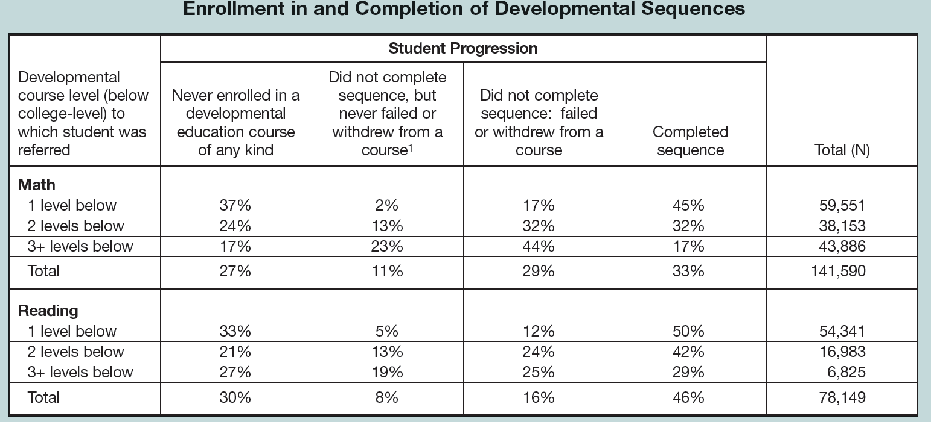
Notes:
Among students who place into a developmental math sequence, only 33% complete the sequence.
29% of all students exited the sequence after failing or withdrawing, 11% exited the sequence even though they did not fail or withdraw.
Overall about 2 of every 3 students do not complete the sequence because they never enroll, don’t complete but never fail, or do not complete because fail/withdraw.
This is data from Achieving the Dream colleges.
From: Bailey at the Community College Research Center
Bailey, T. (2010) Student Progression Through Developmental Sequences in Community Colleges Community College Research Center

Slide 4
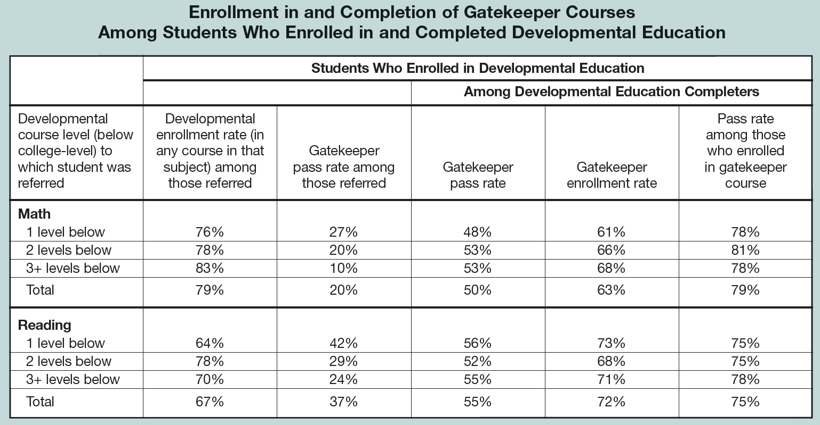
Notes:
only 20% of students who placed into a developmental math course successfully completed the corresponding college level (so-called gatekeeper) course. Of course, the more dev math one has to take, the less likely you are of passing the gatekeeper course.
1 Level Below in Math: 27% of students who complied with the placement results ended up completing a college level math. Wow!
2 Levels: 20%
3+ Levels: 10%
Encouraging that once a student completes the dev math sequence, the pass rate is high (79%).

Slide 5
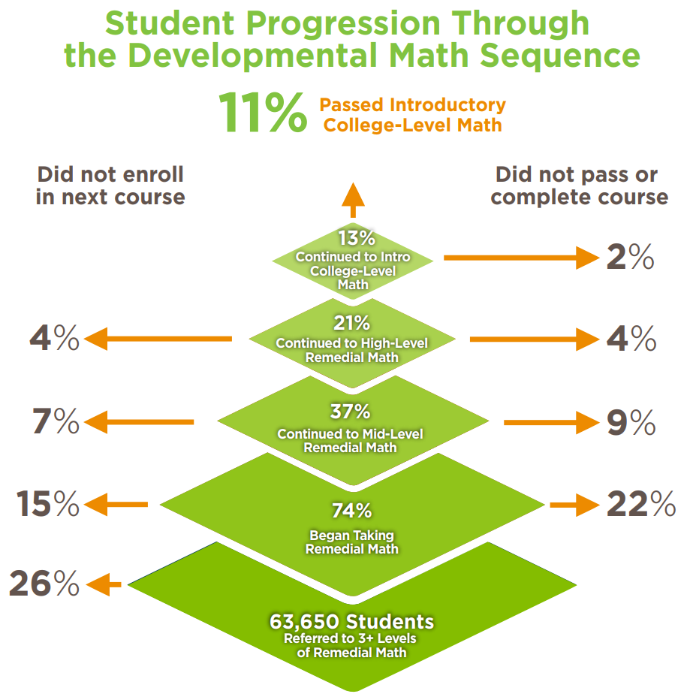
What’s the problem?
Source: Community College Research Center's What We Know About Developmental Education Outcomes.

Slide 6
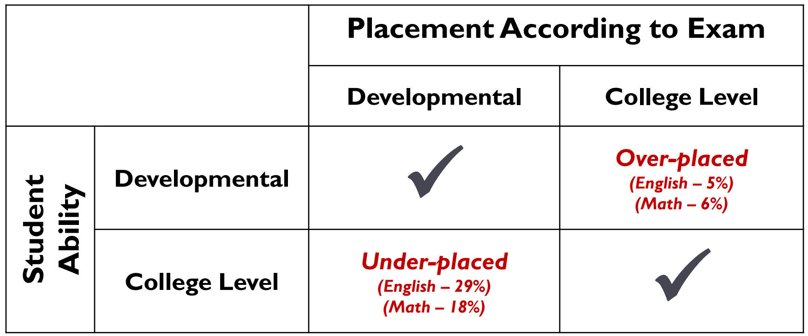
Incorrect placement?
https://ccrc.tc.columbia.edu/media/k2/attachments/moving-beyond-placement-test-multiple-measures.pdf
Notes:
Use of multiple measures is all the rage right now.
HSGPA
ACT/SAT scores
SuccessNavigator

Slide 7
What’s the Problem?
The Data from Complete College America
Notes:
Show percentage of students who complete the degree in 100% time; 150% time
Click Time and Credits to Degree
Show Gateway Success

Slide 8
Potential Solutions
Emporium-Style Remediation
Modules – only present material needed by student
Developmental Math over multiple semesters
Boot Camps to Improve Scores on Placement Test
Aligned Pre-requisite Courses
Co-Requisites
Notes:
aligned prerequisites,” e.g., requiring future statistics students to take a pre-stats course rather than Intermediate Algebra.

Slide 9
What Is Co-Requisite Remediation?
Co-requisite remediation is an approach to developmental education that places students in entry-level college courses while they simultaneously receive remedial academic support.

Slide 10
Why Co-Requisite?
City University of New York
Complete College America Report includes Case Studies from states that have implemented co-requisite models and a blueprint for developing a co-requisite model.
Notes:
Students were randomly assigned to one of the three course types (Group 1: traditional elementary algebra, Group 2: traditional elementary algebra plus a weekly workshop, or Group 3: college-level, credit-bearing, introductory statistics plus a weekly workshop)
Pass Rates
Group 1 38%
Group 2 45%
Group 3 56%
Typical pass rate for Elementary Stats is 69%

Slide 11
Best Practices of a co-req
Attempt for low student-teacher ratio in the co-req course
Same instructor for both co-req section and college-course section
Avoid the heterogenous model. Compare to homogenous model, heterogenous had
Lower pass rates in subsequent college-level courses
A 3 percent decrease in persistence
A decrease of 0.5 courses completed
A decrease of 1.5 college credits earned
Source: Sung-Woo Cho, Community College Research Center

Slide 12
Coreqs at Joliet Junior College
College Algebra
Two hour support course
Four hour college algebra course
Homogeneous grouping
Same instructor
Statistics
one hour support course
Four hour statistics course
Homogeneous grouping
Same instructor

Slide 13
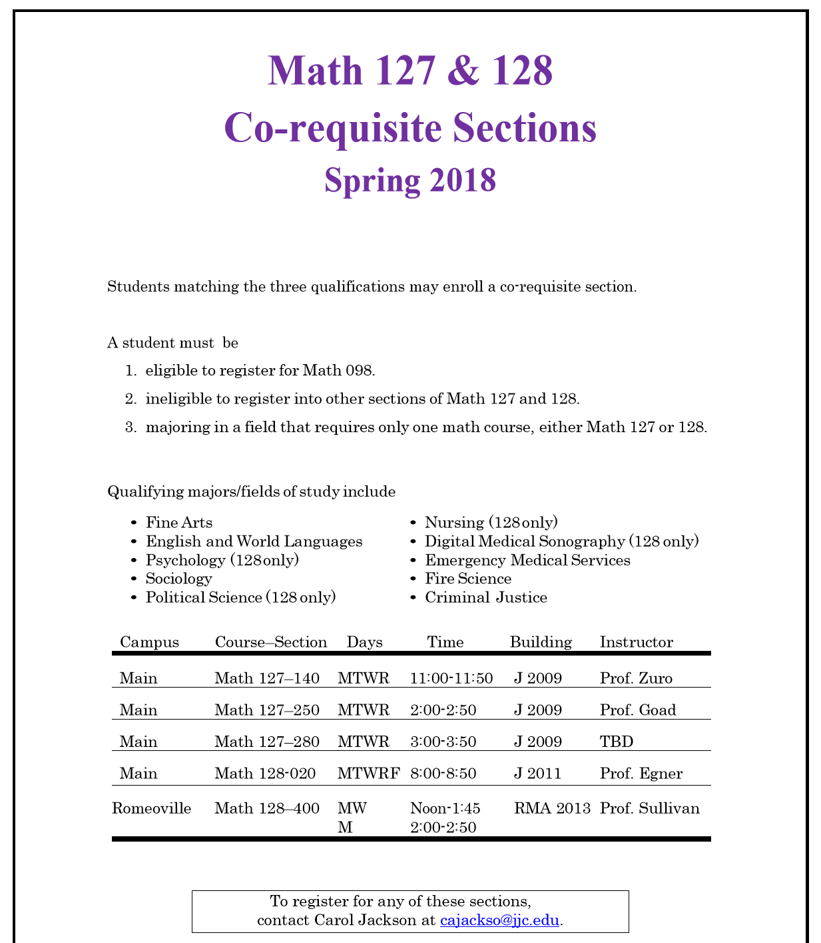
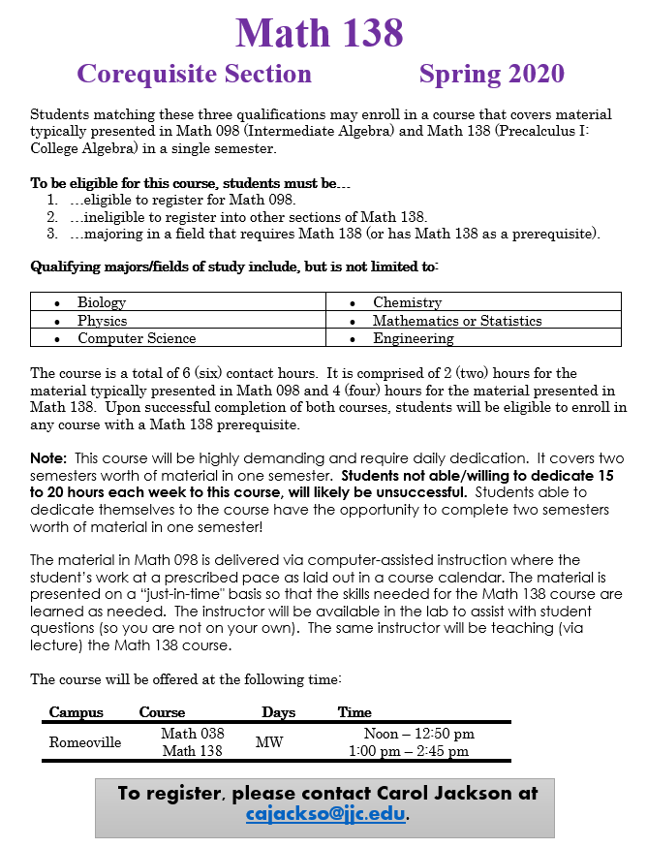
Student Selection

Slide 14
Dive into the college algebra course
Course ID: Sullivan-pearson07201

Slide 15
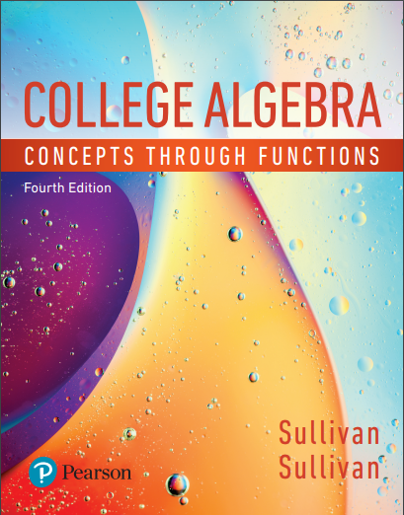
Key Features
Support Course
College Algebra Course
Corequisite Support Text - available as eText and one-color loose leaf print text available to package
Guided MyLab Learning Path that focuses on instruction to the student
Pre-Built, Pre-Assigned Assignments
Classroom Activities
Math Study Skills Videos
College Algebra Concepts through Function, 4e Text
Guided Lecture Notes
Author-in-Action Videos
Enhanced Sample Assignments
Learning Catalytics Questions
Table of Contents

Slide 16
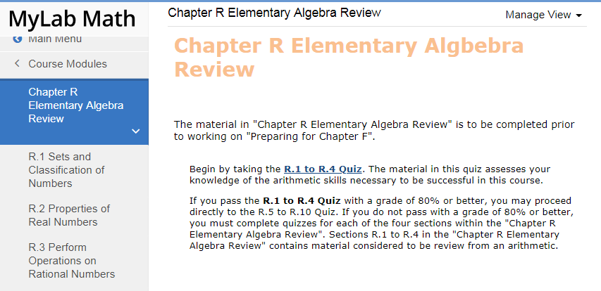
Ch: R Elementary Algebra Review
For those instructors that need to include content from Basic Math and Beginning Algebra
Chapter included in Support Text and in MyLab Math
Mastery Based Learning in MyLab Math
Quiz on Arithmetic and Beginning Algebra
Personalized Homework
Quiz Retake
Notes:
For those instructors that need to include content from Basic Math and Beginning Algebra
Includes 10 section of Basic and beginning algebra content for students who would need more review.

Slide 17
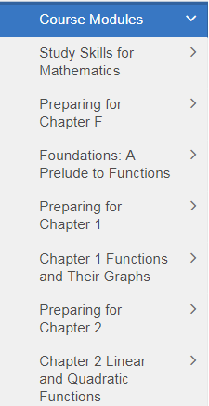
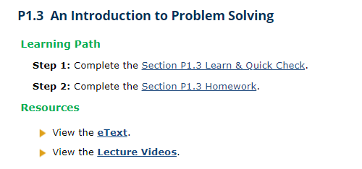
Preparing for the Chapter
Preparing for the Chapter = Support Content
eText to Support Text
Videos and Resources
Homework Assignment broken into two steps
Learn & Quick Check
Homework
Support Content
College Algebra
Content
Notes:
This course includes 24 section of review material from Intermediate Algebra. Before each chapter there is a Preparing for chapter which include 2 steps for students to complete, Step 1 Learn & Quick Check- Step 2 homework. Links to etext and videos covering the review material are included.

Slide 18
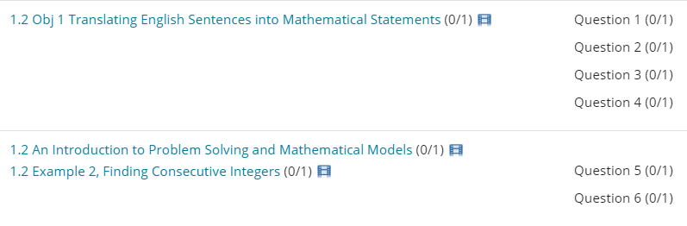
Step 1: Learn & Quick Check
Learn = Instruction on the Support Content
Author Videos
Quick Check Homework Questions
How To Guided Exercises
eText links directly corresponding example
View an Example Learning Aid turned off
Notes:
In step 1, students will work though the Lean and Quick Check material. Included in this instructional material are author videos, quick check questions, guided exercise and if students need to reference the content, links to the etext are included for quick reference. The authors believe in turning off the View an Example Learning Aid - since students can access the eText and Videos. Once completed, students would complete the homework in step 2.

Slide 19
Step 2: Homework
Homework = Practice
Skill Building and Mixed Practice exercises
Reduce amount of guidance

Slide 20
Study Skills for Mathematics
Study Skills for Mathematics
Motivate students to stick with their math course, offer practical tips to succeed and help reinforce a growth mindset.
Assignable - MathXL Assessment Video Exercises
Notes:
Click image to play video!

Slide 21
Study Skills for Mathematics
Study Skills for Mathematics Video Library
SS1 How Learning Math is Different
SS2 The Growth Mindset and Grit
SS3 Resources Available for Help
SS4 Time Management
SS5 How to be An Effective Listener and How to Take Notes
SS6 How to do Math Homework the Right Way
SS7 How to Read a Math Book
SS8 How to Study for a Math Exam
SS9 Overcoming Math and Test Anxiety
Notes:
Here are the video titles

Slide 22
Classroom Activities
For the Instructor:
Every Section of Corequisite Material has a Classroom Activity that will engage students and allow them to work together to drive deeper understanding.
Examples:
Station Mazes
Math Scavenger Hunt
Math Puzzles
Found in MyLab Math: View an Example Here
Teaching suggestions including:
Estimated Time
Focus
Group Size

Slide 23
Dive into the Statistics course
COURSE IDs:
Sullivan-pearson82001 (Interactive Stats 2e)
Sullivan51773 (Statistics 5e)

Slide 24
Interactive Statistics with Integrated Review
Notes:
Page IR64 (1.IR7)
1.IR8
2.IR2 (page IR81, #51 and #83)
2.IR3
3.IR5 (Objective 3)

Slide 25
Sample material

Slide 26
Sample Material

Slide 27
Sample material

Slide 28
Sample material

Slide 29
Sample Material

Slide 30
Interactive stats 2/e
Flipped classroom using interactive stats with guided notebook.
Demo Section 4.1
My courseID: Sullivan-pearson10924

Slide 32
Collaborative classroom

Slide 33
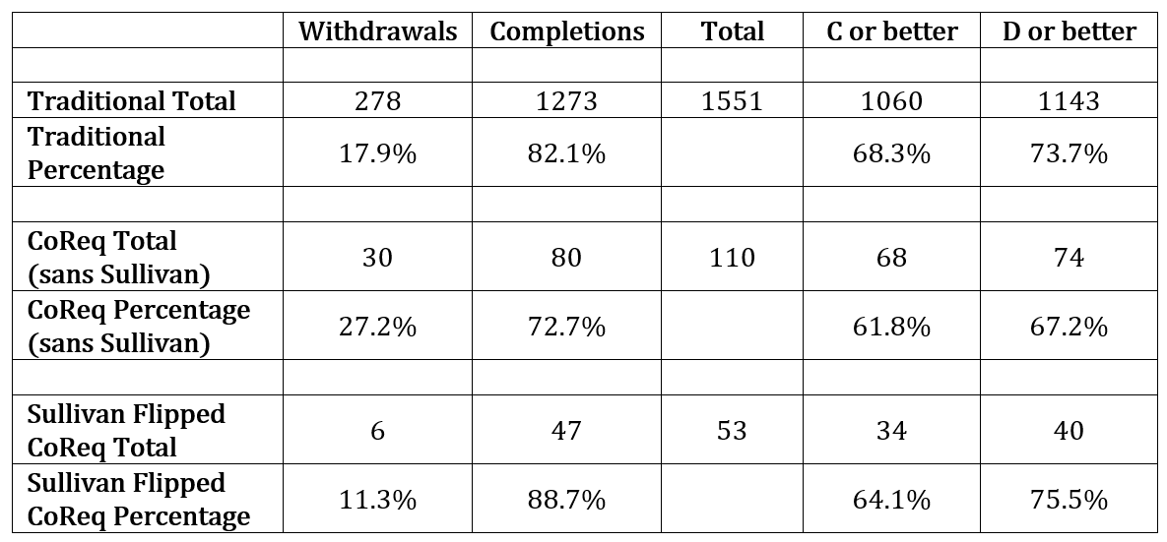
Results at JJC (Elementary Statistics) Fall, 2016 thru Fall, 2018

Slide 34
A Challenge of Co-Req: Tennessee Community Colleges
52% of students passed both courses
Earned hours as a percentage of attempted hours
3% of students passed only the credit course
36% of students failed both courses
Adapted from TBR Brief #3: Co-requisite Remediation Full Implementation 2015-16
Notes:
Let’s look a little closer at the successes and the failures.
Show main slide.
Note that the orange line indicates students who passed both the college-level course and the co-requisite support course.
Indicate the vertical axis label on the left. Students who passed both courses passed an average of 85% of their attempted hours.
Note that this is steady across all ACT scores.
Note that the blue line indicates students who FAILED both the college-level course and the co-requisite support course.
Indicate the vertical axis label on the left. Students who FAILED both courses passed an average of only about 20% of their attempted hours.
Note that this is steady across all ACT scores.
How many students are represented by each line?
52% of all co-requisite students passed both courses.
3% of students passed only the credit course (which combines to make the 55% total on the previous slide)
36% of all students failed both courses (and failed almost all of their courses).
There’s something more going on here that needs to be addressed separately – how to support students with multiple issues.
(FYI to facilitator – 3 percent passed college-level but failed the support course. 9% passed the support course but failed college-level.)
This is cc data but the percentages are similar for the university students. Bottom Line: Students who fail the college-level course and the support course tend to fail almost all of their courses – regardless of ACT score. This suggests the students are not “College Ready” as opposed to “Academically Ready”

Slide 35
College ready versus academically ready

Slide 36
Miscellaneous advice
Teach organizational skills (note taking and homework organization)
Failure is the key to growth (ray dalio from principles pg 37)
Practice exams with mastery homework
Time management/time expectations
Brain development
Constant emails

