Slide 1
Using Real Population Data to Illustrate Difficult Statistical Concepts
Michael Sullivan
Joliet Junior College
msulliva@jjc.edu sullystats@gmail.com https://www.sullystats.com

Slide 2
Distribution of the Sample Mean Home Runs in 2019
https://baseballsavant.mlb.com/statcast_search

Slide 3
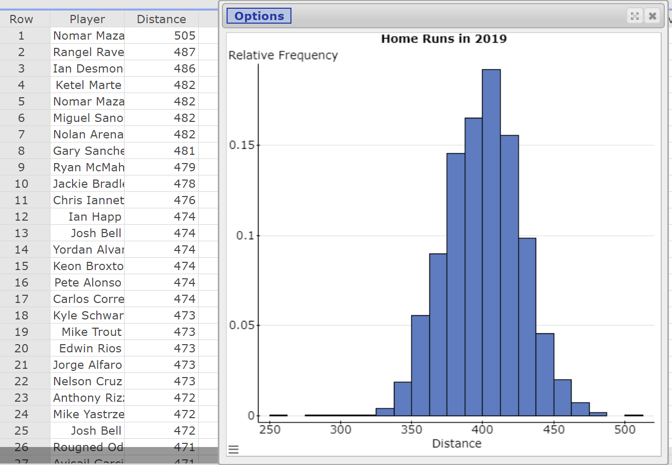
Notes:
I used StatCrunchThis! from StatCrunch to extract the data from the webpage. The data drops right into a StatCrunch spreadsheet.
Shift select. Cntrl-C. Go to StatCrunch spreadsheet. Cntrl-V. Clean up data.
1. Data > Row Selection > Detect > Empty Select Column “Results”.
2. Edit > Rows > Delete
3. Data > Arrange > Slice
Select Results Find Custom - Open in New Data Table
4. Rename Column1 “Distance” Edit > Rows > Delete columns 2 thru 4.

Slide 4
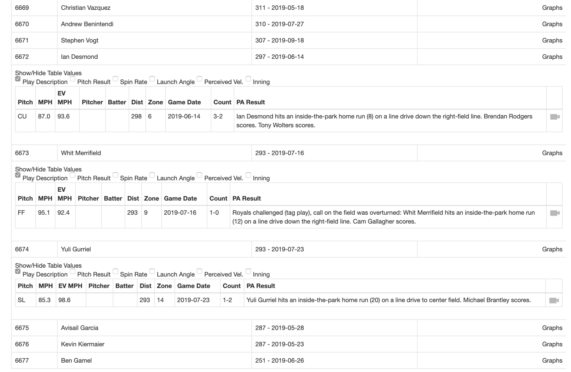
Notes:
Clean up the data by removing “inside the park” homeruns.

Slide 5
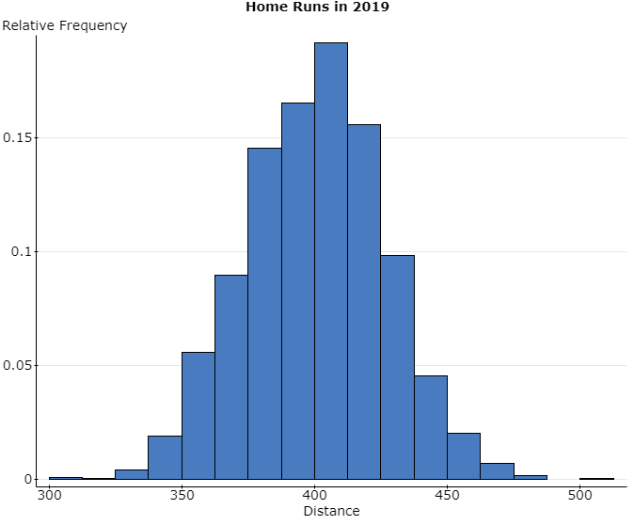
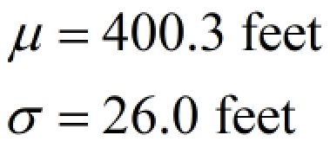

Slide 6
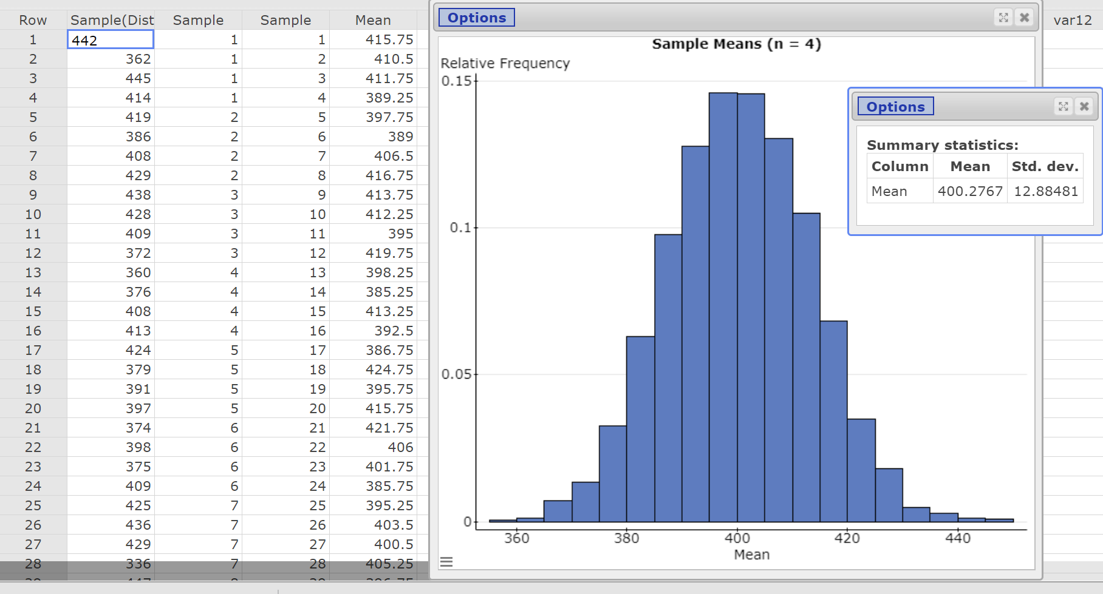
Notes:
This is a random sample of size four from the population obtained many (independent) times.
Data > Sample
Select the Distance column. Enter sample size, number of samples. Choose “Stacked with Sample ID” radio button. Open in a new data table.
To get sample means, select Stat > Summary Stats > Columns. Select Sample(Distance) and group by Sample. Choose sample mean only. Store in Data Table.

Slide 7
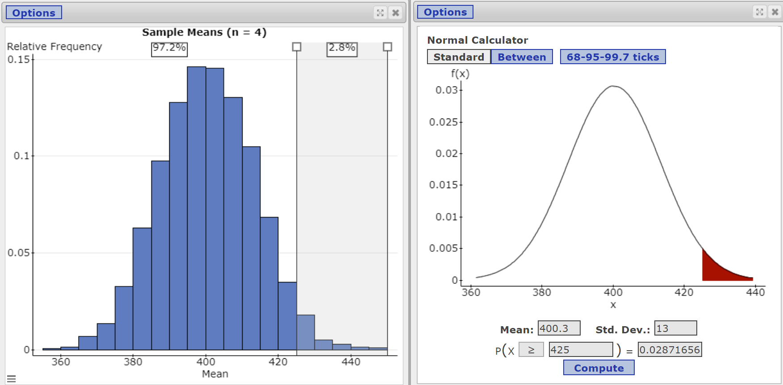
Notes:
Compare the proportion of samples whose mean distance exceeds 425 feet using the simulated data to the proportion obtained from the normal model.
When drawing the histogram, select Percent dividers.

Slide 8
Distribution of the Sample Mean Taxi Rides in Chicago
https://data.cityofchicago.org/
Notes:
Many cities have open portals that give you access to data. Often this data is downloadable as a csv file.

Slide 9
All Taxi Rides on June 7, 2019
Notes:
Once again, the data needs to be cleaned up.

Slide 10
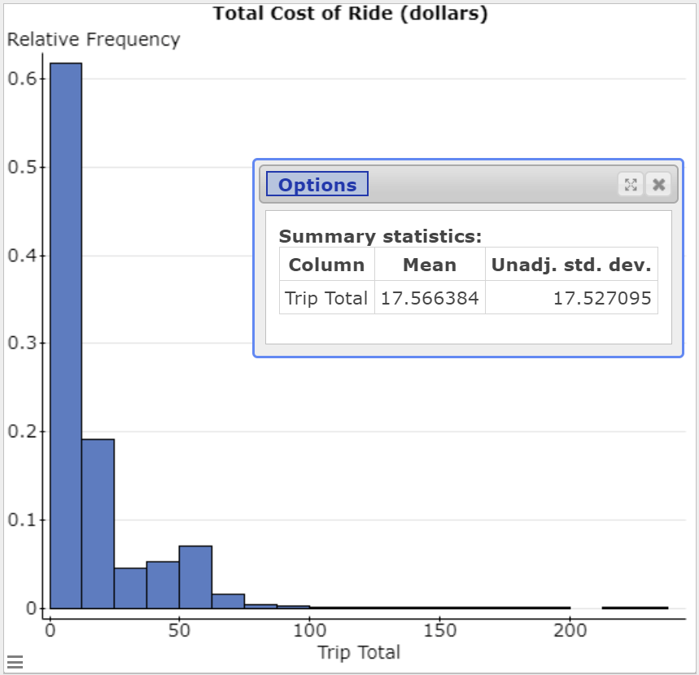
Histogram and Summary Stats
Notes:
Clean data.

Slide 11
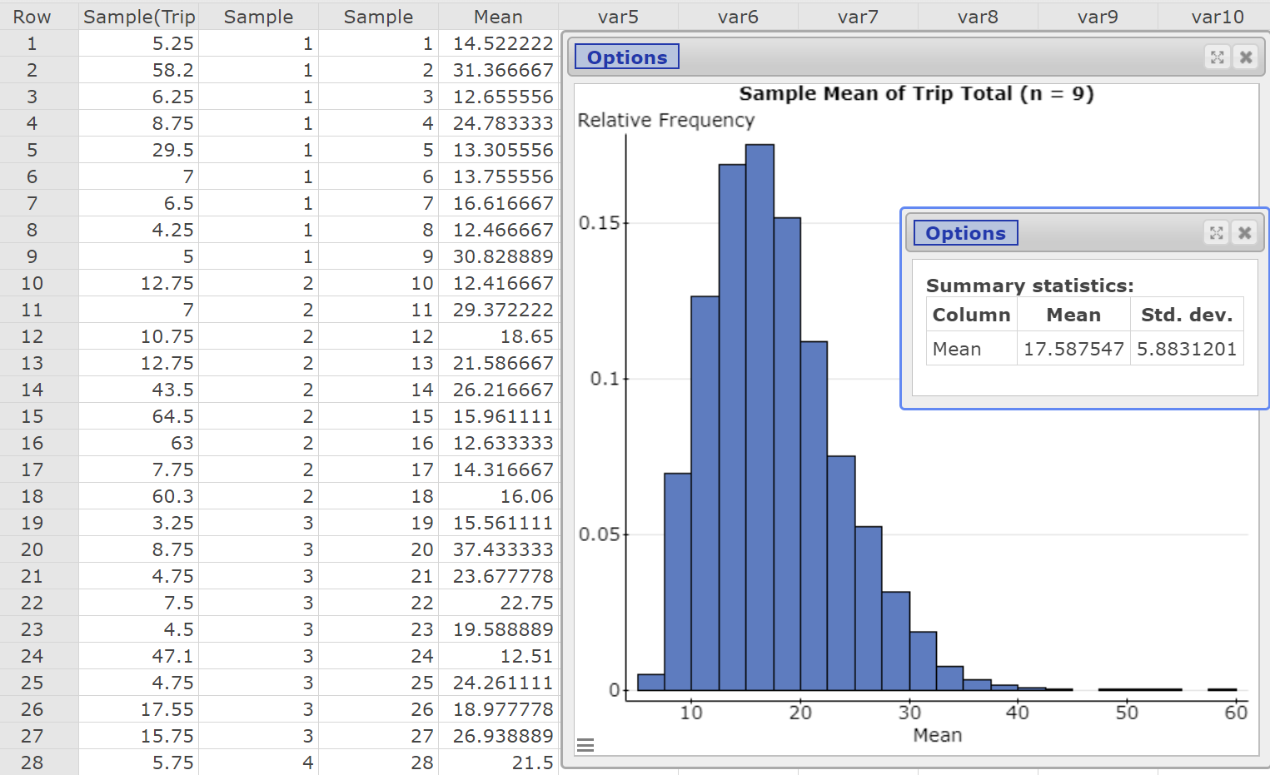
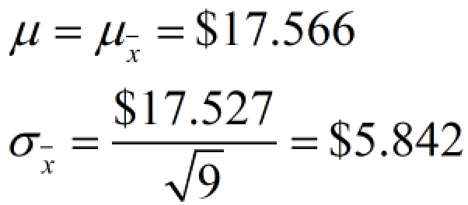
5000 Simple Random Samples of Size n = 9
Notes:
Obtained many random samples of size n = 9 from the population.

Slide 12
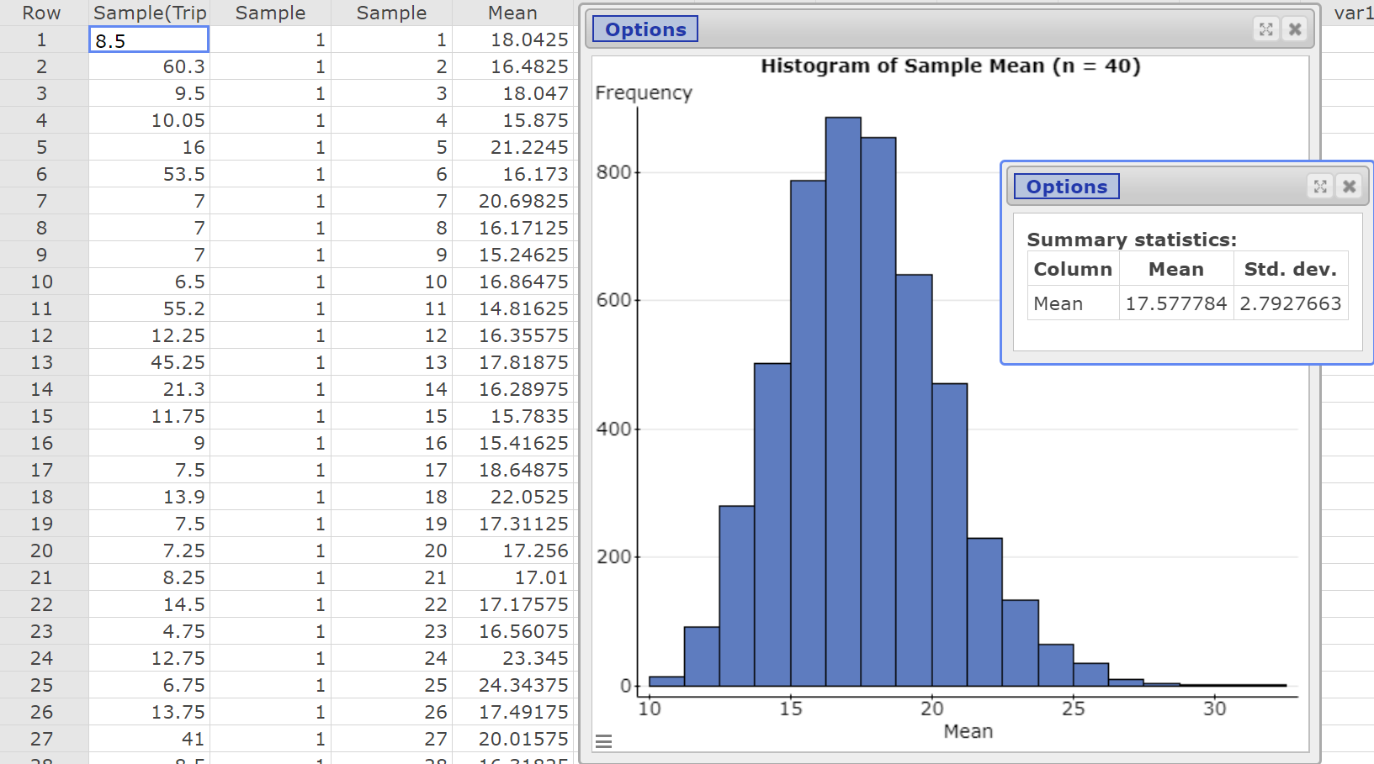
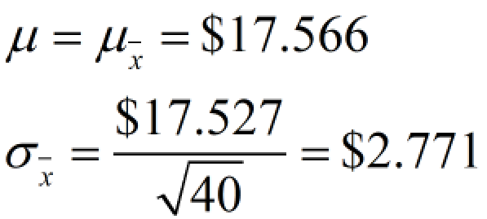
Notes:
Obtained many random samples of size n = 40 from the population.

Slide 13
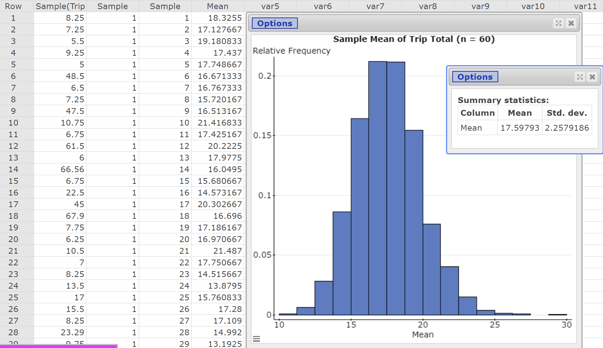
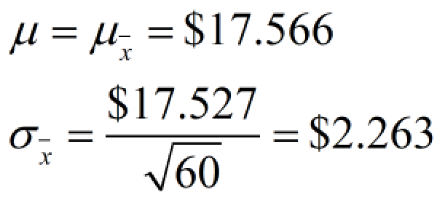
Notes:
Obtained many random samples of size n = 60 from the population.

Slide 14
Tornado Data https://www.spc.noaa.gov/wcm/#data

Slide 15
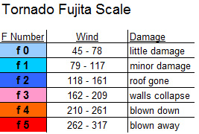
Illustrate the Meaning of Level of Confidence

Slide 16
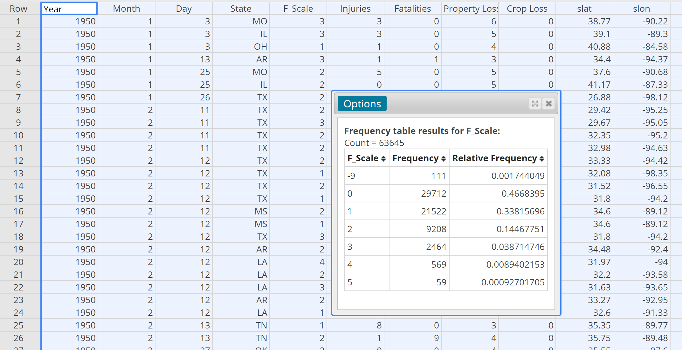
Notes:
Tornadoes whose F-Scale is -9 had an F-scale that was not reported. We will remove these observations from the data set.
Stat > Tables > Frequency

Slide 17
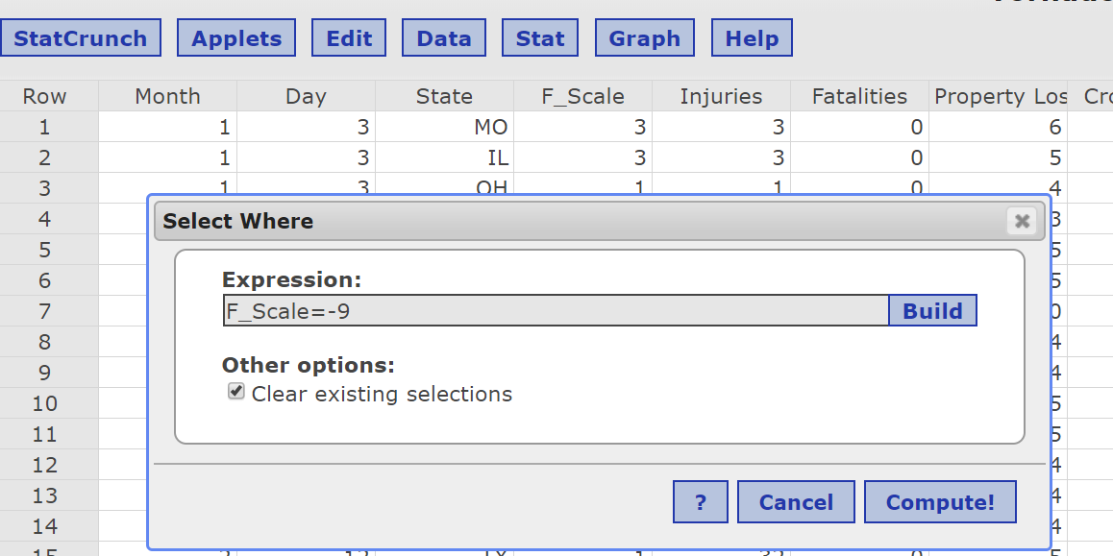
Clean Up the Data
Data > Row Selection > Select Where
Edit > Rows > Delete

Slide 18
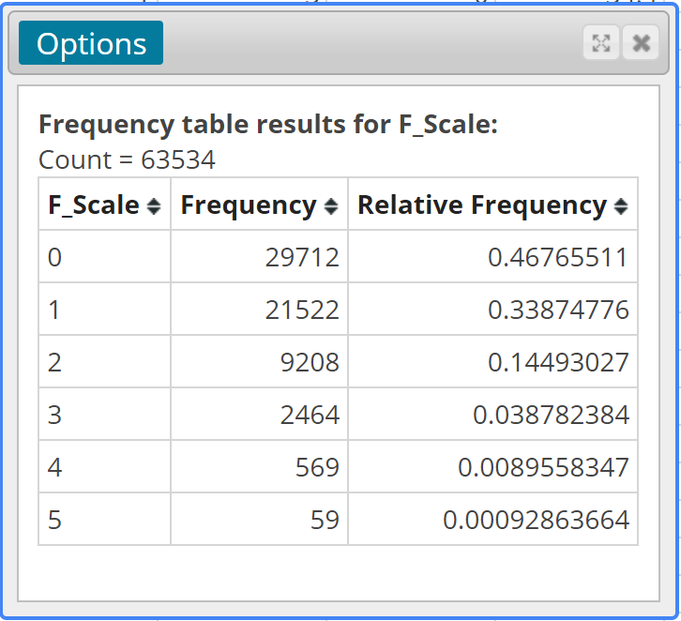
Population Proportion of F0 Tornadoes: 0.468

Slide 19
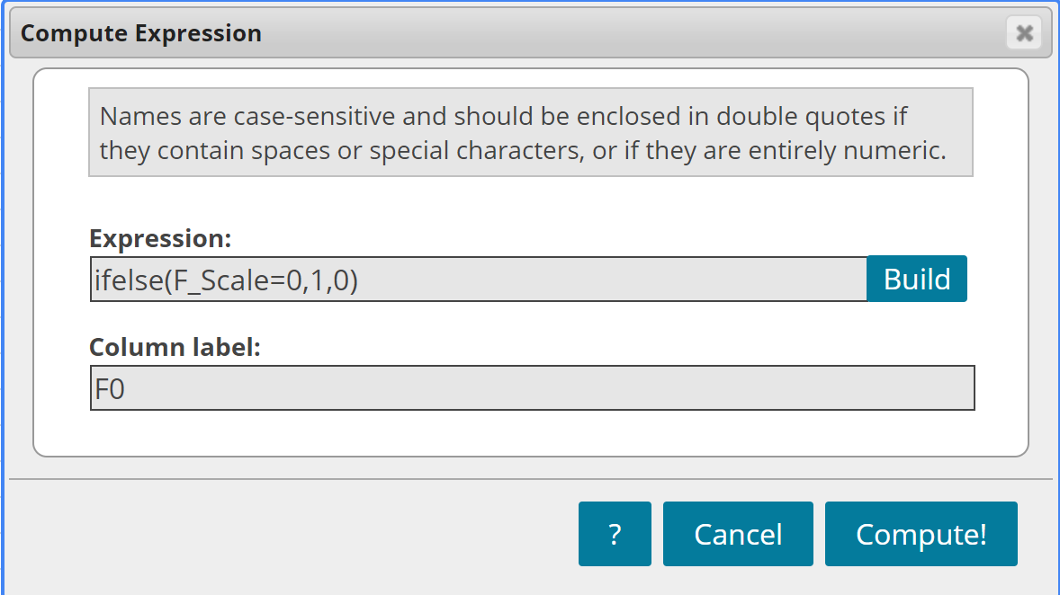
Create a New Variable
Notes:
Creating a Bernoulli random variable from the F-Scale column.

Slide 20
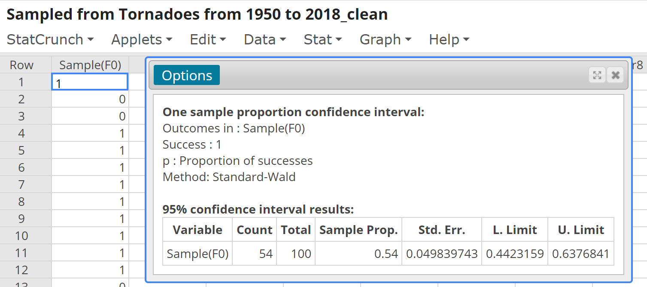
Obtain a Random Sample from the New Variable and Construct a 95% Confidence Interval
Notes:
1. Data > Sample
2. Sample size 100. Store data in new data table.
Confidence Interval: Stat > Proportion Stats > One Sample > With Data

Slide 21
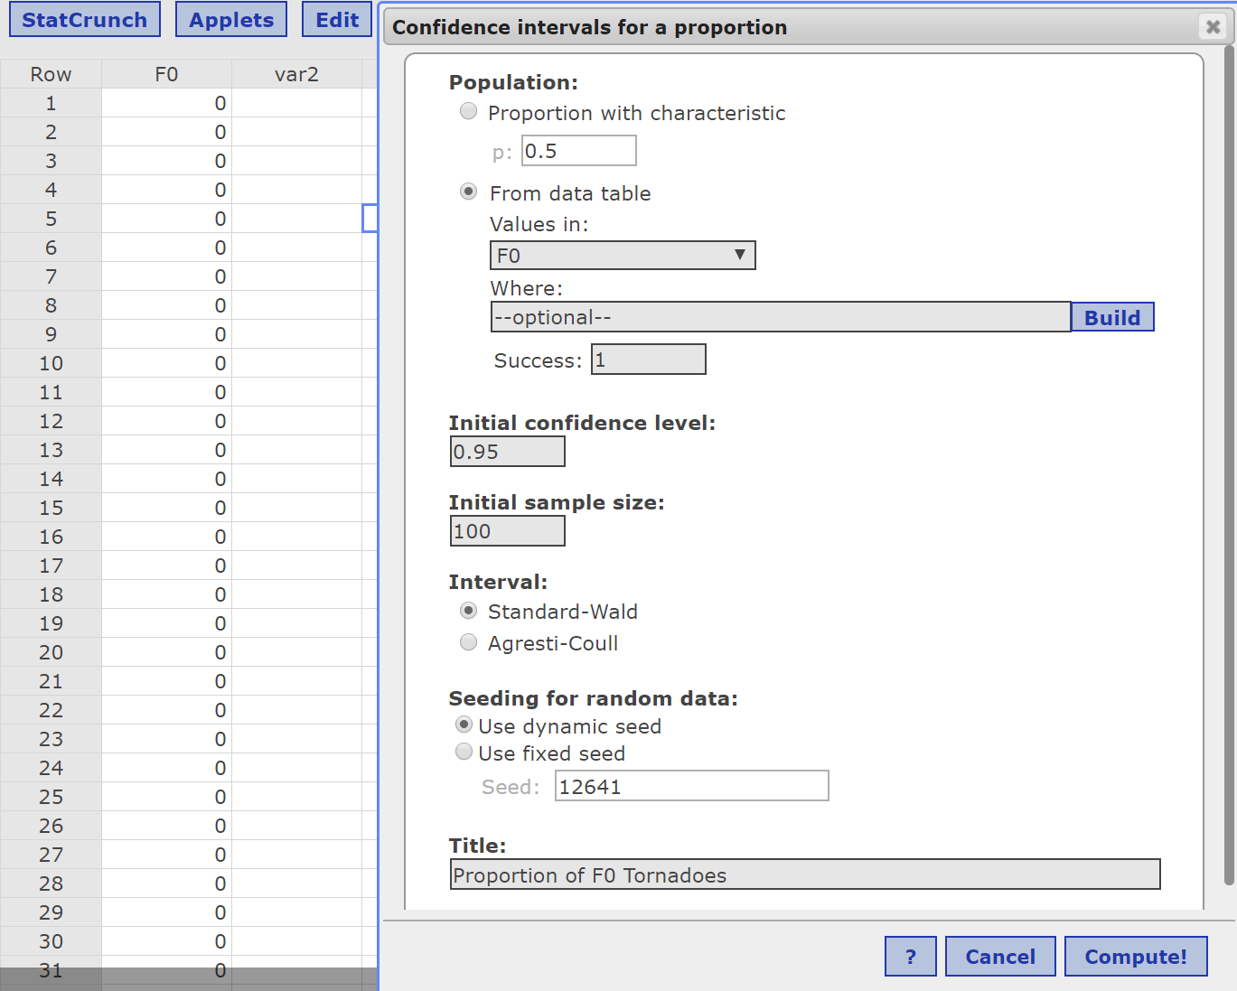
Repeat this Process Many Times (Applet)
Notes:
Use the StatCrunch “Confidence Interval” applet to see the role of level of confidence.

Slide 22
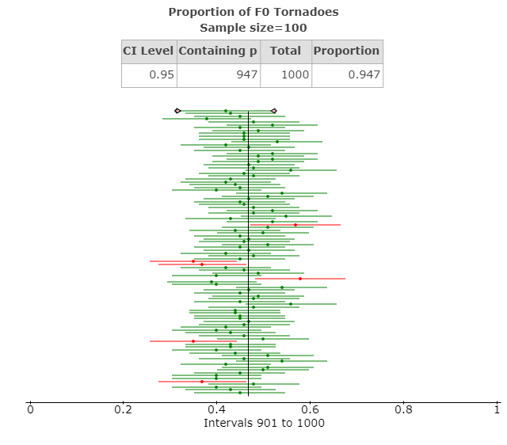
Results
Notes:
Applets > Confidence Interval > Proportion
Choose from raw data

Slide 23
P-Values
Are tornadoes in Georgia on the ground longer than tornadoes nationally?

Slide 24
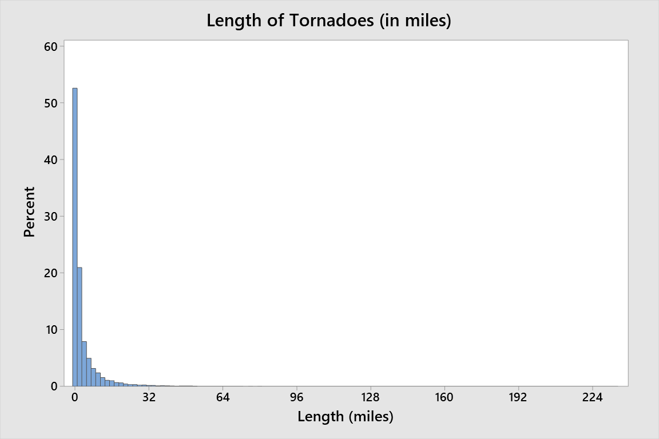
Length of All Tornadoes Since 1950

Slide 25
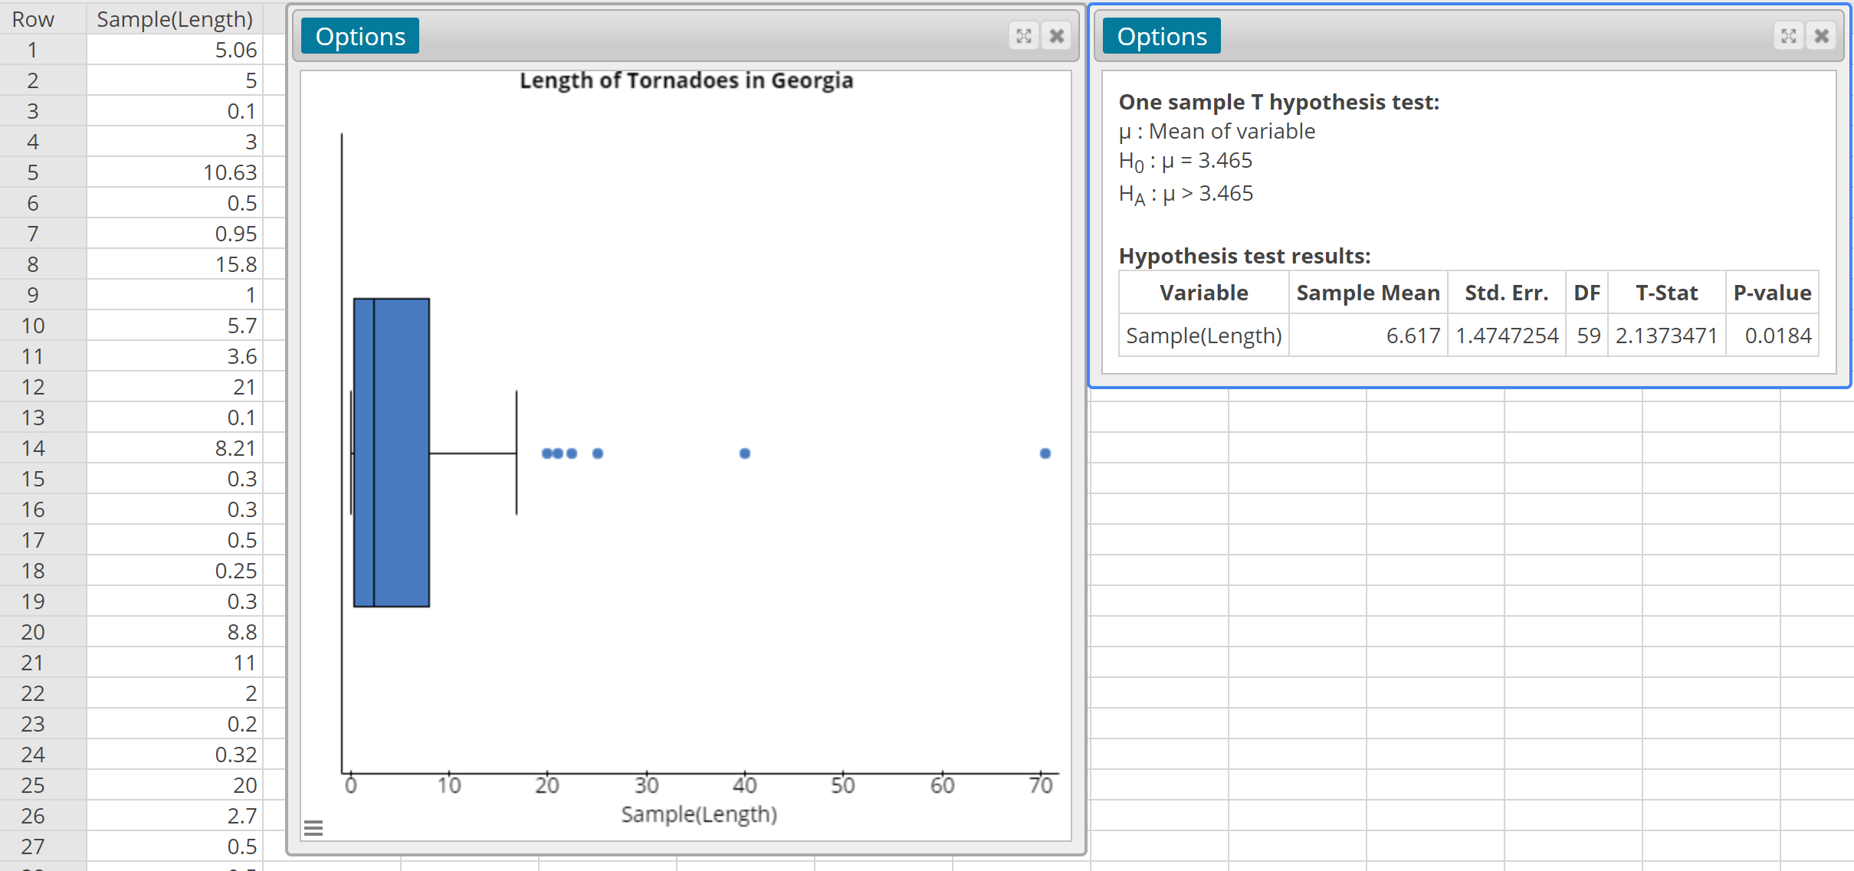
Notes:
Obtained a random sample of n = 60 tornadoes and recorded the length. Notice the P-value is 0.0184.
Stat > T Stats > One Sample > with Data

Slide 26
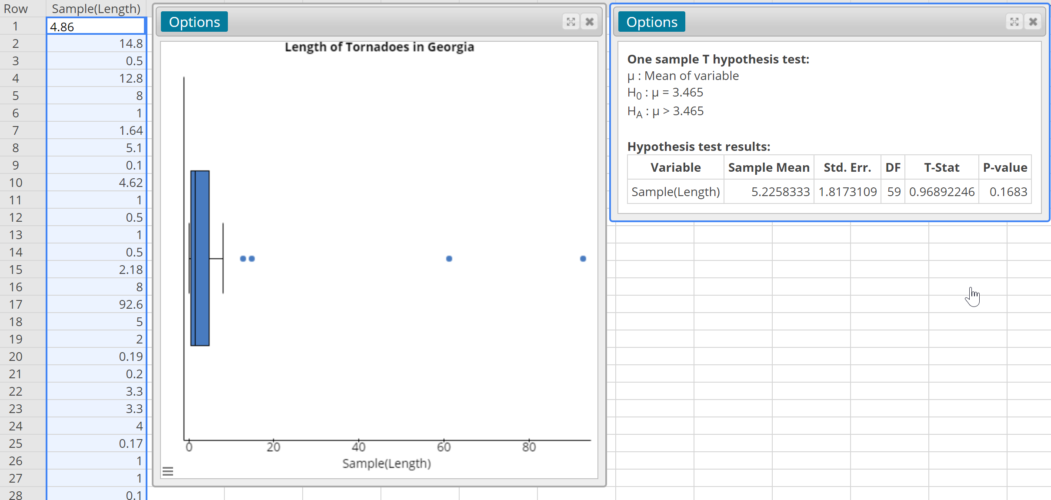
Notes:
Obtained a random sample of n = 60 tornadoes and recorded the length. Notice the P-value is 0.1683.

Slide 27
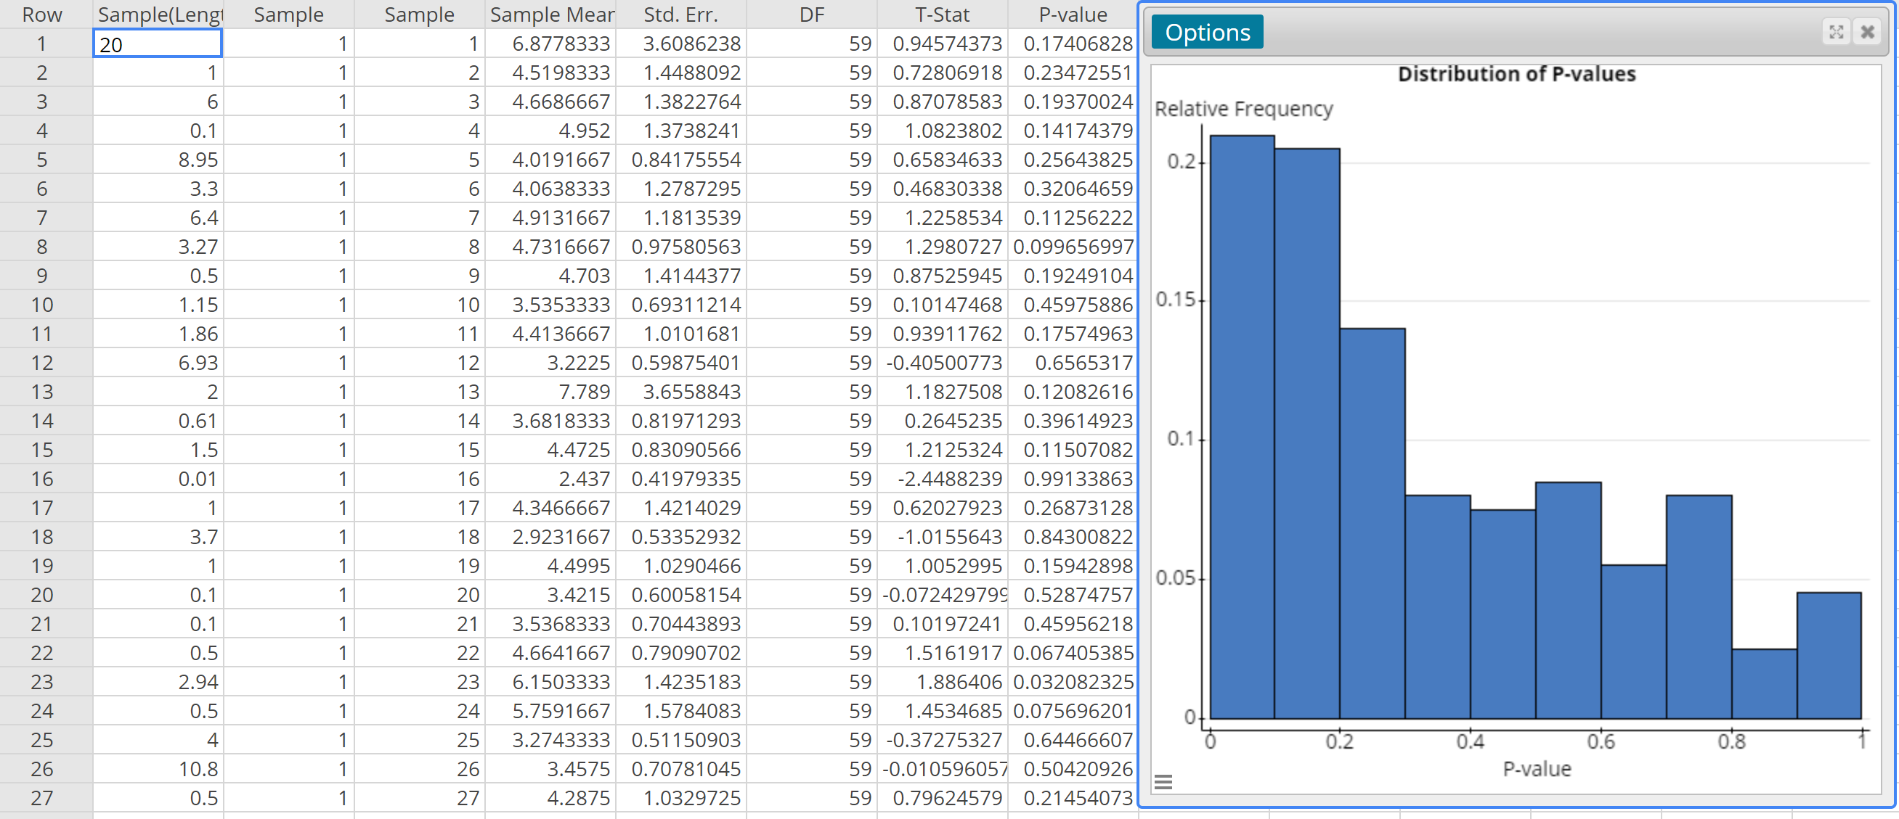
Notes:
This shows the distribution of P-values for 100 different random samples of size n = 60.

Slide 28
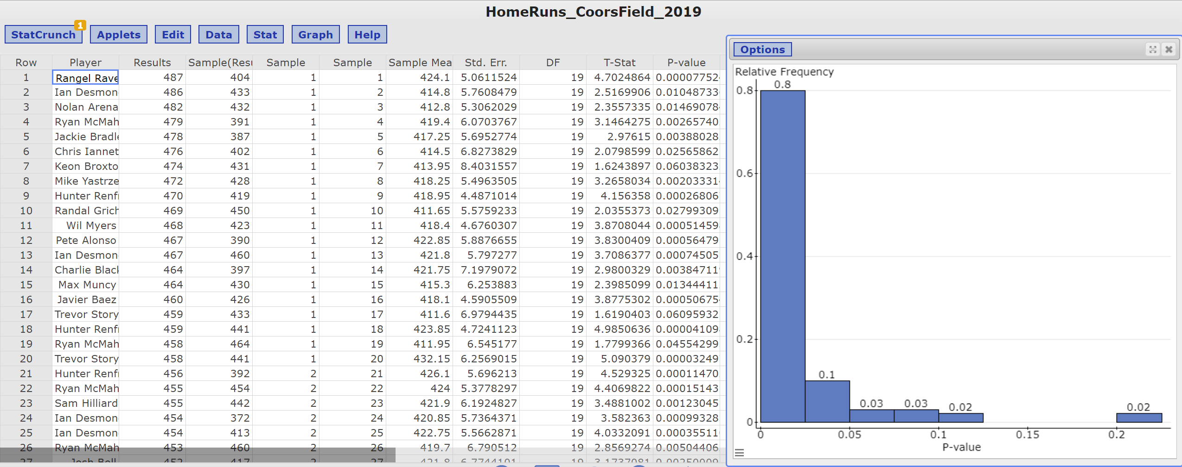
Notes:
This shows the distribution of P-values testing whether homeruns hit at Coor’s Field (in Denver, CO) for a random sample of n = 20 homeruns exceed the national mean of 400.3 feet. Notice the distribution is more “well-behaved”. This is likely due to the fact that the model conditions for estimating the P-value using Student’s t-distribution are satisfied for the homerun data. However, these requirements may not be satisfied for the tornado data.

Slide 29
Moving to a World Beyond “p < 0.05”
https://tandfonline.com/doi/full/10.1080/00031305.2019.1583913

Slide 30
Moving to a World Beyond “p < 0.05”
Don’t
Do
Don’t base your conclusions solely on whether an association or effect was found to be “statistically significant” (i.e., the p-value passed some arbitrary threshold such as p < 0.05).
Don’t believe that an association or effect exists just because it was statistically significant.
Don’t believe that an association or effect is absent just because it was not statistically significant.
Don’t believe that your p-value gives the probability that chance alone produced the observed association or effect or the probability that your test hypothesis is true.
Don’t conclude anything about scientific or practical importance based on statistical significance (or lack thereof).
Accept Uncertainty
Ask thoughtful questions:
What are the practical implications of the estimate?
How precise is the estimate? And is the model correctly specified? The latter question leads naturally to three more:
Are the modeling assumptions understood? Are these assumptions valid? And do the key results hold up when other modeling choices are made?

